Slide 1


Open Future
daniela.kellerova@nadaciapontis.sk

Slide 2
Program gives a chance to those who fall through formal education system
Slovakia has major problems with educating children from poorer or second language background, especially Roma (OECD 2017, UNDP 2010)
Primary education is the highest achieved education for up to 70% of Roma children, and only about 0.3% is in higher education (OECD 2010).
Only 9% of Slovak women work in IT, the lowest percentage in the EU.
45% of IT teachers at primary schools do not have sufficient teaching support or education.
After 2020, up to 90% of jobs will need digital skills.

Slide 3
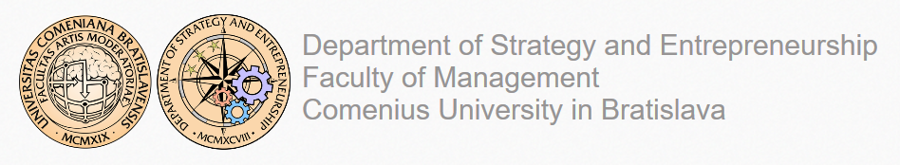


Open Future
Because we believe that talent is everywhere, but opportunities are not
An extra-curricular program, which brings top tech innovations, soft and hard skills mentoring to the disadvantaged communities.
We are increasing the chances for a better future for young people through promoting creativity, entrepreneurship and digital skills.
Collaborative content by
• Enterprenerial skills
• Digital skills
• Soft skills

Slide 4

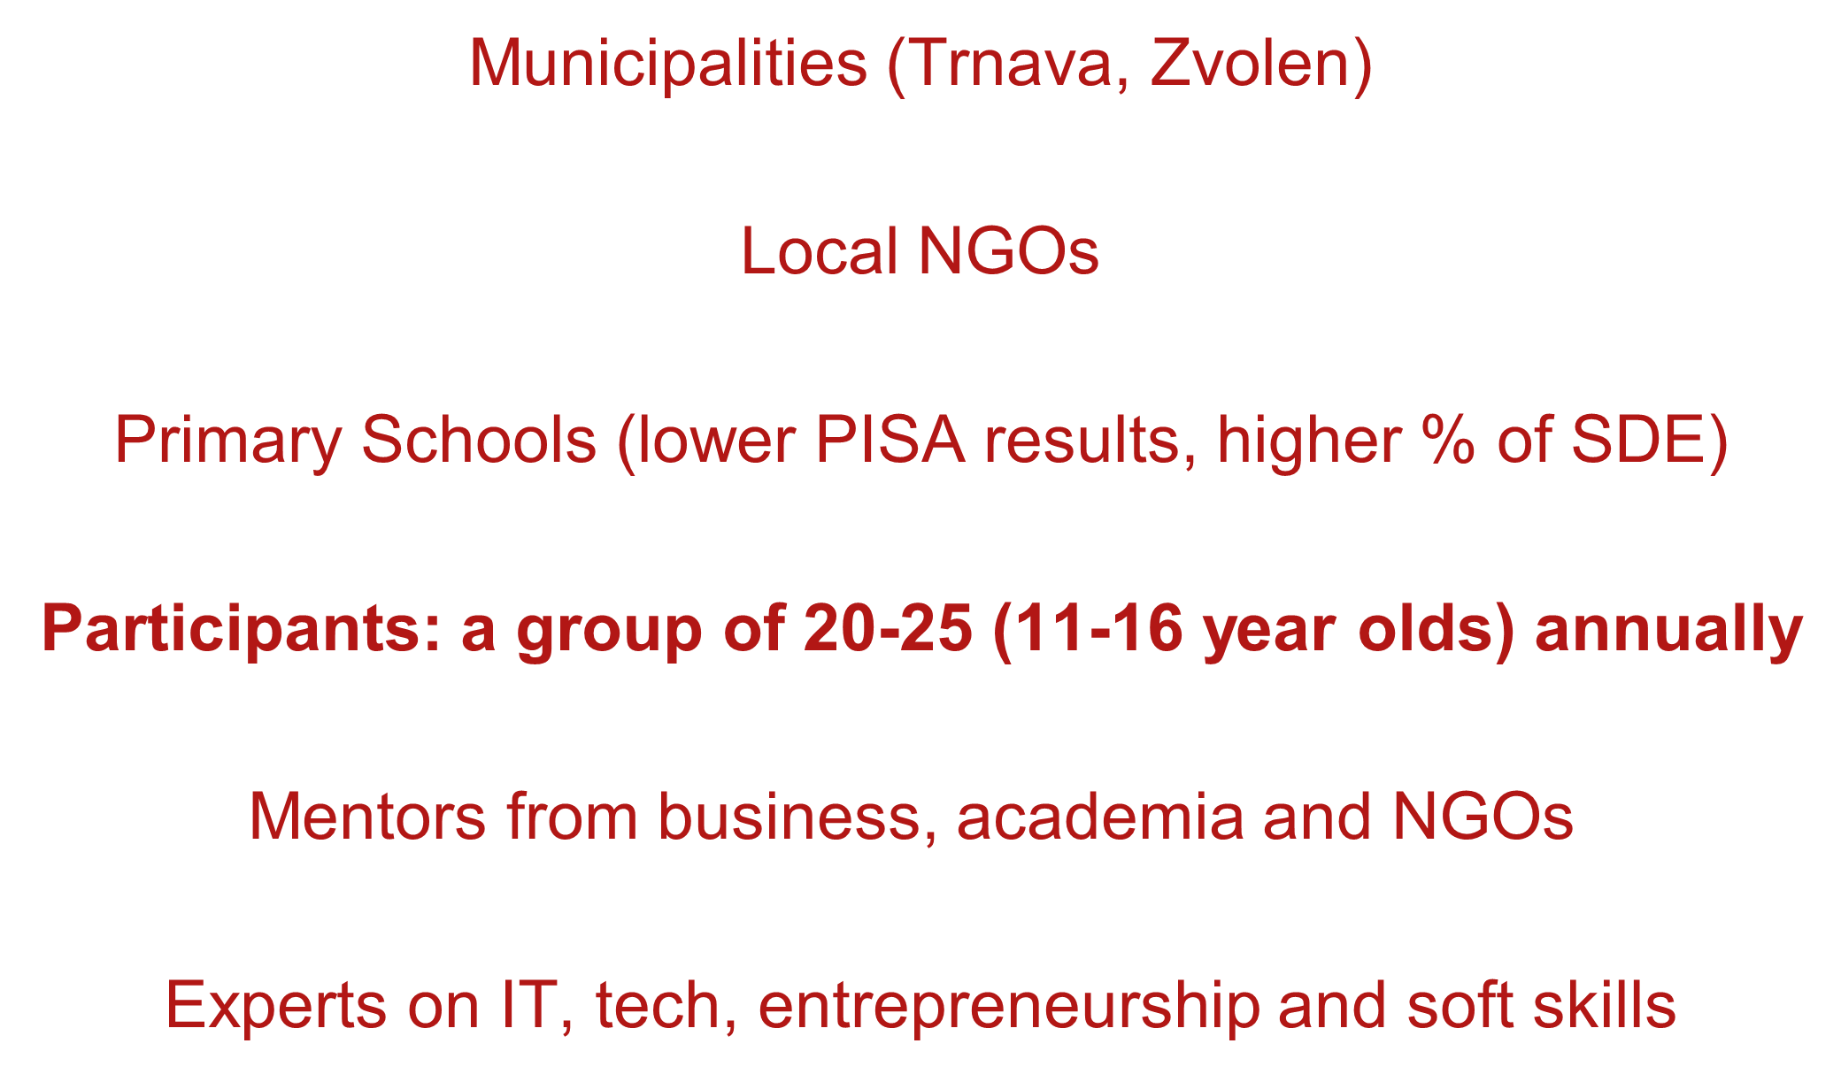
The program creates an ecosystem and connects various stakeholders

Slide 5
Slovak Telekom Endowment Fund
Digital skills gap survey results
In socially disadvantaged households, lack of digital technology
Only 52% (40% for Roma) has Internet at home
Only 28% has a laptop (21% for Roma)
Bad schools results correlate with lack of digital skills

Slide 6
High quality after-school clubs needed
Reliance on school computers and teachers (insufficient tech, or illprepared teachers – code.org).
Roma children - the greatest potential for learning in computer clubs (20%) – higher in lack of informal support
Competitions/projects depend on teachers/students are insufficient in learning the skills: shows need to go group to group and support the active, deeper learning

Slide 7
Thank you

