Slide 1
Help us change Slovak Education EDUpoint – an innovative space for teachers´ encouragement and support in education

Slide 2
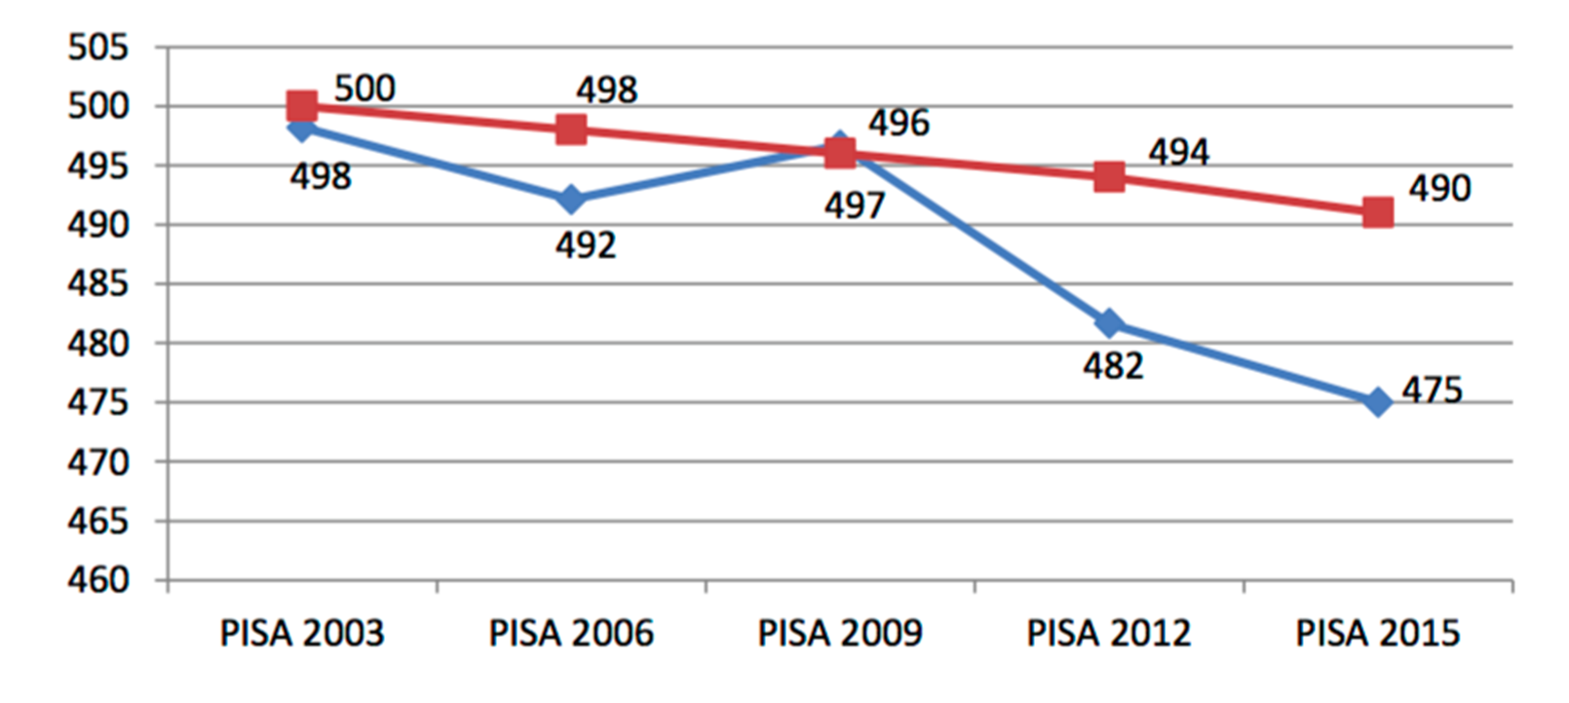
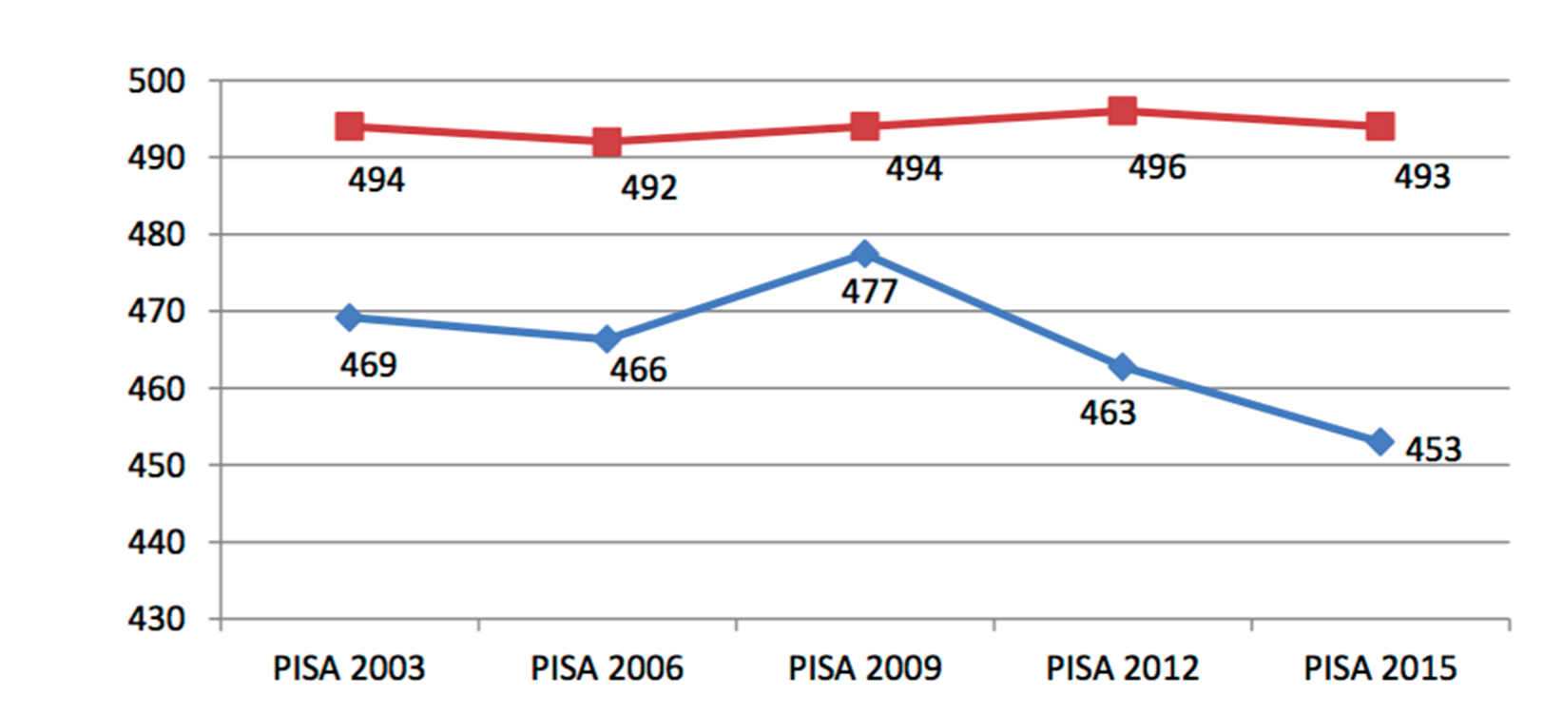
Alarming signals
Only 64 % of children feel happy in school. OECD average is 80 %.
Slovak pupils‘ results in both mathematical and reading literacy have long been below the OECD average.
Mathematical literacy
Reading literacy
Slovak Republic
OECD average
(PISA 2018 results will be released in December 2019)
The world of technology has rapidly progressed, but in the field of education, it feels like time has stopped.

Slide 3
Generation 3.0: Answer for Slovak Education and Skills of the 21st Century
To provide students with the skills, knowledge and attitudes necessary for life in the 21st century, skilled and motivated teachers are needed.
However, teachers often feel lonely as they lack an ecosystem to interconnect them effectively and provide them with the opportunity to share the best innovative learning approaches.

Slide 4
Generation 3.0: Answer for Slovak Education and Skills of the 21st Century
EDUpoint creates space for regular meetings of leaders in education, teachers, school principals, pedagogy students, and the general public interested in better learning.
It brings inspirational workshops, good practice sharing, discussions, experience ex-change, and the creation of incentives to improve education.

Slide 5
Results
72 % teachers reported, that thanks to the activity, their motivation to teach has encreased.
Almost 69 % reported, that the new educational aproach gave them new didactic techniques, which they immediatelly used in teaching process.
Up to 88 % would recommend the activity, which they were part of to their colleagues.
Up to 71,5 % teachers reported, their main motivation to participate in activities were: “I am searching for new methods to have my teaching more interesting.”

