Slide 1



S♥CODE
RAISING A DIGITALLY SKILLED GENERATION FOR THE 21ST CENTURY
SociSDGs Event, 4th June 2019
Alena Kanabová & Zuzana Tanková

Slide 2
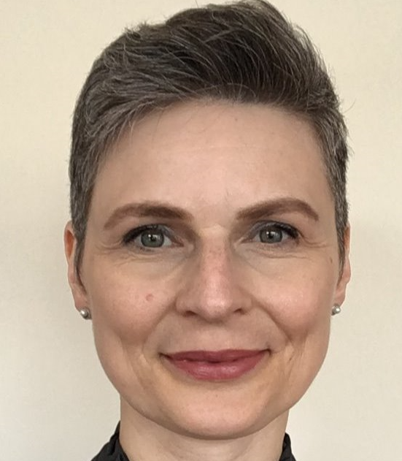

INTRODUCTION
ALENA KANABOVÁ
Senior Manager
Corporate Citizenship Lead in Accenture Slovakia
alena.kanabova@accenture.com
ZUZANA TANKOVÁ
Associate Manager
S♥Code Project Coordinator and Trainer
zuzana.tankova@accenture.com

Slide 3
Agenda
  S♥Code Project Context and Introduction
  S♥Code Project Approach and Delivery
  Q&A

Slide 4
Skills to Succeed At Accenture
Accenture vision is to improve the way the world works and lives — for our clients, our people and our communities. Our goal is to make a measurable difference around the world, including closing unemployment gaps through Skills to Succeed Program
GOALS FOR 2020
DELIVER IN-DEMAND SKILLS
CREATE SUSTAINABLE JOBS AND BUSINESSES
COLLABORATE TO CLOSE EMPLOYMENT GAPS
Equip 3+ million people with the skills to get a job or build a business.
Increase our focus on the transition from skill-building programs to sustainable jobs and businesses.
Partner with organizations
to create large-scale, long-term solutions that close global employment gaps.
Notes:
Our focus on innovating for society has grown well beyond what we envisioned when we launched Skills to Succeed. We continue to explore new horizons with our clients and our nonprofit partners to help achieve the goals we have set for 2020.

Slide 5
NEW SKILLS NOW
NEW SKILLS NOW:
INCLUSION IN THE
DIGITAL ECONOMY
WATCH THE VIDEO
Notes:
Our focus on innovating for society has grown well beyond what we envisioned when we launched Skills to Succeed. We continue to explore new horizons with our clients and our nonprofit partners to help achieve the goals we have set for 2020.
https://www.youtube.com/watch?v=5lcNLSBqs90&feature=youtu.be

Slide 6
FUTURE OF WORK IN DIGITAL ECONOMY
Technology is evolving at an unprecedented pace, fundamentally changing the future of work
  By 2024, roles requiring digital skills will grow by 12%
  Middle-skills jobs that require digital skills are growing 2.5x faster than jobs that require analogue skills
  65% of children who started school in 2016 will hold jobs that do not exist yet
  DIGITAL SKILLS (know how to use, manipulate and create technologies and data) are one of the 6 key New Skills families required for the inclusion in Digital Economy
Sources:
World Economic Forum, The Future of Jobs, Chapter 1 – The Future of Jobs and Skills, 2016;
OECD, The Risk of Automation for Jobs in OECD Countries, 2016.
Notes:
As we could learn from a video, digital technologies are transforming every facet of our society, creating new opportunities and challenges while fundamentally altering the way we live, work and interact. The use of technology can change lives for the better by allowing businesses, governments and nonprofits to tackle societal challenges in new and innovative ways.
At the same time, the unprecedented pace of change is disrupting society faster than humans can adapt. Accenture is committed to confronting these complex issues by harnessing our ecosystem of strategic partners and our global reach.
We are continually evolving our corporate citizenship programs not only to meet the priorities of today, but to anticipate the needs of tomorrow. Our local CC strategy went through the refresh in past years, to address these challenges and one of the areas of focus we have defined is building digital skills.
So on the top of investing into initiatives aiming at general shift of education systems towards building the new skills in general, our focus is on digital skills building, since we perceive this as an area where we as a technology company can contribute the most.

Slide 7
Are Slovak schools prepared to build tech know how of our kids?
  45% of Slovak schools don’t have any teacher qualified for Computer Science teaching.
NO!
  Tools to teach quality CS lessons are missing, obsolete given the pace of digital economy development or expensive for schools to afford them.
  Computer Science is an area with the biggest wage gap between the state (education) sector and private sector. If somebody is skilled in CS, he/she will easily find multiple times better paid job as an IT specialist than as a teacher, while Slovak IT sector lacks thousands of skilled employees.
Notes:
As it is not only about closure of immediate employment gaps (that we focus on within several own initiatives or programs which we pursue e.g. through partnerships with NGOs to provide IT re-skilling or new skilling programs for adults), part of our local activities are aimed at bringing systematic change to Slovak education system to prepare young generation to succeed in the labor market, with specific focus on digital skills.

Slide 8
Can We change how Computer science is taught in Slovakia?
  Flagship Project of Accenture Corporate Citizenship efforts in Slovakia, initiated in 2016
  Reaching measurable results, while maximizing delivery efficiency due to:
    Re-use of tools and materials available on Code.org website;
    Applying the core business delivery methods (e.g. Teach the Teacher, Pilot-Rollout) to deliver the project in Corporate Social Responsibility area;
    Use of the local partners’ ecosystem, including co-volunteering unseen at this scale in Slovakia before for impact multiplication.
Yes!
through
S♥CODE*
*Slovakia Loves to Code
Notes:
The question is whether we can contribute to the systematic change of computer science education. And the answer is YES.

Slide 9
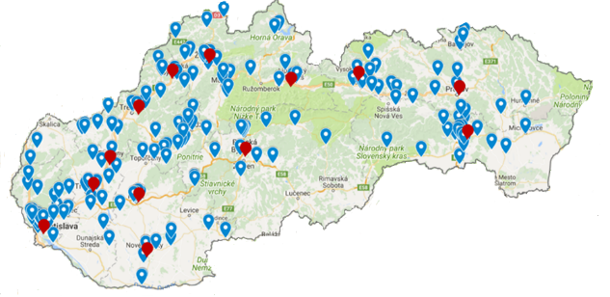
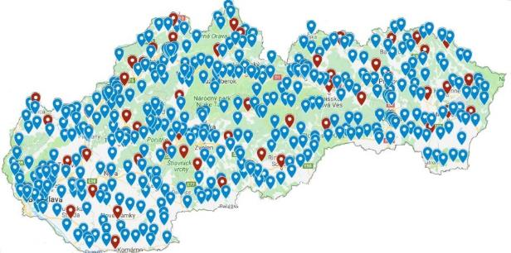



DID WE SUCCEED?
2016-2018
2019
Training location
Involved school
20
volunteers
from Accenture
341 trained
teachers
9%
of all Slovak elementary schools reached
100 volunteers from
5 companies
1000+ trained
teachers*
>25%
of all Slovak elementary schools reached*
*Note: Forecast based on actual results as of May 2019 (528 teachers from 274 schools already trained in 4 months (spring round of training sessions).
20% CRITICAL MASS
OF CHANGE AGENTS
THRESHOLD TRESSPASSED
Copyright © 2019 Accenture. All rights reserved.
Notes:
The impact from initial 3 years of the program has been multiplied this year and interim results show that we will trespass the critical 20% mass of change agents if we continue with the teacher training in the current pace.

Slide 10
Agenda
  S♥Code Project Context and Introduction
  S♥Code Project Delivery Approach
  Q&A
Notes:
And how did we do it?

Slide 11
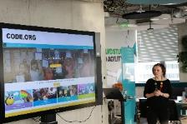
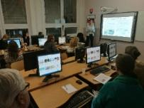
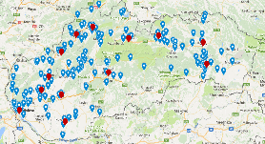
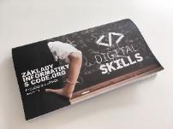

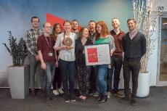





Project Delivery Approach Summary
Using Code.org content
+ website translation into Slovak
Teach the Teacher
approach
Pilot-Rollout approach
Training content enrichment
and teachers support
Partners ecosystem
Volunteers’ engagement
… and
Long-term impact verification and measurement through the Competition
Notes:
There are several components, which made our project successful and in upcoming minutes we will introduce each of them.

Slide 12


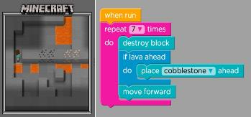
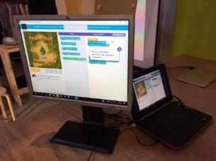
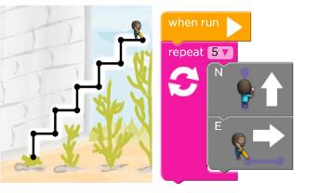
Why USING Code.org CURRICULUM
We did not need to ‘reinvent the wheel’ – the Code.org tools are prepared by Computer Science professionals in cooperation with teachers and students
Content relevancy in time
Easy adoption by teachers
Suitable for unqualified teachers
Attractive for kids
Suitable even for integrated children with special needs
Long term use
Free of charge
Notes:
CONTENT RELEVANCY IN TIME ensured - is updated and enhanced on ongoing basis
Easy adoption by teachers supported by ready to use teachers tools and dashboards
Suitable also for UNQUALIFIED TEACHERS
ATTRACTIVE FOR KIDS (using popular themes for girls and boys, thus supporting both genders equal involvement)
Suitable even for INTEGRATED CHILDREN with special needs
Providing enough content to be used in CS lessons LONG TERM (thus enabling gradual improvement of Slovakia CS education‘s quality).
FREE OF CHARGE Also our training is free of charge.

Slide 13


Teach the teacher Approach
If 1 trained teacher involves several classes kids in coding (~100 kids), with more teachers trained, impact is long-term and significantly multiplied. Thousands of kids can start and learn to code.
Teaching kids directly:
1 class is impacted
as 1 shot
Teaching 1 teacher how to use Code.org tools:
Multiple classes are impacted LONG TERM
Notes:
Even the most innovative technologies fail if their application lacks behind. The market is full of great technology resources to teach Computer Science; however, success heavily relies on application. We see a missing link between these resources and children: and that’s the TEACHERS.
Teachers are those, who are in daily contact with children. It is their mission to teach them the digital skills needed to succeed in the 21st century. In most cases, however, they lack these critical skills themselves and we must provide them with proper tools so that ALL CHILDREN FROM ALL SCHOOLS get the skills needed.
How do we address this challenge?
We train teachers in order to maximize the number of reached students in the long-term perspective
We partner with other tech companies, including our clients
Our approach enables us to reach critical mass of schools and more than 40 000 children within 1 year.
This way, 1 volunteer can make a real difference in the life of 2000 children

Slide 14






Pilot-rollout Approach
We followed proven approach to test the project idea with minimum investment. It is also continuously applied upon further training content updates.
First we designed teacher training and defined most efficient delivery approach
We trained the first sample group of teachers in Bratislava (in Accenture premises)
We collected feedback from trained teachers, evaluated it and applied lessons learned to further trainings
We travelled to multiple regions outside capital city to deliver more teachers training (in premises provided by partnering schools)
Notes:
Another method that we used, which we regularly apply in the work for our clients is pilot-rollout approach.

Slide 15
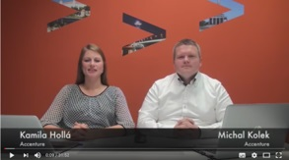

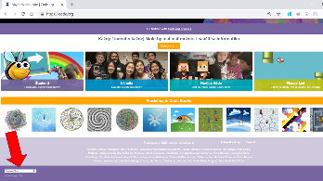
Support adoption into teaching practice
We took additional steps to reduce barriers of Code.org curriculum use by teachers and provided them with additional support. In addition, the training content was enhanced by internet safety topic, leveraging the synergy with our co-volunteering partners.
  TRAINING VIDEO posted on YouTube
  CONTACT E-MAIL ADDRESS for teachers
  Dedicated WEBSITE and FACEBOOK GROUP
  TEACHERS’ HANDBOOK prepared
  INTERNET SAFETY topic added to training content
  TRANSLATION of Code.org courses into Slovak
Notes:
And this was our extra mile: to address the issues identified through teachers’ feedback – what were the barriers of the method adoption into teaching practice?

Slide 16


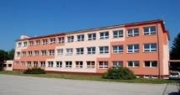








partners ecosystem
In addition to partnership with Code.org, leveraging local partners ecosystem was a key enabler for a project delivery with excellent cost/impact ratio.
PONTIS FOUNDATION
Key channel for contacts to elementary schools at the beginning of project
Provided capacity for training application administration.
OTHER NGOs
Promotion within their communities
Tech4Kids Program jointly organized events and initiatives
LOCAL SCHOOLS
Provide premises for training delivery (free of charge)
Training location directly at local schools supports the perception of training as a serious educational event (and thus encourages teachers to participate)
BUSINESS LEADERS FORUM
Co-volunteering with other tech companies from Digital Skills Group increased the number of volunteers delivering teachers training to 100+ volunteers, thus enabling for significant project scale up
Topic of children internet security added into curriculum

Slide 17
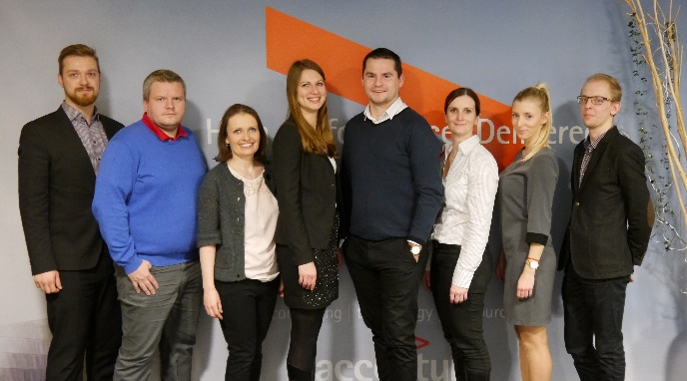
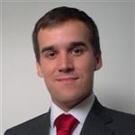
VOLUNTEERS ENGAGEMENT
Volunteers were the key enabler for project delivery success – from project ideation and organizing trainings, translating the Code.org content, through providing contacts to local schools to training delivery. Significant project scale-up was further enabled also by pro bono investment of involved companies.
„It was great feeling to train the teachers who teach kids of my ex-schoolmates. I felt that I pay-back to the community everything I got from it when I was young.“
Group of Accenture Consultants that initiated the project
Patrik Polonec
Accenture Consultant
S♥Code Trainer
Notes:
It’s not only about training delivery. We are using different knowledge, skills and strengths of various people – from PM & organization, gathering contacts, promo, trasnlations, etc… we can use many profiles.
We started with 20 Accenture volunteers/trainers, now we have 100 trained and 80 active volunteers from 5 companies. People volunteer to train as well as to translate….
In addition, companies provide financial and non-financial support – dedicated pro bono budget, expenses reimbursement, TNT contributed by delivery services, etc…

Slide 18
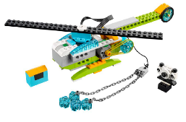
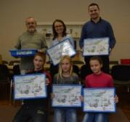
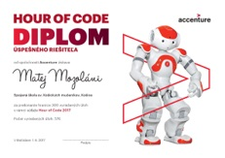
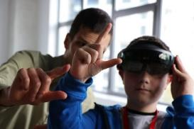
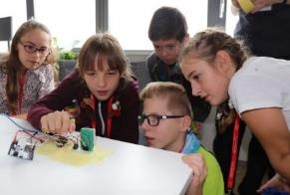
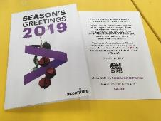
Impact Measurement
To motivate teachers adopt learned knowledge as soon as possible into teaching practice and to verify long-term impact, we organize a competition for involved schools.
COMPETITION
Provides input on:
No. of schools using the tools following the teachers training
No. of students are involved in coding
Which courses of Code.org are used
Feedback from schools and students
AWARDS
For schools*
For students
*Last Xmas, instead of buying gifts for our local clients, we dedicated financial amount od 10 EUR per individual person for purchase of micro:bit HW for winning schools + clients might click on the link providing more info about our project to double this amount.

Slide 19

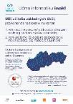





PROJECT JourneY Overview
FY16
FY17
FY18
FY19
T-t-T PILOT
IN BRATISLAVA
1st round of regional T-t-T
2nd round of regional T-t-T
Co-volunteering
trainings launched
46 teachers
187 teachers
119 teachers
1000 teachers (Forecast*)
1st Accenture Hour of Code Campaign participation
in Slovakia
Online Training
video published
Digital Skills group formed within Business Leaders Forum platform
Recognized as Slovakia's Social Innovation of the year
T-t-T = Teach-the-Teacher Trainings
*Note: Forecast based on actual results as of May 2019 (528 teachers from 274 schools already trained in 4 months (spring round of running training sessions).
One of 7 global semi-finalists in Community category)
Recognized by
Code.org as
remarkable local
ambition
Translation of Code.org into Slovak
Becoming Code.org partner for Slovakia
Copyright © 2019 Accenture. All rights reserved.
Notes:
Of course, it took us some time to make an impact that we are presenting now. We launched our project in spring 2016, following our initial local participation in Hour of Code campaign. The pilot training was organized in our premises in Bratislava for ~50 teachers, we rolled-out the training to several Slovak cities / regional centers in 2017 and 2018.
An important milestone was VIA BONA Slovakia award in 2018 that project received as the country social innovation of the year, awarded to socially responsible companies. This boosted the interest of other socially responsible companies to join forces with us and co-volunteer for even bigger impact. This enabled us to GO BIG in 2019 under the slogan ‘Let’s teach computer science differently!’

Slide 20
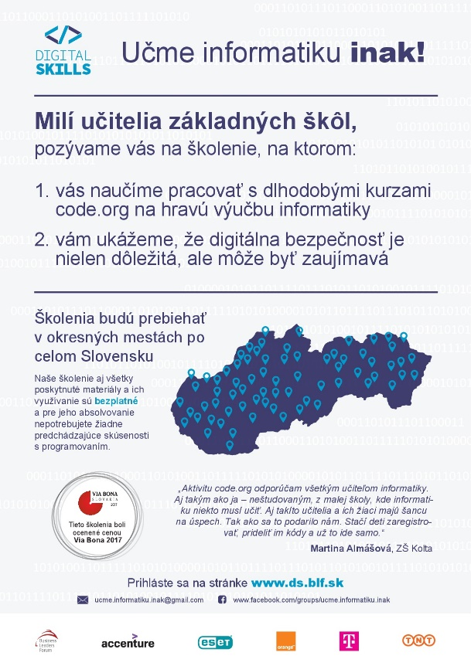
Going Big in 2019
Under the slogan “LET’S TEACH COMPUTER SCIENCE DIFFERENTLY!” and in co-volunteering mode with our partners, we have ambition to deliver teacher training in all districts of Slovakia (79 training sites).
Training of trainers launched in Jan 2019, teachers training launched in Feb 2019.
Dedicated project coordinator is financed from Accenture Pro Bono budget.
Website www.ds.blf.sk and a Facebook group were created for sharing information with teachers and promote the trainings.
More advanced courses content from Code.org tested within our Girls Game Lab (girls coding club with programming in JavaScript), to potentially enhance our teachers training curriculum next year with more advanced coding concepts.

Slide 21

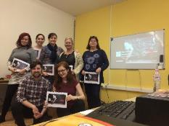
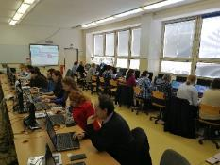
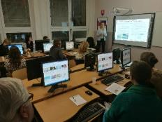
teachers feedback
„We would like to thank enthusiasts from the company Accenture for the training, it was awesome!“
“I recommend Code.org to all CS teachers. Also to those like me – not specialized in CS, teaching it simply because somebody has to. Even this kind of teachers and their students have chance for success. You only need to register and start programming.”
Martina Almášová
Teacher from school of Kolta village
„You opened the doors for us, thank you – I have learnt something new and overall it is more simple than it seemed to be.“
„Thanks to the project we had a chance to see the talent of some students for coding and we plan to develop their gift in the future. THANKS!”
Notes:
List top 5 things that teachers appreciate

Slide 22
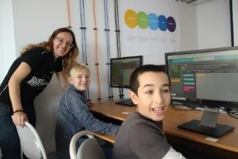
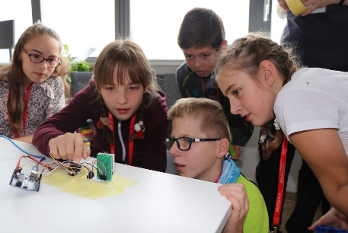
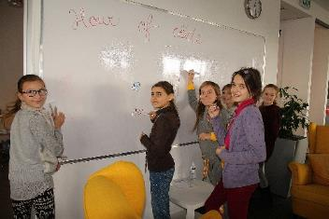
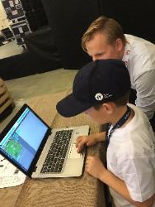

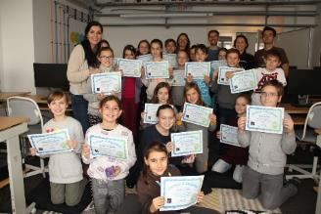
pupils feedback
I really like it!
I finally understand
Computer Science
I’ll do this also at home. It’s fun!
It’s great, will we use it also on next lesson?
Notes:
Thanks to our S♥Code program, thousands of kids can learn the foundational computer science concepts already at the primary school.
They might not become programmers, but thanks to this, they are more prepared to face the digital disruption at any job they choose in their life.

Slide 23

Code.org Feedback
S♥CODE IS CHANGING THE LIVES OF THOUSANDS OF STUDENTS BY GIVING THEM THE DIGITAL SKILLS NEEDED
TO SUCCEED IN THE 21ST CENTURY.
SUKY KANG
Director of International Partnerships Code.org

Slide 24
Agenda
  S♥Code Project Context and Introduction
  S♥Code Project Approach and Delivery
  Q&A

Slide 25
Appendix

Slide 26

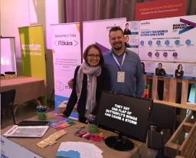
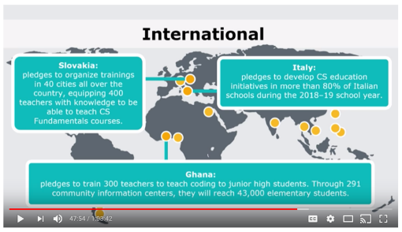
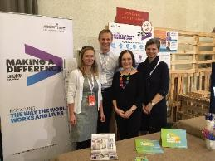
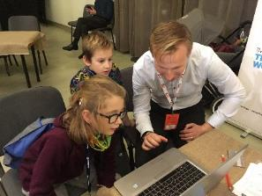
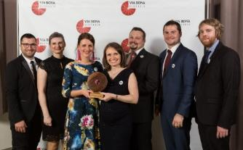
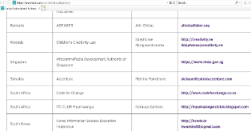
External recognition and promotion
Promoting our project externally not only builds an awareness about the need to improve computer science education but also inspires others to join forces to innovate education in this area.
  Nation-wide
  Prestigious Via Bona Slovakia award winner in the Social Innovations category (Apr. 2018)
  Regional
  Participation in CEE CSR Summit - Responsible Marketplace
  (Nov. 2017, Nov. 2018)
  Global
  Accenture Slovakia on the list of Official Code.org country partners
  Our pledge recognized as 1 of 3 most impressive international initiatives by Code.org (Dec. 2018)

Slide 27
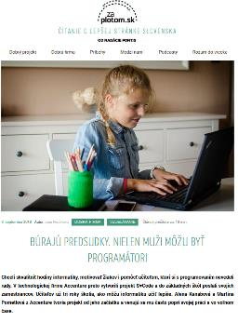
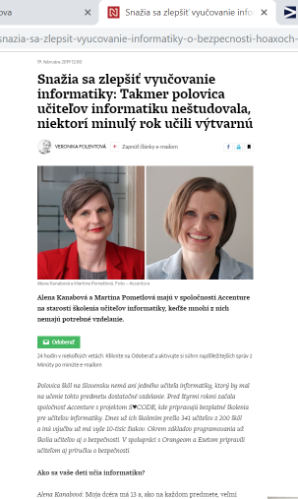
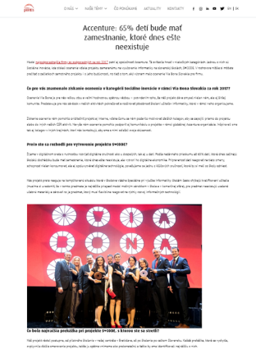
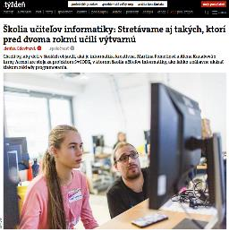
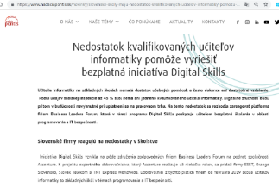
Online and Social Media presence Examples
  Headline story on ‘Minute by Minute’ app, Facebook post and Article of Slovak daily Denník N
Article on online magazine zaplotom.sk and Article on Pontis Foundation website
Article on VIA BONA Slovakia website
  Article on Slovak weekly
  .Tyzden

Slide 28
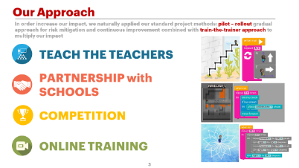
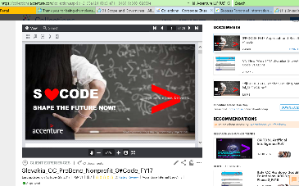
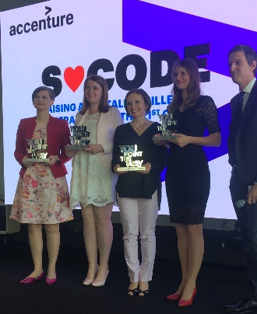
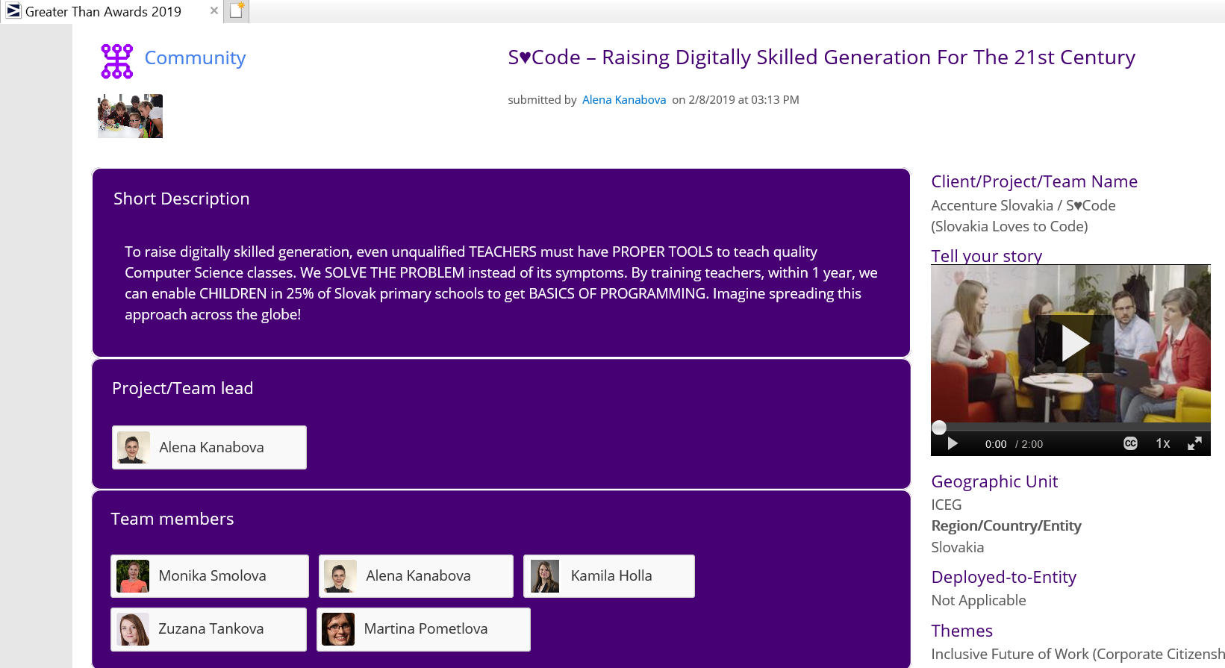
Collaboration across Accenture
S♥Code solution is easily scalable to other countries. We have plans to roll-it out within the region and we actively support with knowledge and experience sharing other colleagues from other countries, considering or already pursuing with similar initiatives.
  Accenture KNOWLEDGE EXCHANGE DATABASE contribution
  Presentation on GLOBAL CORPORATE CITIZENSHIP CALLS (May 2018, June 2019)
  Accenture GREATER THAN AWARD 2019 – Community Category regional round winner and one of 7 global semi-finalist (May 2019)
  INDIVIDUAL KNOWLEDGE & EXPERIENCE SHARING wit other countries: e.g. Czech Republic, Hungary, Romania, South Africa, Ireland, Philippines, Italy… (ongoing)

Slide 29
local CC strategy for Digital skills Building
Target group | Activity / Project Example | Focus
Elementary school (6-15 years) | S♥Code (Teach- the-Teacher Campaign and related events for schools and non-profits working with children) European Week of Code events Hour of Code week events | Equip teachers to be able to teach interesting and high quality IT classes over long period of time Raise interest in IT in the age with less prejudice against the “technical” majors – focus on girls
Elementary and high school - GIRLS (10-19 years) | Girls Game Lab Scratch Match & Scratchathon Girls in STEM Girls’ Day | Motivate girls to study technical majors and for career in technology
IT majors university students (18 – 25 years) | Targeted lectures, conferences, internships and team projects Scholarship program for female IT majors students | Motivate technical university students to join Accenture Support female IT students to increase support gender diversity in IT sector
Other (unemployed non-IT major university graduates, women, immigrants) | New-skilling training courses (e.g. IT in the Course, Women Tester Academy, Summer IT camp for women, PC skills training for asylum seekers, …) | Provide various target beneficiary groups with training to obtain skills necessary to find job in IT sector or increase their changes of employment in other areas
Copyright © 2019 Accenture. All rights reserved.

Slide 30






NEW SKILLS NOW FRAMEWORK
The new skills now framework identifies six core ‘skills families’ (with varied levels of ‘mastery’) for people to shape and own their success in the digital future.
Foundational skills
Medium skills
Mastery of skills
Foundational skills to get work and be ready for the workforce
Digital literacy
Focused attention
Numeracy, writing and reading
Self-efficacy & working memory
Employability basics
Organisation & time mgmt.
Prioritisation
Sequencing
Business conduct & protocol
Job searching (e.g. resume writing and interviewing)
LEARN TO EARN
BUILD TECH KNOW HOW
Skills and know-how to use, manipulate, and create technologies and data
Awareness of and ability to use professional tools & programs
Awareness of data sources & applications
Coding & content creation
Data interpretation
Understanding of professional tools/programs’ functionality
Analysis and application of data
Graphic and visual design
Software design
APPLY WE’Q
Skills to interact, build relationships and show the self-awareness needed to work with others in-person and virtually
Collaboration & communication
Listening
Self-control
Teamwork
Active listening
Emotional self-regulation
Mindfulness & self-awareness
Negotiation & social intelligence
Delegation (inc. upwards and downwards management)
Leadership and service mindset
Storytelling
CREATE & SOLVE
Skills to approach problem-solving creatively, using empathy, logic and novel thinking
Basic problem solving
Creativity
Empathy
Decision making
Judgement
Logical reason
Planning and execution
Analysis & synthesis
Critical thinking
Design thinking
Entrepreneurial mindset
CULTIVATE A GROWTH MINDSET
Skills to stay relevant, continuously learn and grow, and adapt to change
Flexibility & curiosity
Motivation to learn
Openness & optimism
Receptiveness to change
Adaptability & continuous learning
Agility, imagination & zest
Grit & perseverence
Ability to give/receive feedback
Global mindset
Growth mindset
Resilience
SPECIALISE FOR WORK
Relevant skills to address local market priorities and industry needs
This skills family contains the broad sets of skills required to specialise for different types of work. These skills are not static or fixed and will need to continuously change based on context, industry, market demand and type of work

Slide 31
Useful Links
Overview of the project approach (video)
https://www.youtube.com/watch?v=x3zrv0o_bmQ&feature=youtu.be
Public website with traning information (in Slovak language):
www.ds.blf.sk
Facebook Group (in Slovak language):
https://www.facebook.com/groups/ucme.informatiku.inak/
Publicly Available Online Training (in Slovak language):
https://www.youtube.com/watch?v=45wJSvaR-6g&feature=youtu.be
Inclusion in Digital Economy and New Skills Now materials
https://www.accenture.com/us-en/company-inclusive-future-work
Copyright © 2019 Accenture. All rights reserved.

