Slide 2
Agenda:
16:00 – 16:10 (CET): Introduction
Aija Lokenbaha, project manager, LatConsul
16:10 – 16:30: LAPAS experience with SDG’s
Inese Vaivare, Director of The Latvian Platform for Development Cooperation (LAPAS)
16:30 – 16:50: Ending the poverty?
Martins Valters, project “Age is not an Obstacle”
16:50 – 17:00: Q & A, Discussion

Slide 3
Housekeeping:
This webinar is being recorded and it will be published on our YouTube channel afterwards
Please use #sociSDG for social media
Your voice will be automatically muted upon joining the webinar
To ask questions or engage in discussion please use the chat window
If you have any comments, please write us at sociSDGs@gmail.com

Slide 4
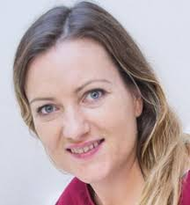
Introduction to the topic:
Aija Lokenbaha (project manager, LatConsul)

Slide 5
Introduction to the topic
SDG 1 - End poverty in all its forms everywhere
While extreme poverty has eased considerably since 1990, pockets of the worst forms of poverty persist. Ending poverty requires universal social protection systems aimed at safeguarding all individuals throughout the life cycle. It also requires targeted measures to reduce vulnerability to disasters and to address specific underserved geographic areas within each country.

Slide 6
Poverty is more than the lack of income and resources to ensure a sustainable livelihood. Its manifestations include hunger and malnutrition, limited access to education and other basic services, social discrimination and exclusion as well as the lack of participation in decision-making.

Slide 7
783 million people live below the international poverty line of US$1.90 a day
In 2016, almost 10 per cent of the world’s workers live with their families on less than US$1.90 per person per day
Globally, there are 122 women aged 25 to 34 living in extreme poverty for every 100 men of the same age group.
Most people living below the poverty line belong to two regions: Southern Asia and sub-Saharan Africa
High poverty rates are often found in small, fragile and conflict-affected countries
One in four children under age five in the world has inadequate height for his or her age
As of 2016, only 45% of the world’s population were effectively covered by at least one social protection cash benefit.
In 2017, economic losses due to disasters, including three major hurricanes in the USA and the Caribbean, were estimated at over $300 billion.

Slide 8
Relation to other SDGs
So many of the Sustainable Development Goals affect and are affected by poverty - possibly why End Poverty was created as SDG Goal #1. There is a correlation between income inequality and higher rates of health and social problems (eg. obesity, mental illness, incarceration), lower rates of social goods (eg. life expectancy, educational level, social mobility) causing trust, anxiety, excessive consumption and further illness. Unsurprisingly, the downward spiral leads to greater volumes of people at the bottom of the pyramid: As wealth increases, so fewer people have it. The most have the least.

Slide 9
LAPAS experience with SDG’s
Inese Vaivare, Director of The Latvian Platform for Development Cooperation (LAPAS)

Slide 10
International seminar
Sustainable Development Goals in the Activities of NGOs

Slide 11
Established in 2004 when joined EU - from receiver to donor
Main areas - development cooperation and global education
In 2018 - 35 members - small rural and networks, wide areas of topics
Work in development cooperation - maturity
Many projects - global education and communication

Slide 12
Why SDGs
In 2014 - post2015 process at global level and sub-grant for advocacy plan at national level
Joined forces with environmental NGOs
How to apply nationaly - “everything is ok”
Established working group with external experts - how to mainstream in other projects

Slide 13
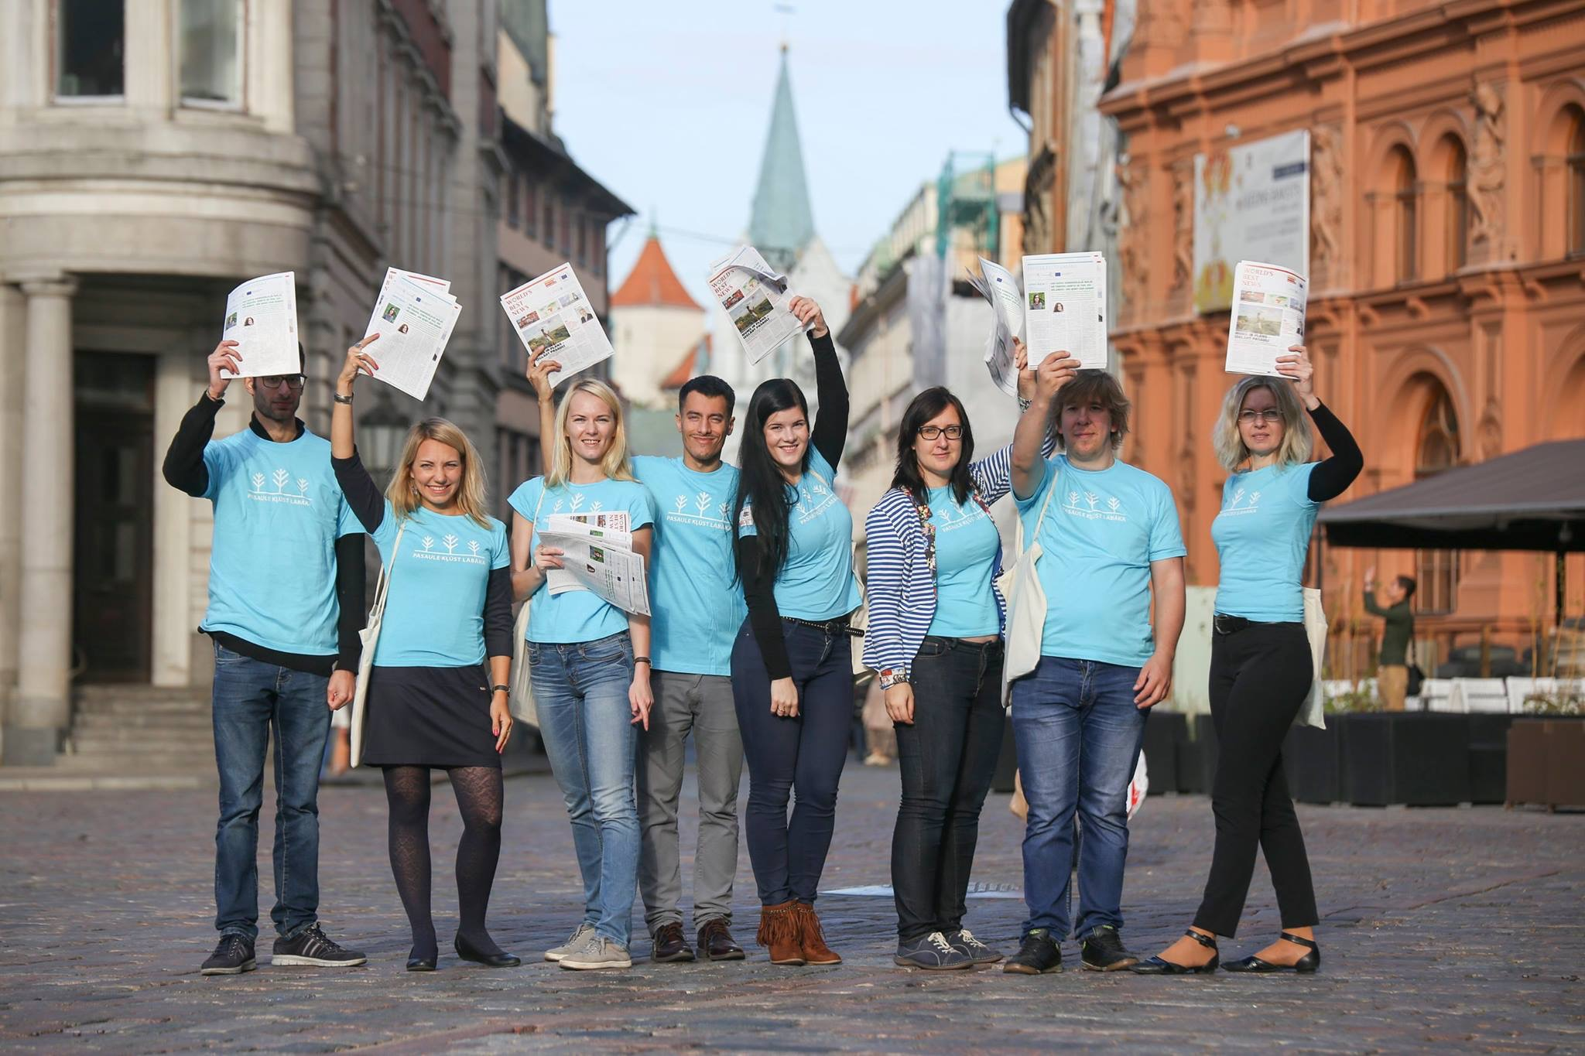
Phase 1 - mainstreaming
glocalisation methodology
regional discussions with Union of Local Governments - localising SDGs
training for youth in regions
gathering materials - web page, guidelines for teachers
explaining through topics - fast fashion
for different audiences - social workers, teachers, private sector

Slide 14
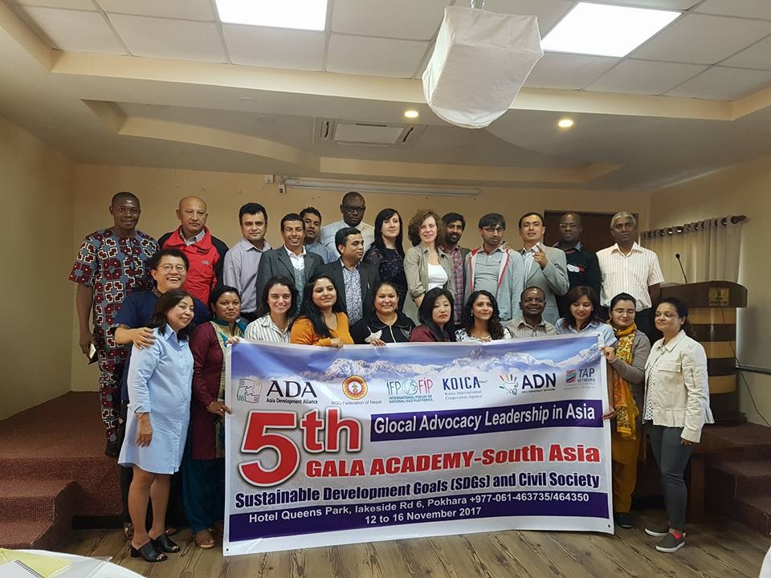
Phase 2 - shock
In autumn of 2017 - VNR will be presented in 2018
So many international processes, events, competent experts, suggestions and guidelines
Systematization of information and digging deeper
There is NO external answer

Slide 15
Phase 3 - failure
Planned publication - based on the best practices and opinion papers by NGOs
Very low involvement due to the low awareness raising how to link work of NGOs with SDGs, no time, “too far away”
Government process - closed

Slide 16
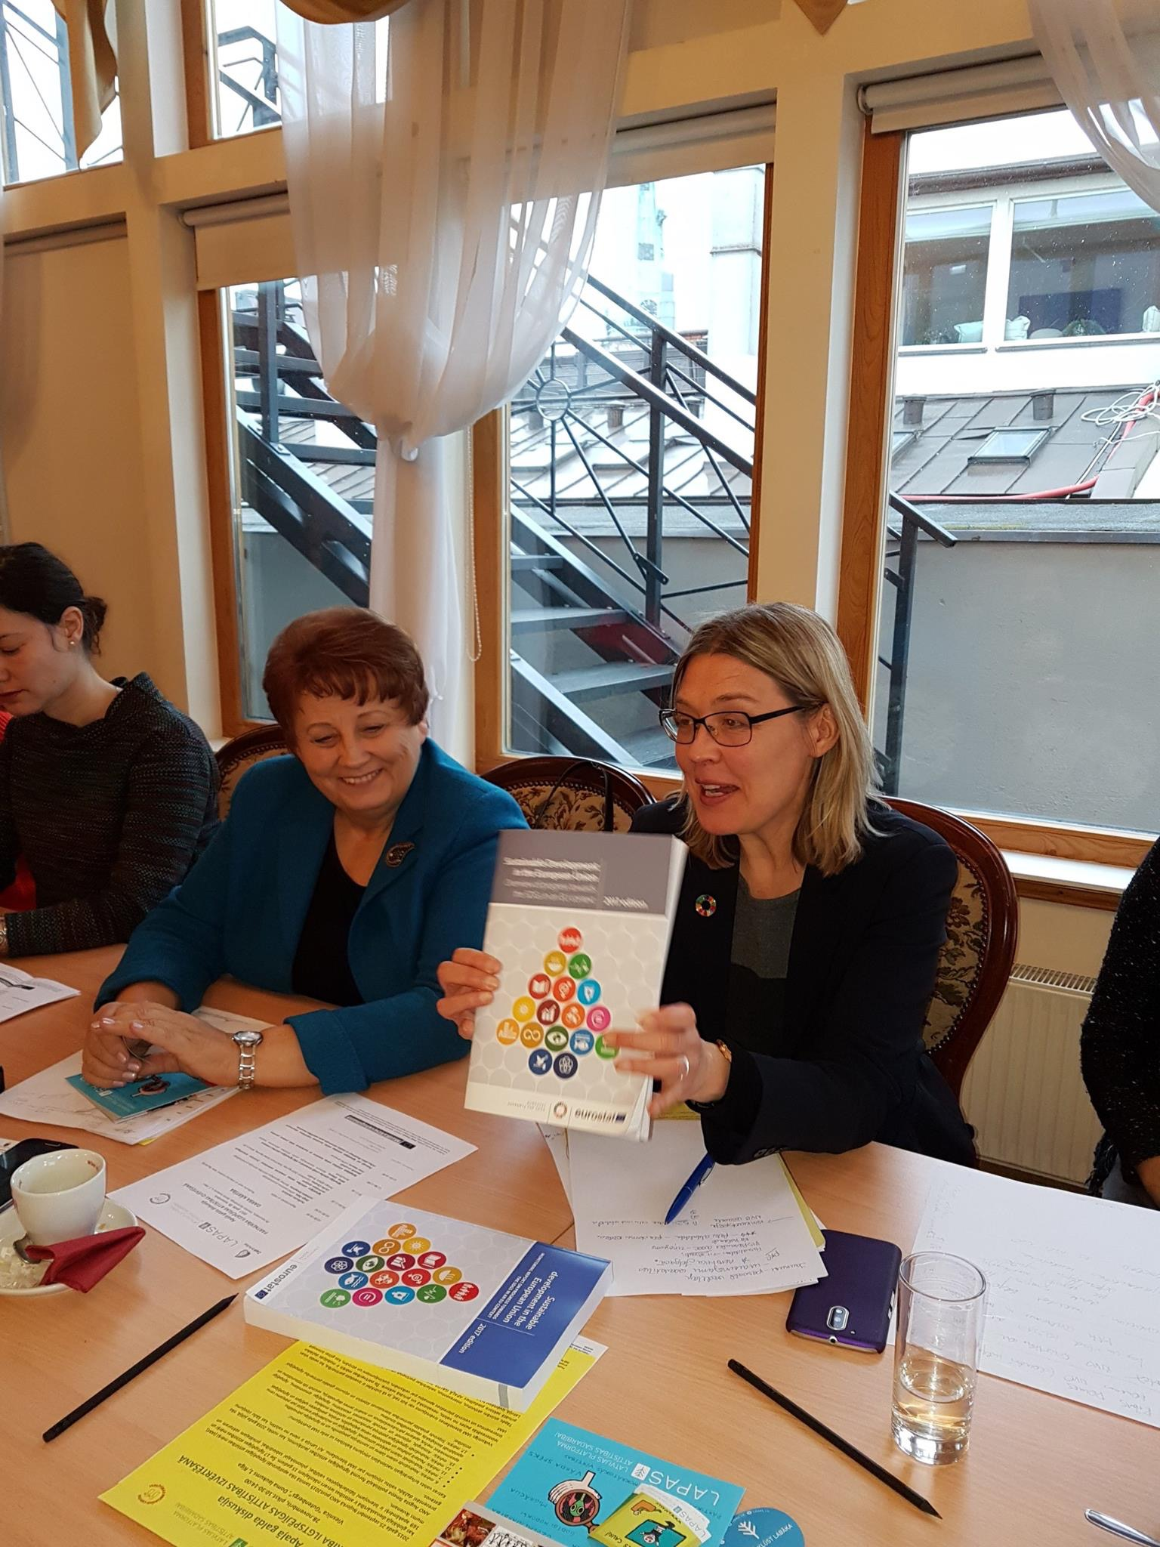
Phase 4 - we did it
Support from external partners Embassy of Sweden
Political support - key
All stakeholders at one table
Formalize NGO involvement
Participate in international events

Slide 17
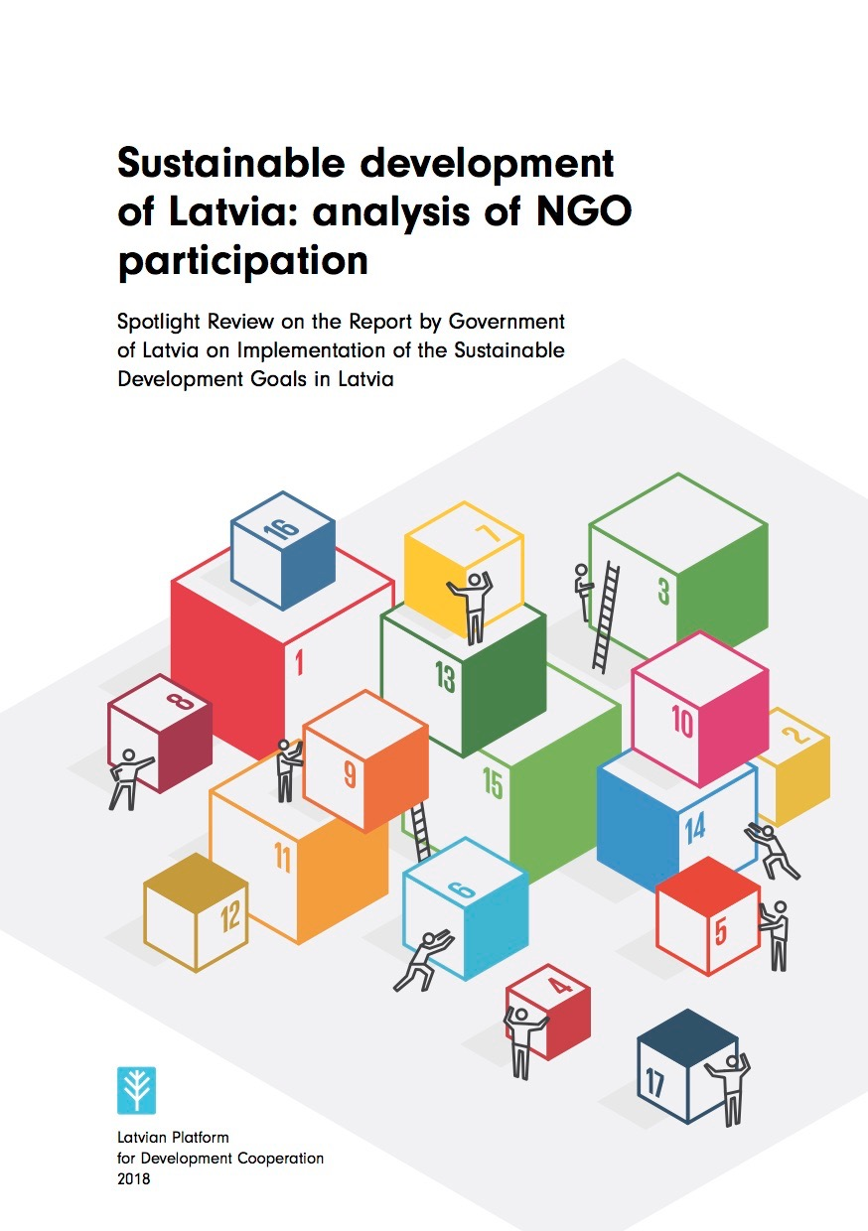
Spotlight report
Human security and social capital
Sustainable development strategy - not linked with SDGs, only policy docs mapped
National Development Plan - “economic breakthrough” - need for civic not only social dialogue
NGO involvement in budgeting - very low
Indicators - no discussions with stakeholders
NGOs not involved in the mapping of SDGs
Case study on reproductive health
Specific focus - leaving noone behind, inequality, gender and youth
Institutional mechanism - governmental, parliamentarian
Awareness raising
SDG17

Slide 18
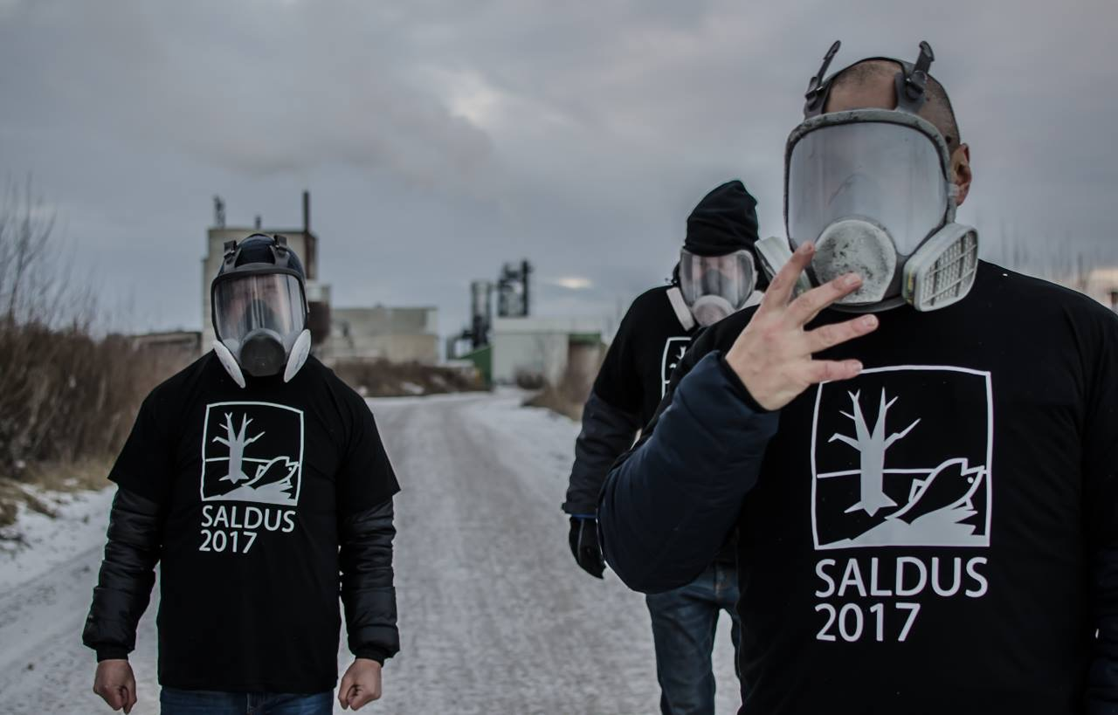
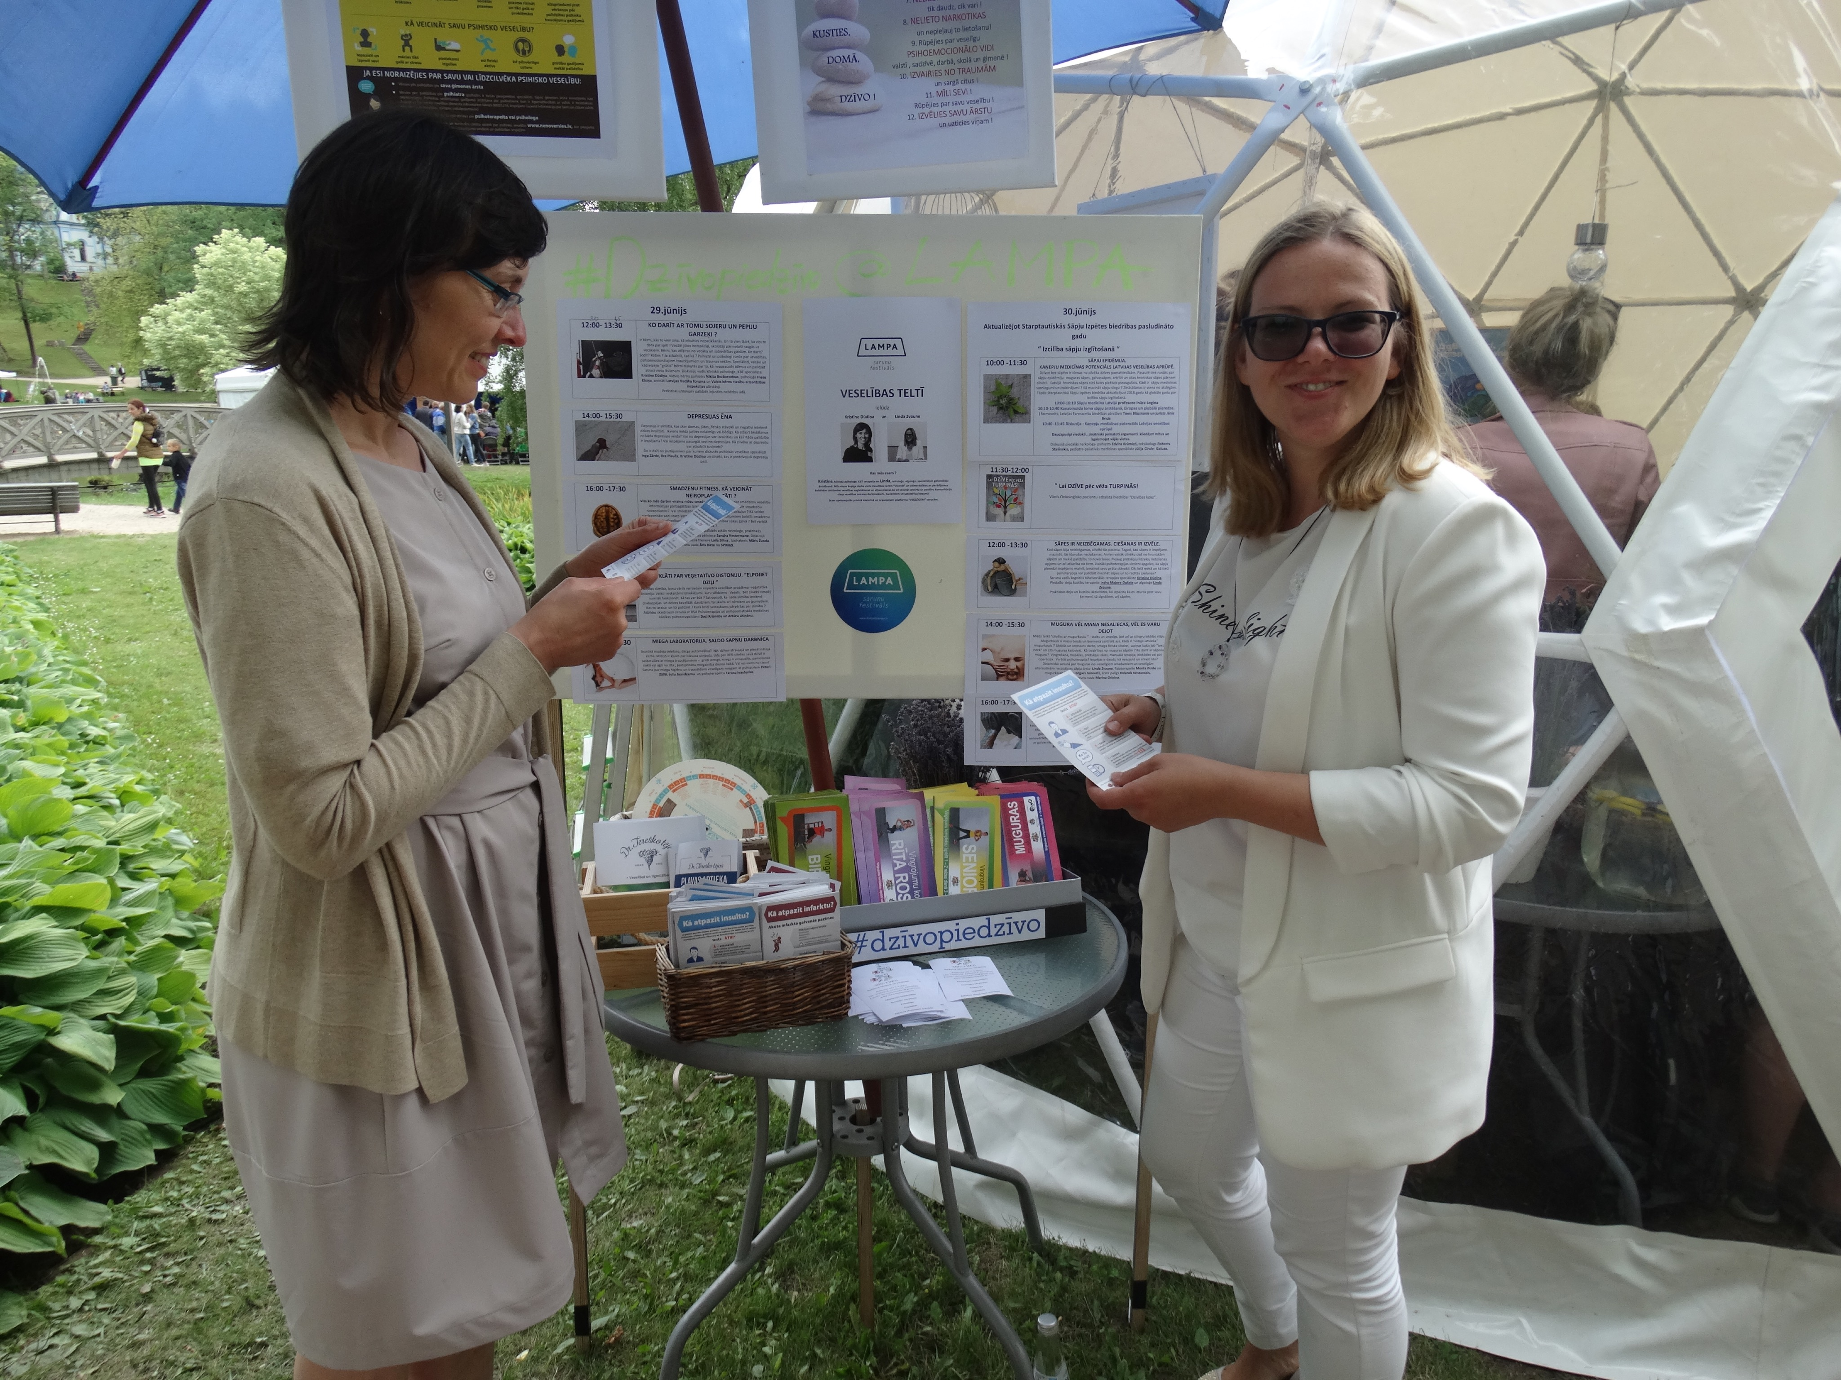
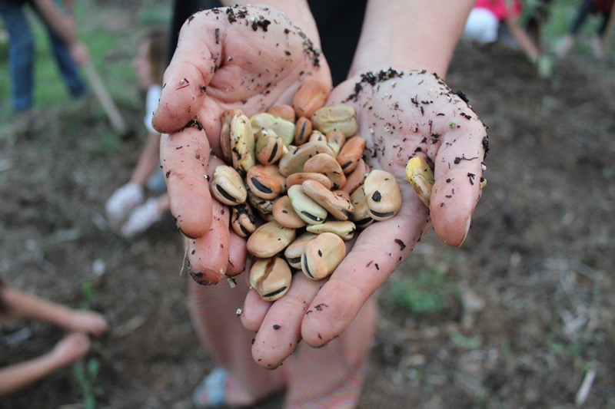
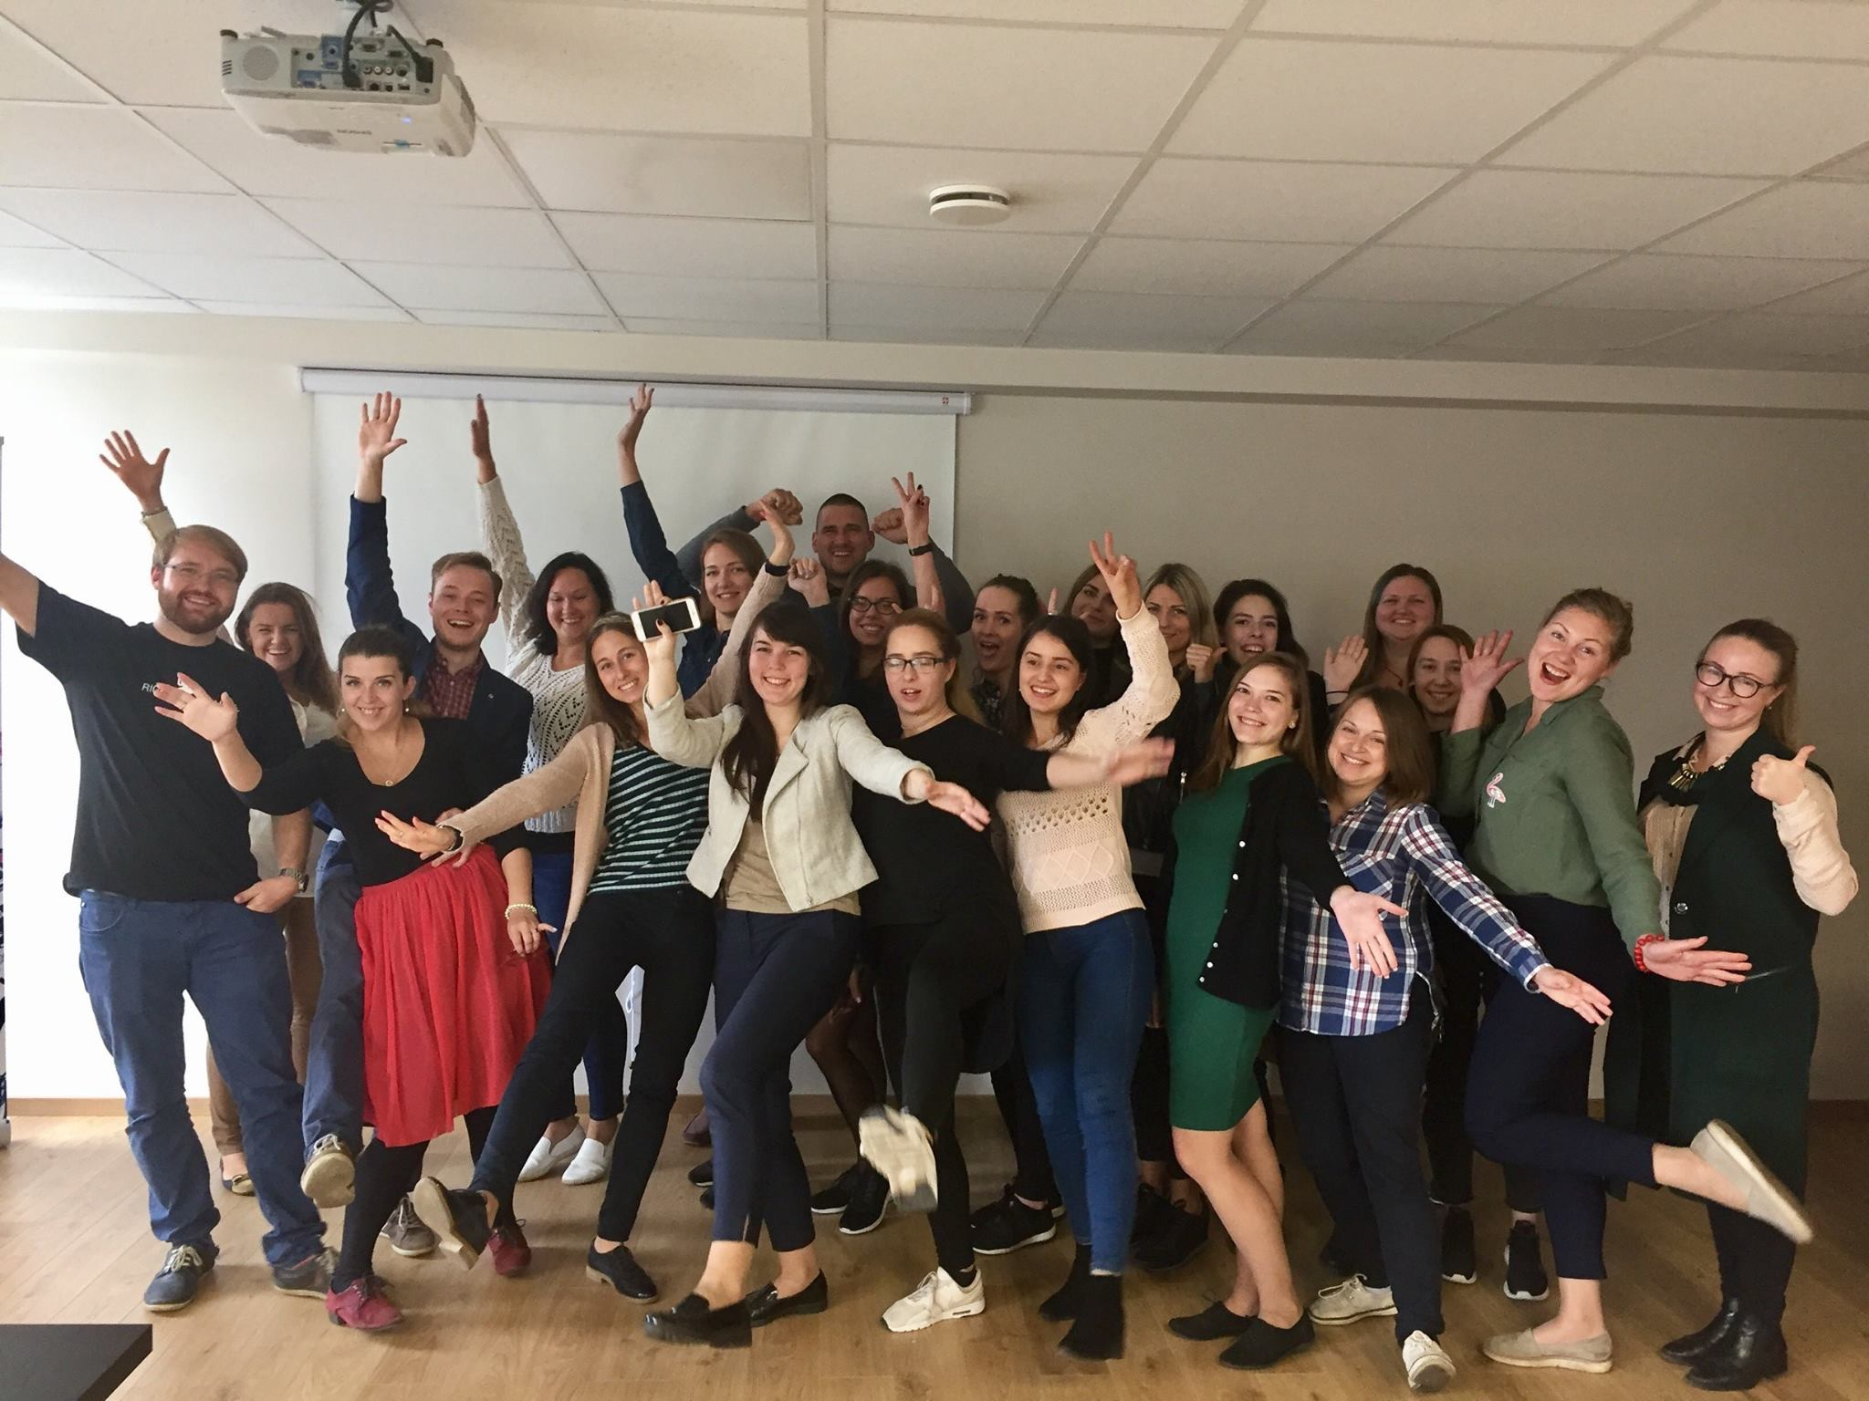
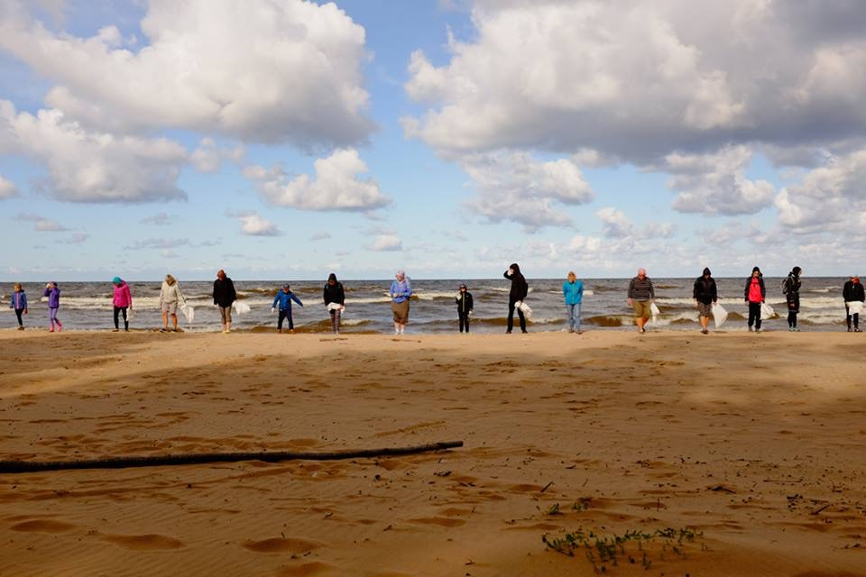
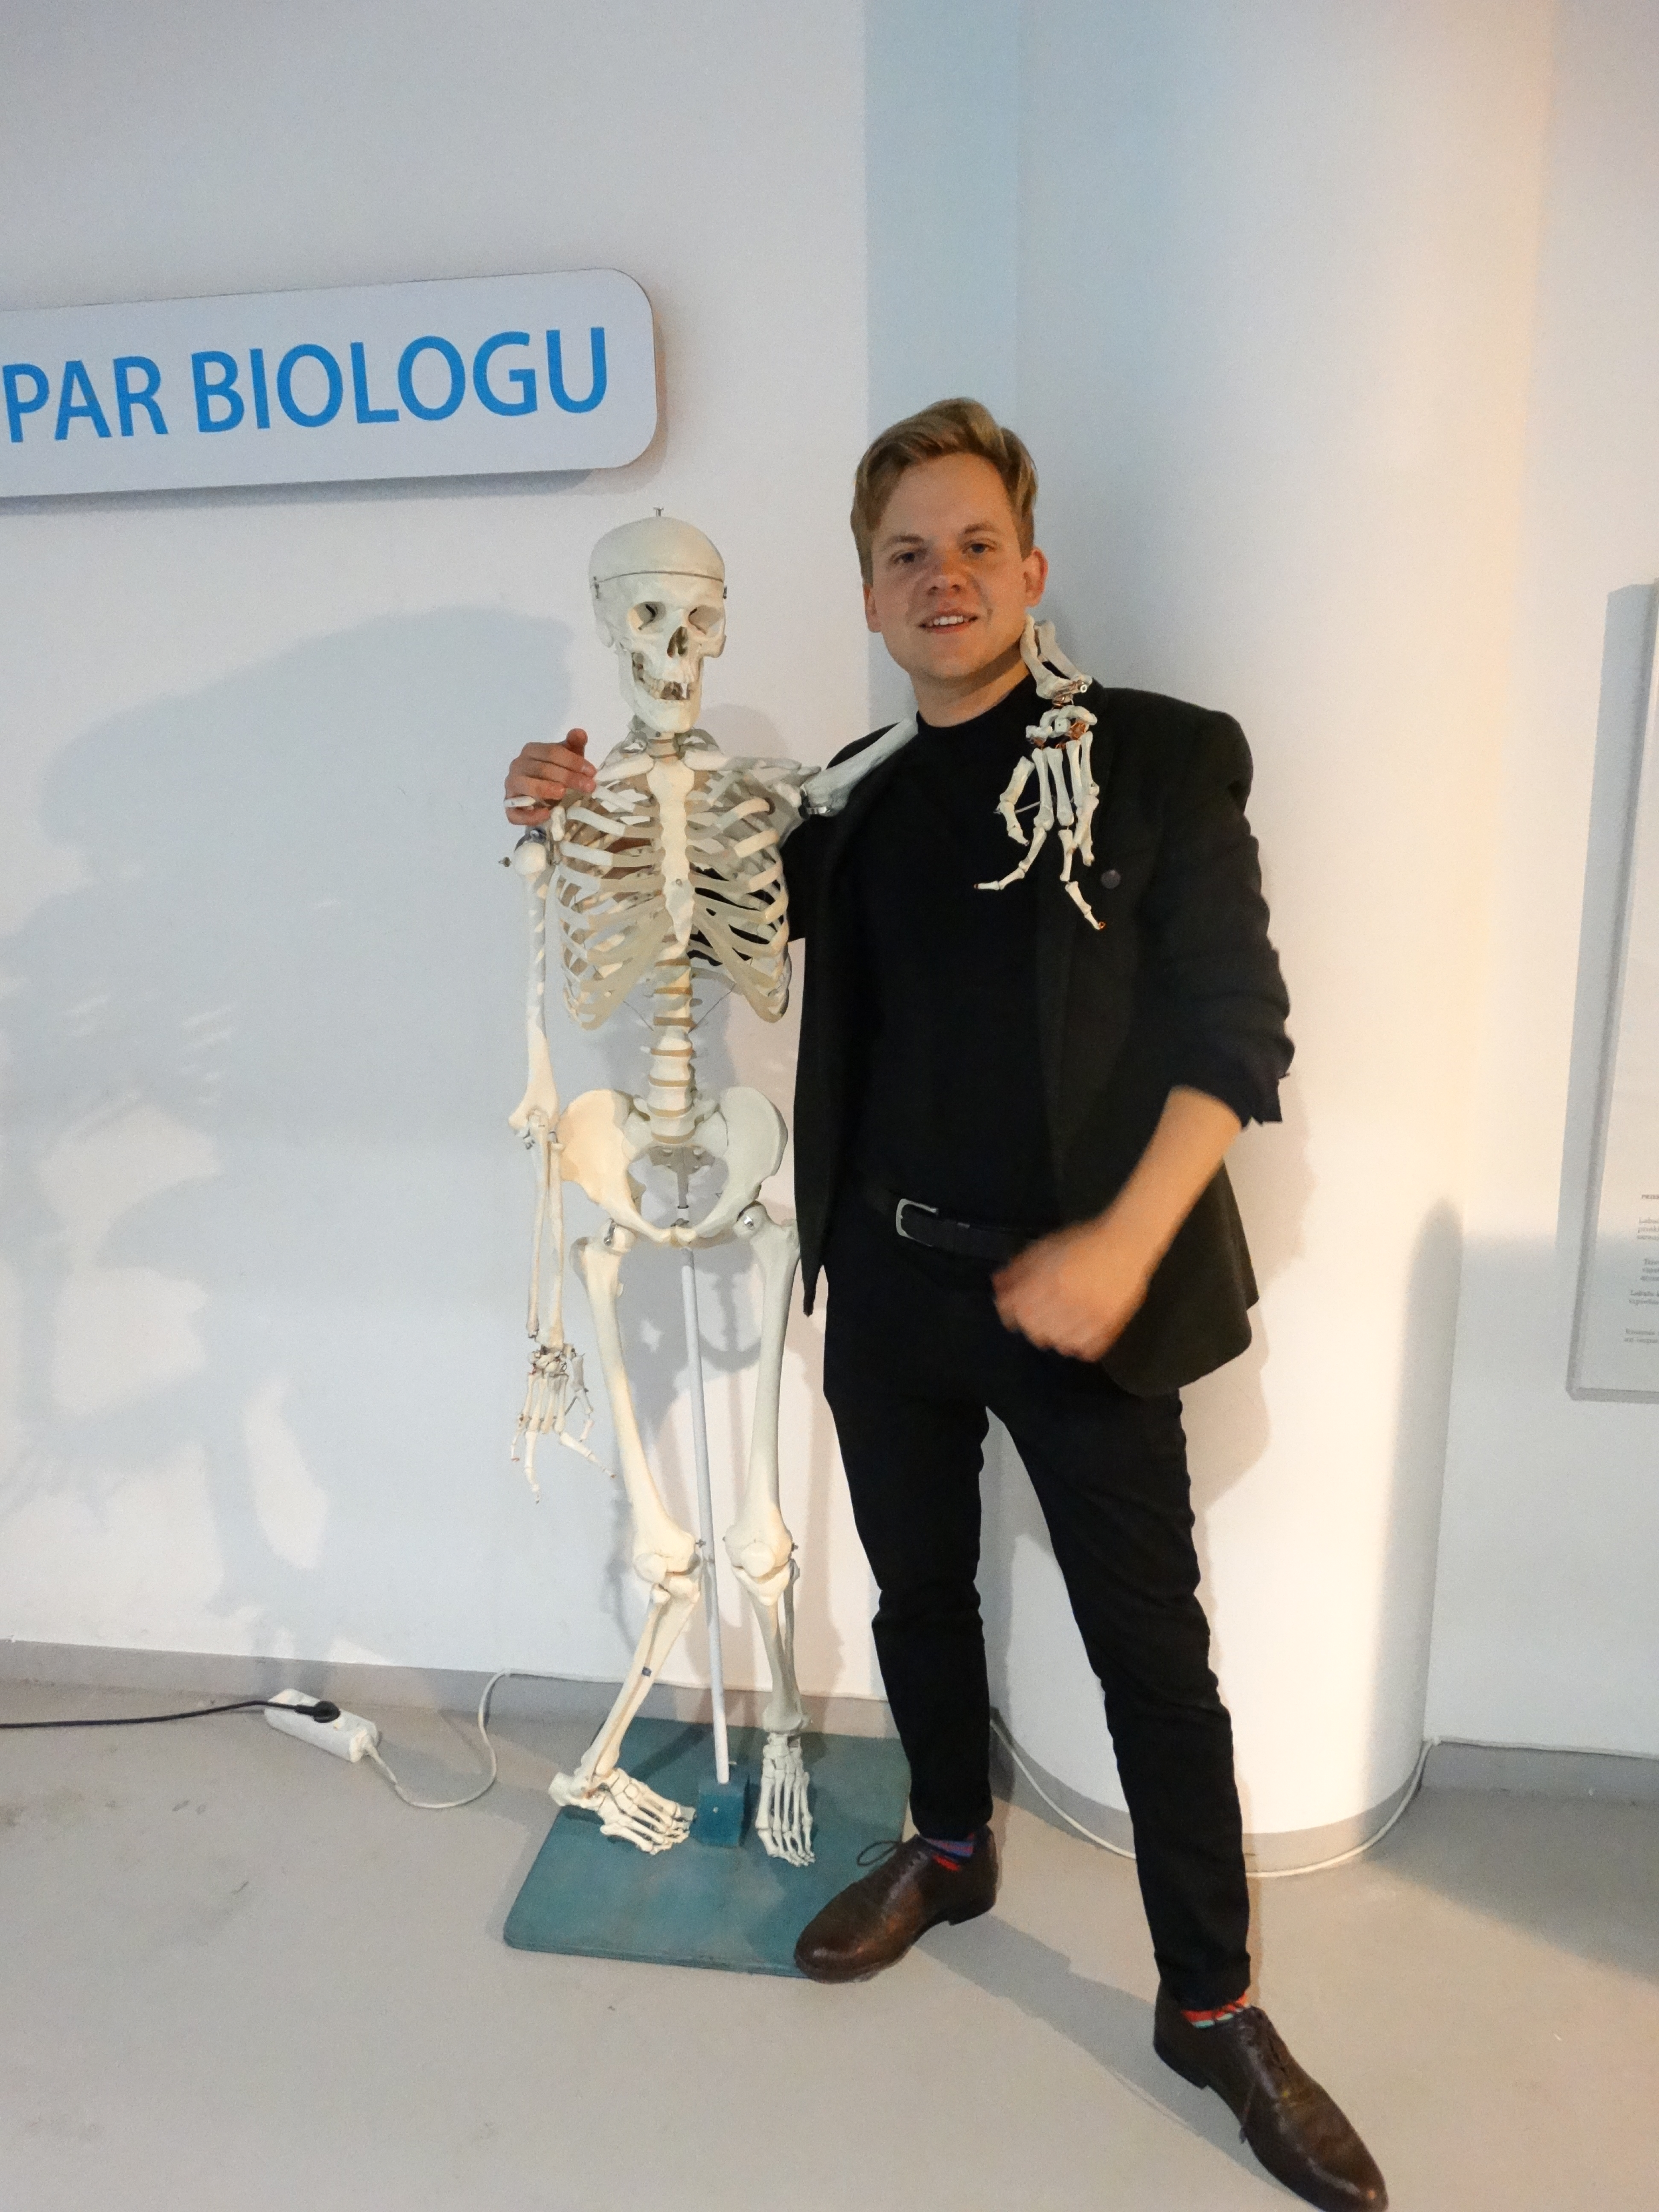
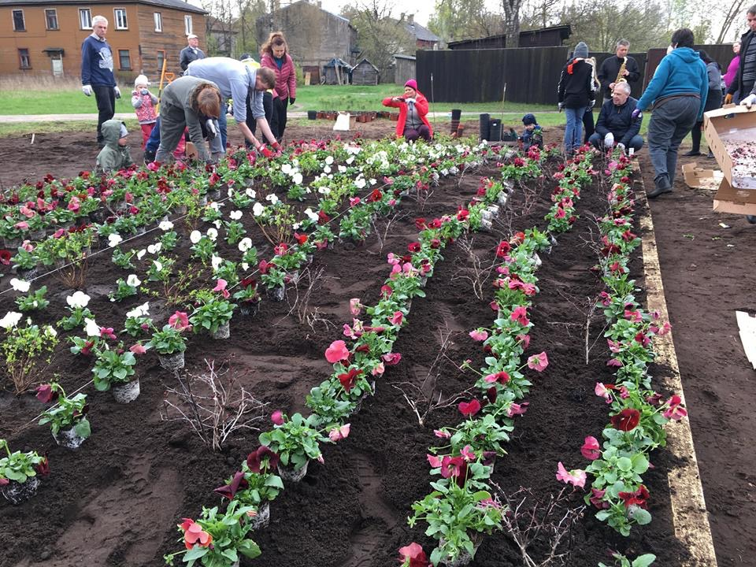
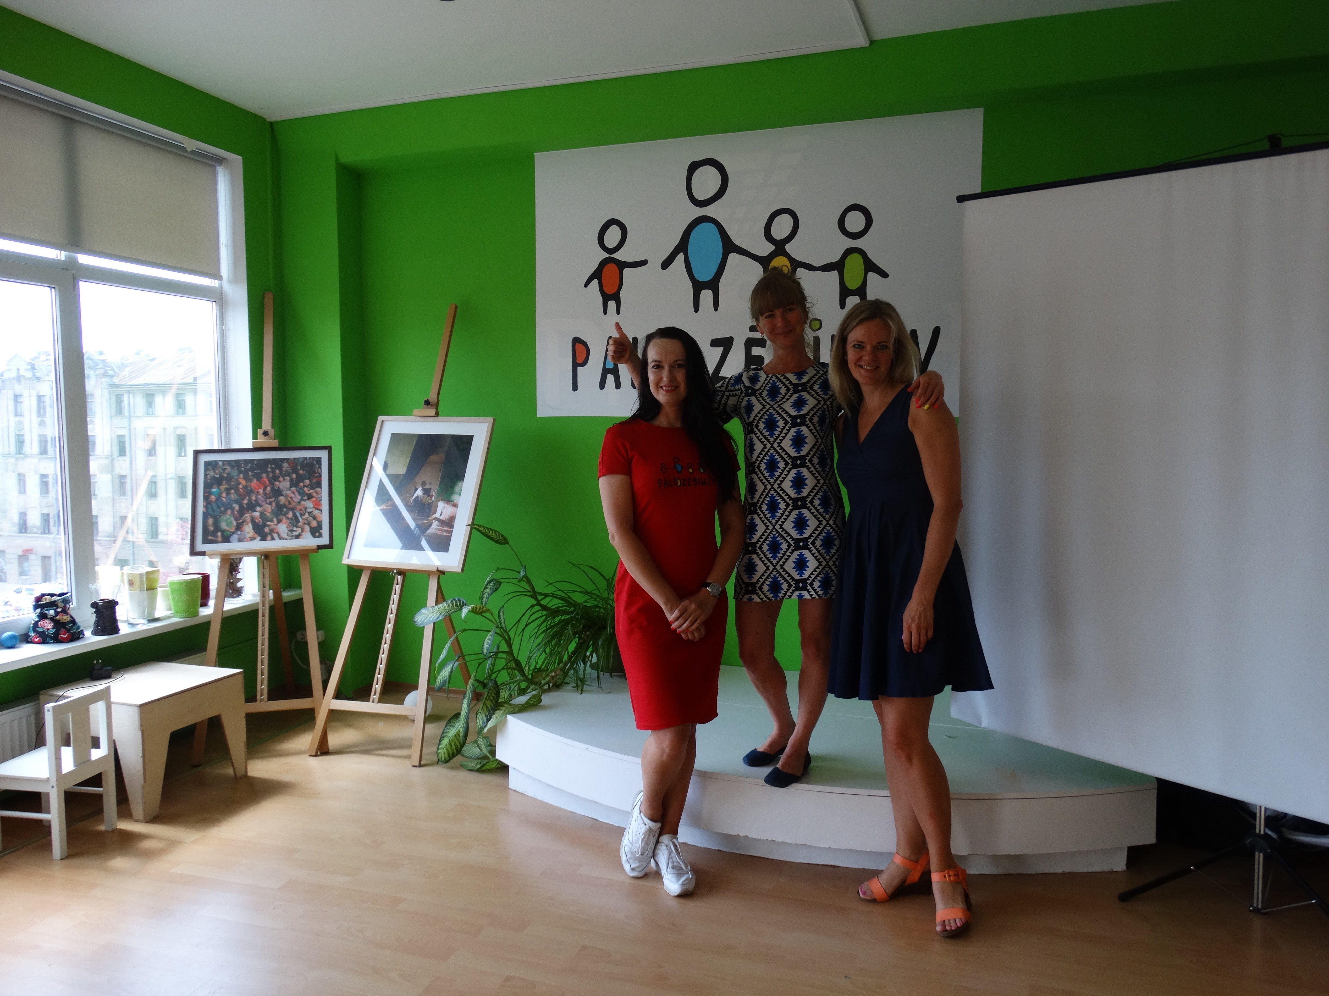
Annex - cases

Slide 19
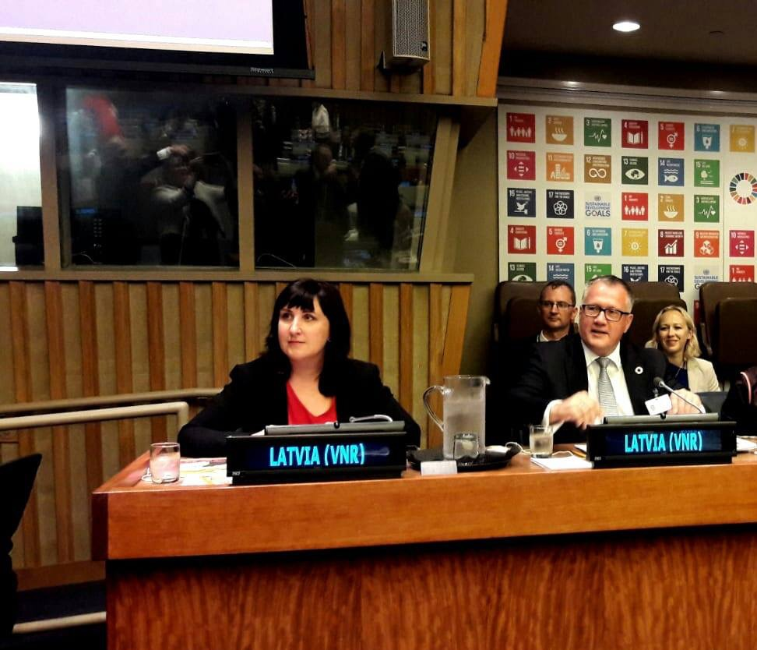
HLPF - hand in hand
Co-presentation in the panel discussion
Side-events - NGO and governmental
Very low representation of real national level NGOs
Huge learning about the process and about content

Slide 20
And now what?
Follow up event - more than 50 people applied, 14 (!) speakers
Questionnaire - in favor about the multistakeholder coalition
New National Development Plan is drafted
Many opportunities. Except resources
Solution - focusing - statistics
Awareness raising - constant mainstreaming

Slide 21
SDG1
High inequality
Poverty risk groups
Linked with all SDGs
Cases – FB page, palidzesim.lv, family support

Slide 22
SDG3
Health insurance reform
Healthy towns/municipalities
Reproductive health – political issue
Prevention, education, men’s health
Lack of family doctors in regions
Cases – Veloronis, Marta center, Linda Zvaune

Slide 23
Ending the poverty?
Martins Valters, project “Age is not an Obstacle”

Slide 24
Definitions of poverty
Condition where people's basic needs for food, clothing, and shelter are not being met.
Poverty is generally of two types:
(1) Absolute poverty is synonymous with destitution and occurs when people cannot obtain adequate resources (measured in terms of calories or nutrition) to support a minimum level of physical health. Absolute poverty means about the same everywhere, and can be eradicated as demonstrated by some countries.
(2) Relative poverty occurs when people do not enjoy a certain minimum level of living standards as determined by a government (and enjoyed by the bulk of the population) that vary from country to country, sometimes within the same country. Read more: http://www.businessdictionary.com/definition/poverty.html

Slide 25
Consequences
Poverty and Happiness
"Resolve not to be poor: whatever you have, spend less. Poverty is a great enemy to human happiness; it certainly destroys liberty, and it makes some virtues impracticable, and others extremely difficult.«
Samuel Johnson
The Danger of Poverty
"Poverty often deprives a man of all spirit and virtue; it is hard for an empty bag to stand upright.«
Benjamin Franklin

Slide 26
What can we do with the absolute poverty?
By my own opinion such, problem in Europe does not exist at all ☺
The average European eats more delicious food than king Henry VIII or queen Victoria could imagine
The systems of social insurance and social assistance ensure that problem of absolute poverty in Europe is resolved
Even any homeless person can get shelter and food, if he/ she ask such assistance

Slide 27
Social assistance
Prescribed by the Government:
Guaranteed minimum income – 128.06 euros per month
Apartment allowance - the amount, the payment procedure and the persons entitled to receive the benefit are determined by the municipality in its binding regulations.
Municipalities (119) themselves determine income level to assign person status of needy person and what kind (41) of social assistance they provide. The most widespread ways of social assistance are:
Real Estate Tax Rebate on Land and Buildings (100%)
In 94% municipalities there is an allowance for emergency (crisis)
70% municipalities have defined benefits in different anniversaries
68% municipalities have defined benefits for funerals
In 67% municipalities are different benefits for medical treatment and expenses for medicine

Slide 28
Social services
Social services are provided by the Social departments of the municipalities. They may include:
social care services at the person's place of residence;
care in long-term social care and social rehabilitation institutions;
social rehabilitation services at the person's place of residence and institution;
professional rehabilitation services;
provision of technical auxiliary tools
More detailed information about Latvian systems of social insurance, social assistance and social services will be provided by Mrs. _______

Slide 29
What can we do with the relative poverty?
The main reason of relative poverty is not located outside the person (neighbours, society, government), but inside the person, who feels him-/herself poor or needy
It is related to dissatisfaction about what he/ she already owns
It is related to difference between wishes and real possibilities
This problem cannot be solved by any system of social assistance or protection by increasing social grants or services
We can do nothing with the relative poverty, but show the way, how person can reduce difference between his/ her wishes and possibilities
We work on this in our project «Age is not an obstacle»

Slide 30
Age is not an obstacle (I)
Project «Age is not an obstacle» is financed by NordPlus Adult
Participants are Latvian, Lithuanian, Estonian associations of pensioners’ organisations and Riga Stradins university
The global objective of the project is to is to enhance the quality of lives of retired persons in Baltics.

Slide 31
Age is not an obstacle (II)
The particular objective of the project is to develop training program for retired persons and persons of preretirement age, relevant methodology and training materials, as well as training trainers from different pensioners’ organisations. The program includes (but not limited) following modules:
How to survive in adaptation period after retirement (incl. opportunities to receive social assistance and to organise small business)
How to maintain physical health
How to maintain psychological health and acquire new knowledge and skills
How to avoid and overcome loneliness

Slide 32
Retirement and poverty
The amount of the pension depends on the social tax paid and it is fair principle!
According Latvian official statistics
41.9% of all retired persons and
74% of single pensioners are exposed to the risk of poverty.
31`540 persons (6.9%) receive pensions less than official level of poverty (guaranteed minimum income) 128.06 euros a month (and receive social assistance)
The average pension in the 4th quarter 2018 was 329 euros

Slide 33
Role of retired persons in society
The biological objective of existence of any alive creature is to continue the species.
The biological objective of existence of any human is to continue family, tribe, nation, civilisation, mankind.
Our children must raise their children (our grandchildren!), not to waste their resources to keep their parents (us) alive!
Grandparents are to assist their children to raise grandchildren, avoiding to substitute them or even to dominate!
To be able to implement this role, retired persons have to take care on themselves him /herself!
How to acquire resources necessary? Continuing to work or starting own business!

Slide 34
What we did to reduce poverty of retired?
Thanks to efforts of ex-minister of Welfare Mrs. Dagnija Staķe and ex-state secretary of the ministry Mrs. Baiba Paševica the first unified and exhaustive overview of social assistance, social services and healthcare in all and every municipality in Latvia is developed and available on the project website in Latvian and in Russian http://vecumsnavskerslis.lv/lv/1modula-programma
Training materials on such issues as: how to start the business, how to develop creative ideas for the new business, what legal and financial circumstances should be taken into account, where acquire start money are developed and published on the project website and training of trainers for all 4 modules is close to the finish.

Slide 35
Social entrepreneurship
In 2018 came into force Law on social enterprises and it provides new opportunities as well to entrepreneurs as to target groups.
Target groups are the same most exposed to the risk of poverty:
Persons with special needs
persons with mental disabilities;
Persons with status of poor
Unemployed, unemployed with dependents, unemployed elder than 54, long term unemployed
Ethnical minority gypsies
Prisoners and persons released from prisons
persons with alcohol, narcotic, psychotropic or toxic substances, gambling or computer game addiction problems
persons whose place of residence is declared in a night shelter;
victims of trafficking
persons who have been granted refugee, alternative or stateless person status in the Republic of Latvia;
orphans and children left without parental care at the age of 15 years

Slide 36
Amount of the grant
for start-ups (up to 1 year running time) the maximum grant is 20 thousand euros;
• for companies with a lifetime of 1 to 3 years, the maximum grant is 50 thousand euros;
• for companies with a lifetime of over 3 years, the maximum grant is 200 thousand euros.

Slide 37
Eligible expenses
Long-term investments:
• tangible - the cost of purchasing new equipment, equipment, transport, if this is necessary for the purpose of the business project;
• intangible - the cost of acquiring patents, licenses, trademarks, trademarks, concessions, computer programs.
• Current assets - raw material, material purchase costs, rent and lease, as well as other costs necessary to achieve the objective of the business plan;
• Remuneration costs for employees - salary (monthly salary; supplement for additional work; employer state social insurance) compulsory contributions; benefits and compensation of the employer from which income tax and state social insurance contributions are calculated);
• training, consultancy expenses (up to EUR 3 thousand).

Slide 38
Ending the poverty ???
Is this formulation objective or it is just a deceiving slogan of politicians?
I am used to formulate objectives using SMART conception:
Specific
Measurable
Achievable/ Agreed on
Real
Time constrained
Take the minute and consider yourself.
And take the relevant decision.

Slide 39
Q & A, Discussion

