Slide 1
International seminar
Sustainable Development Goals in the Activities of NGOs

Slide 2
Established in 2004 when joined EU - from receiver to donor
Main areas - development cooperation and global education
In 2018 - 35 members - small rural and networks, wide areas of topics
Work in development cooperation - maturity
Many projects - global education and communication

Slide 3
Why SDGs
In 2014 - post2015 process at global level and sub-grant for advocacy plan at national level
Joined forces with environmental NGOs
How to apply nationaly - “everything is ok”
Established working group with external experts - how to mainstream in other projects

Slide 4
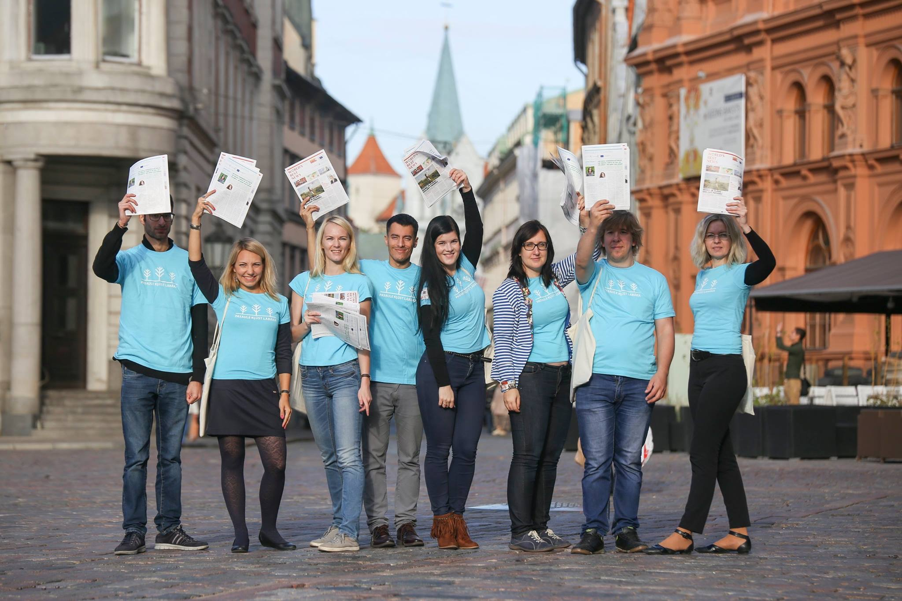
Phase 1 - mainstreaming
glocalisation methodology
regional discussions with Union of Local Governments - localising SDGs
training for youth in regions
gathering materials - web page, guidelines for teachers
explaining through topics - fast fashion
for different audiences - social workers, teachers, private sector

Slide 5
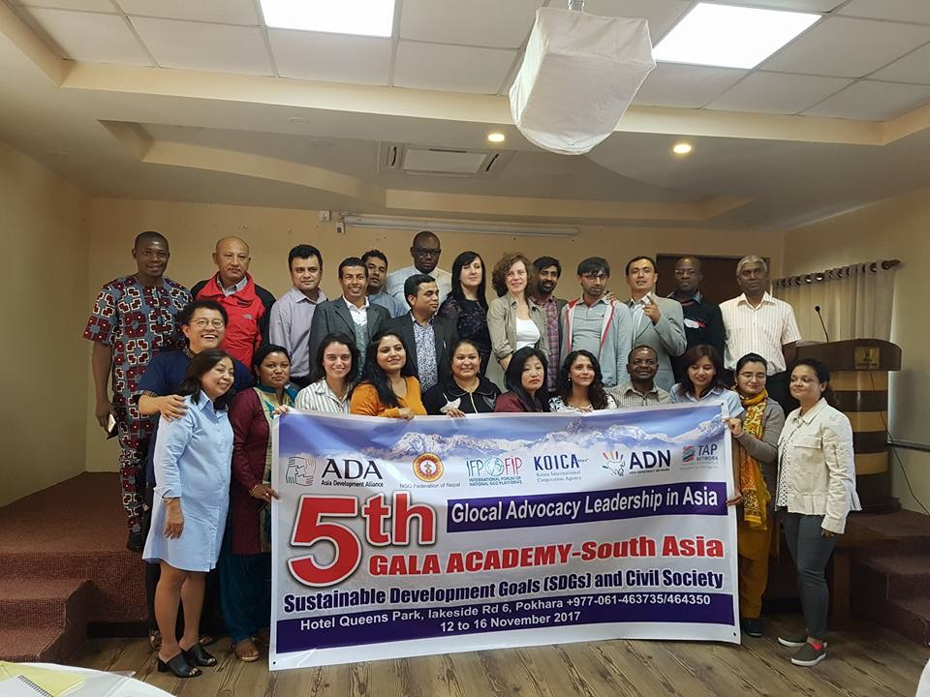
Phase 2 - shock
In autumn of 2017 - VNR will be presented in 2018
So many international processes, events, competent experts, suggestions and guidelines
Systematization of information and digging deeper
There is NO external answer

Slide 6
Phase 3 - failure
Planned publication - based on the best practices and opinion papers by NGOs
Very low involvement due to the low awareness raising how to link work of NGOs with SDGs, no time, “too far away”
Government process - closed

Slide 7
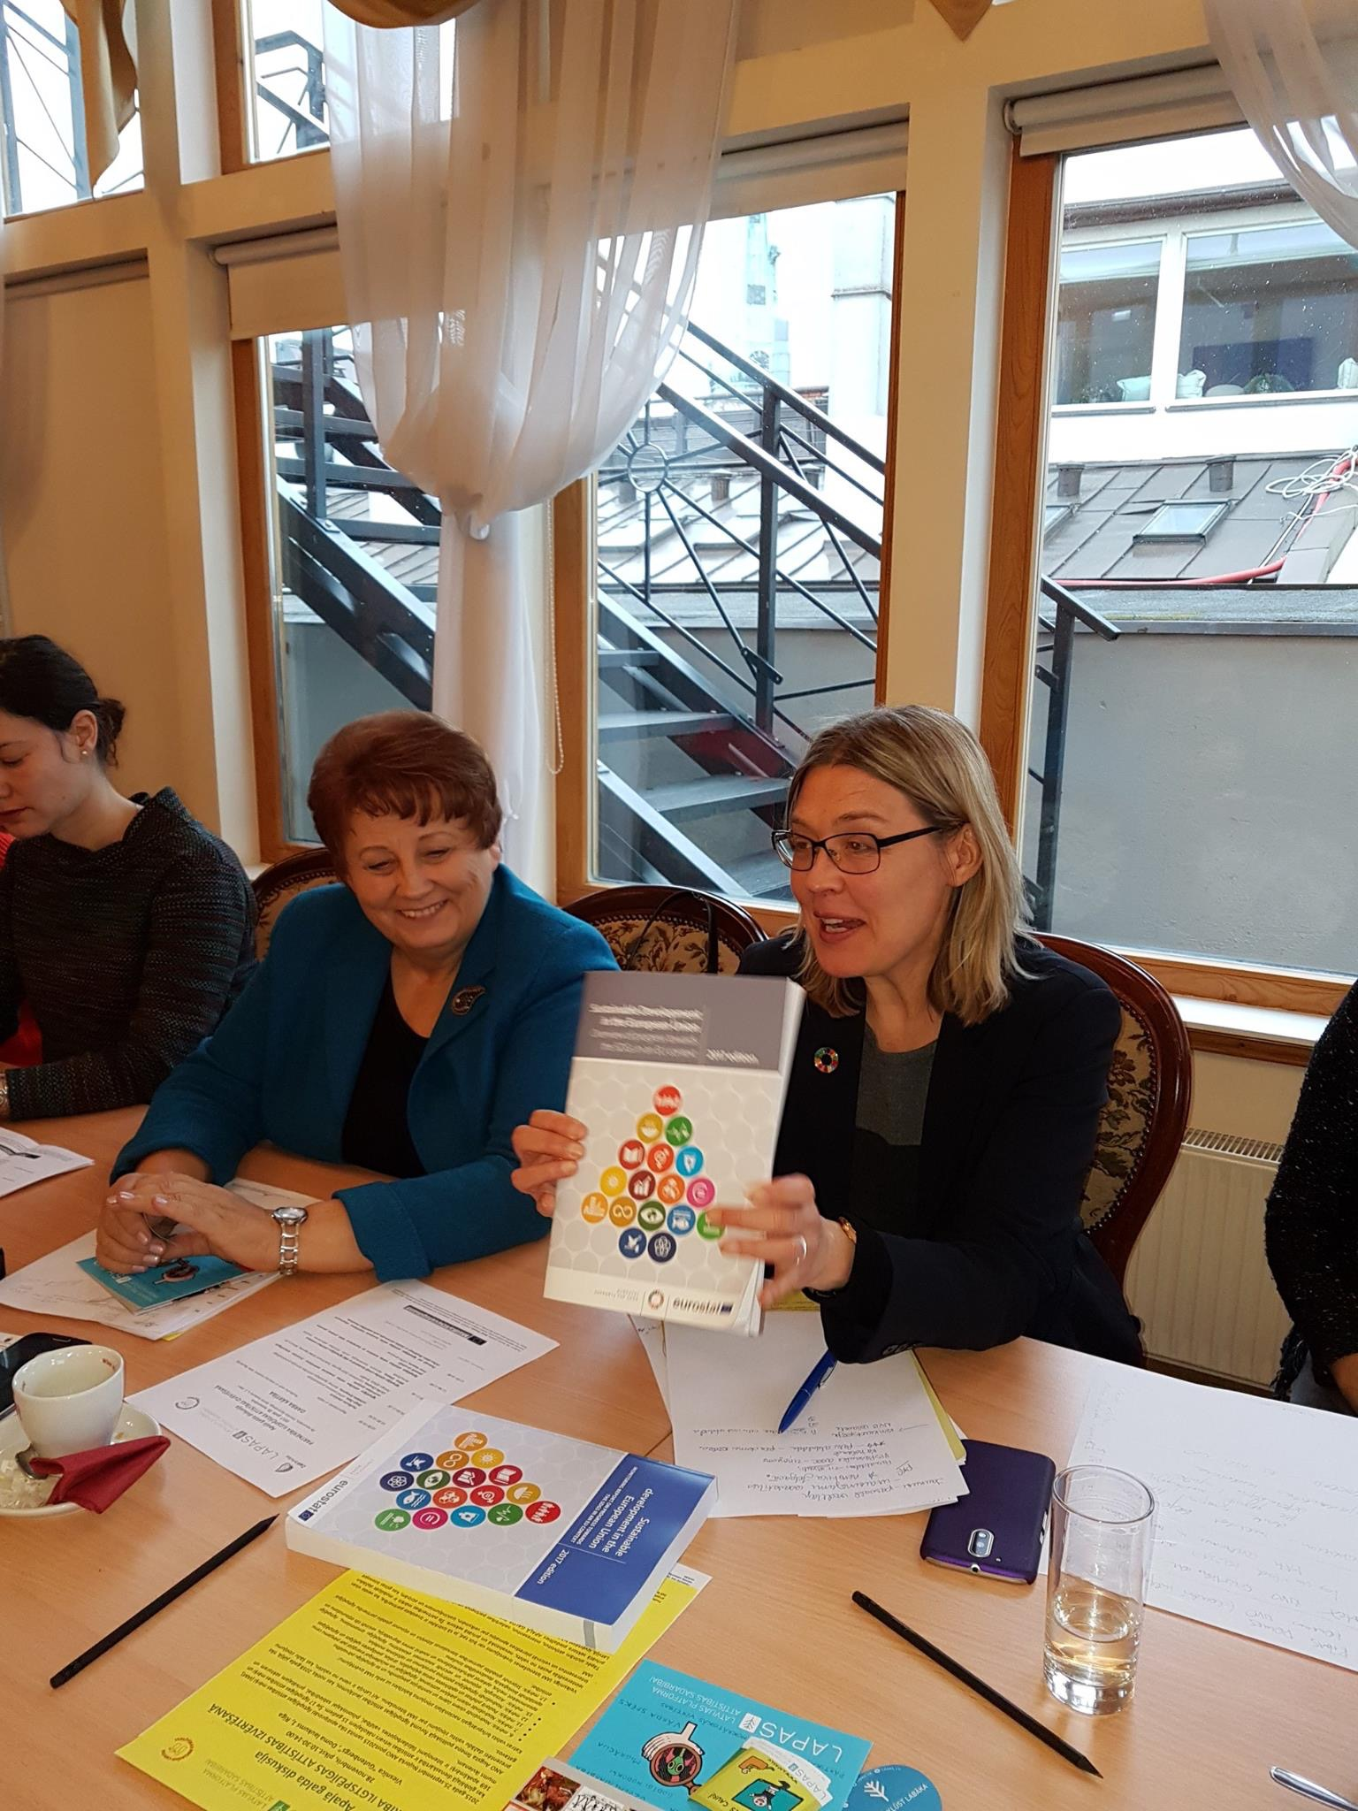
Phase 4 - we did it
Support from external partners Embassy of Sweden
Political support - key
All stakeholders at one table
Formalize NGO involvement
Participate in international events

Slide 8
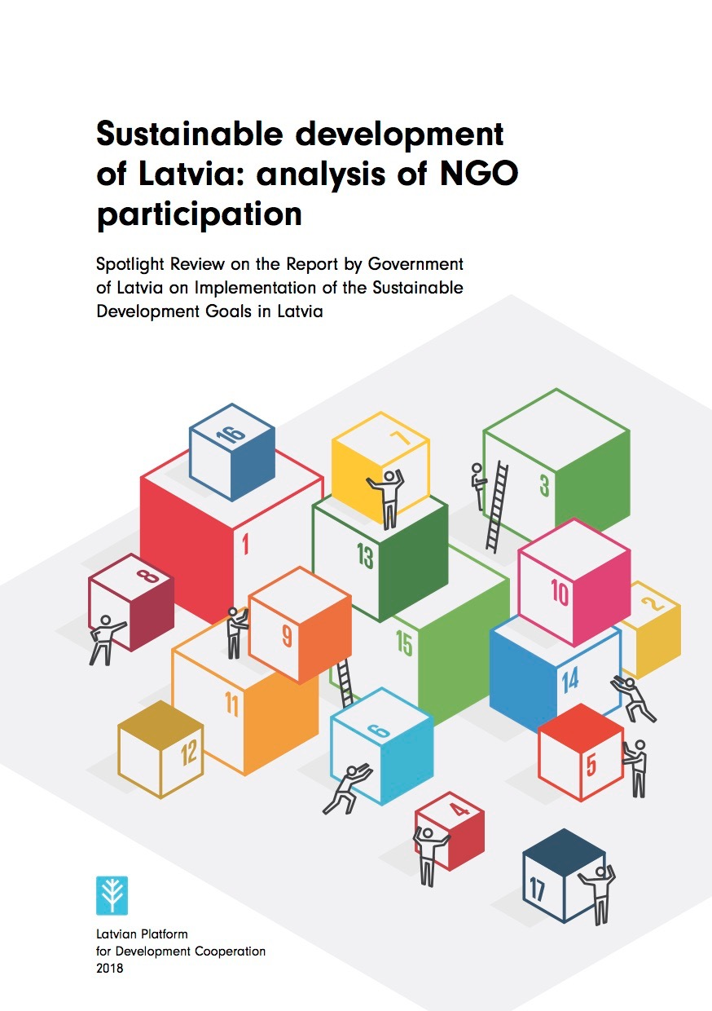
Spotlight report
Human security and social capital
Sustainable development strategy - not linked with SDGs, only policy docs mapped
National Development Plan - “economic breakthrough” - need for civic not only social dialogue
NGO involvement in budgeting - very low
Indicators - no discussions with stakeholders
NGOs not involved in the mapping of SDGs
Case study on reproductive health
Specific focus - leaving noone behind, inequality, gender and youth
Institutional mechanism - governmental, parliamentarian
Awareness raising
SDG17

Slide 9
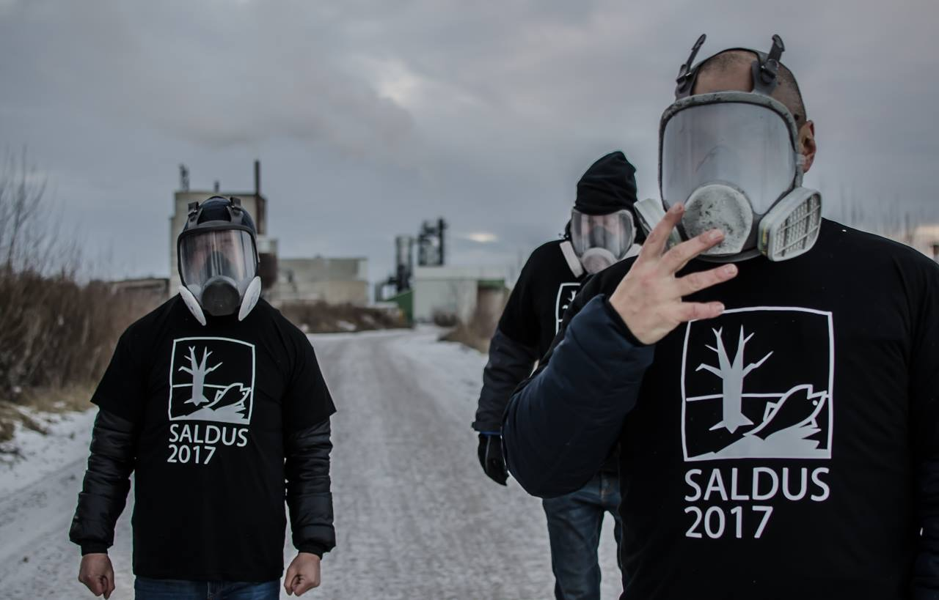
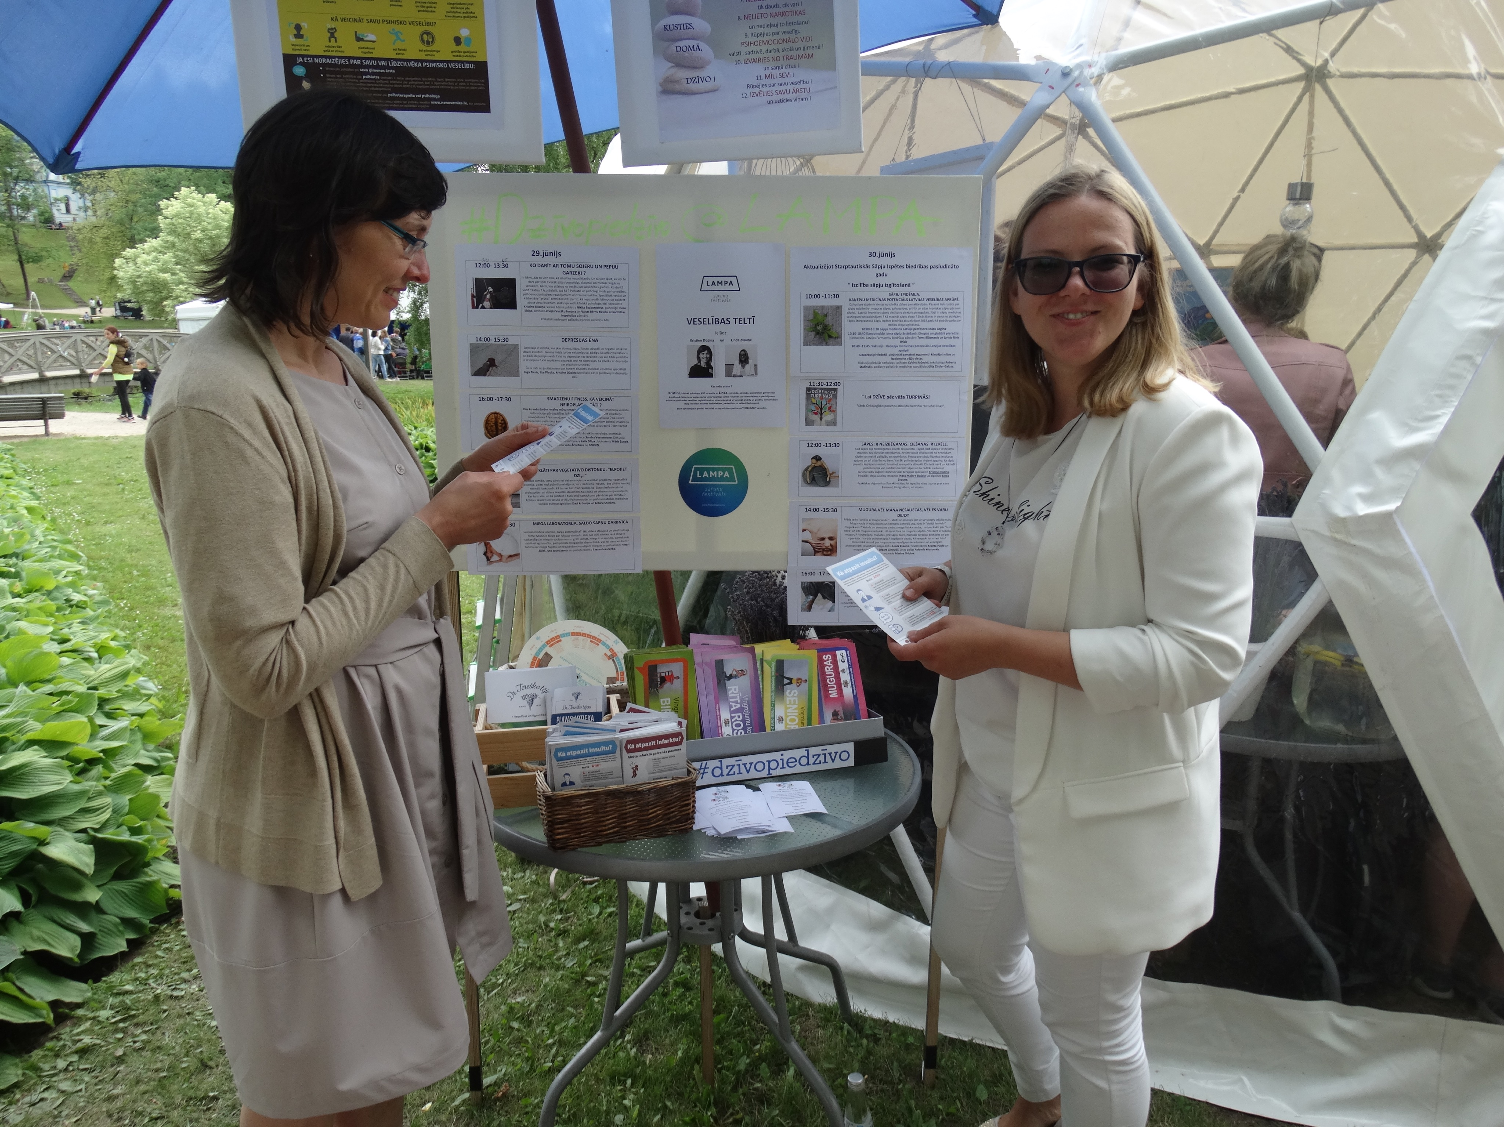
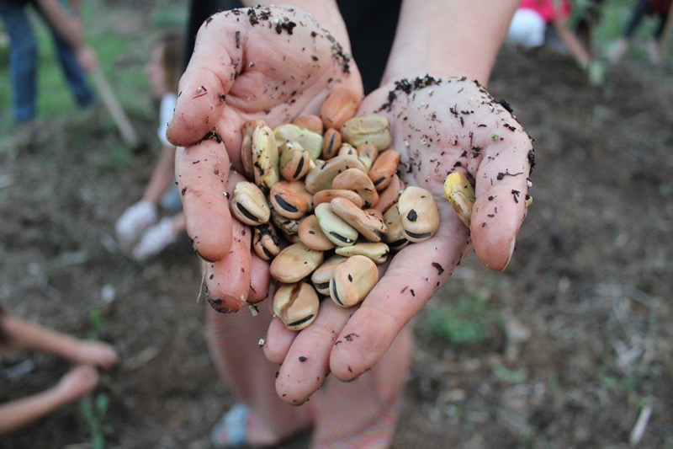
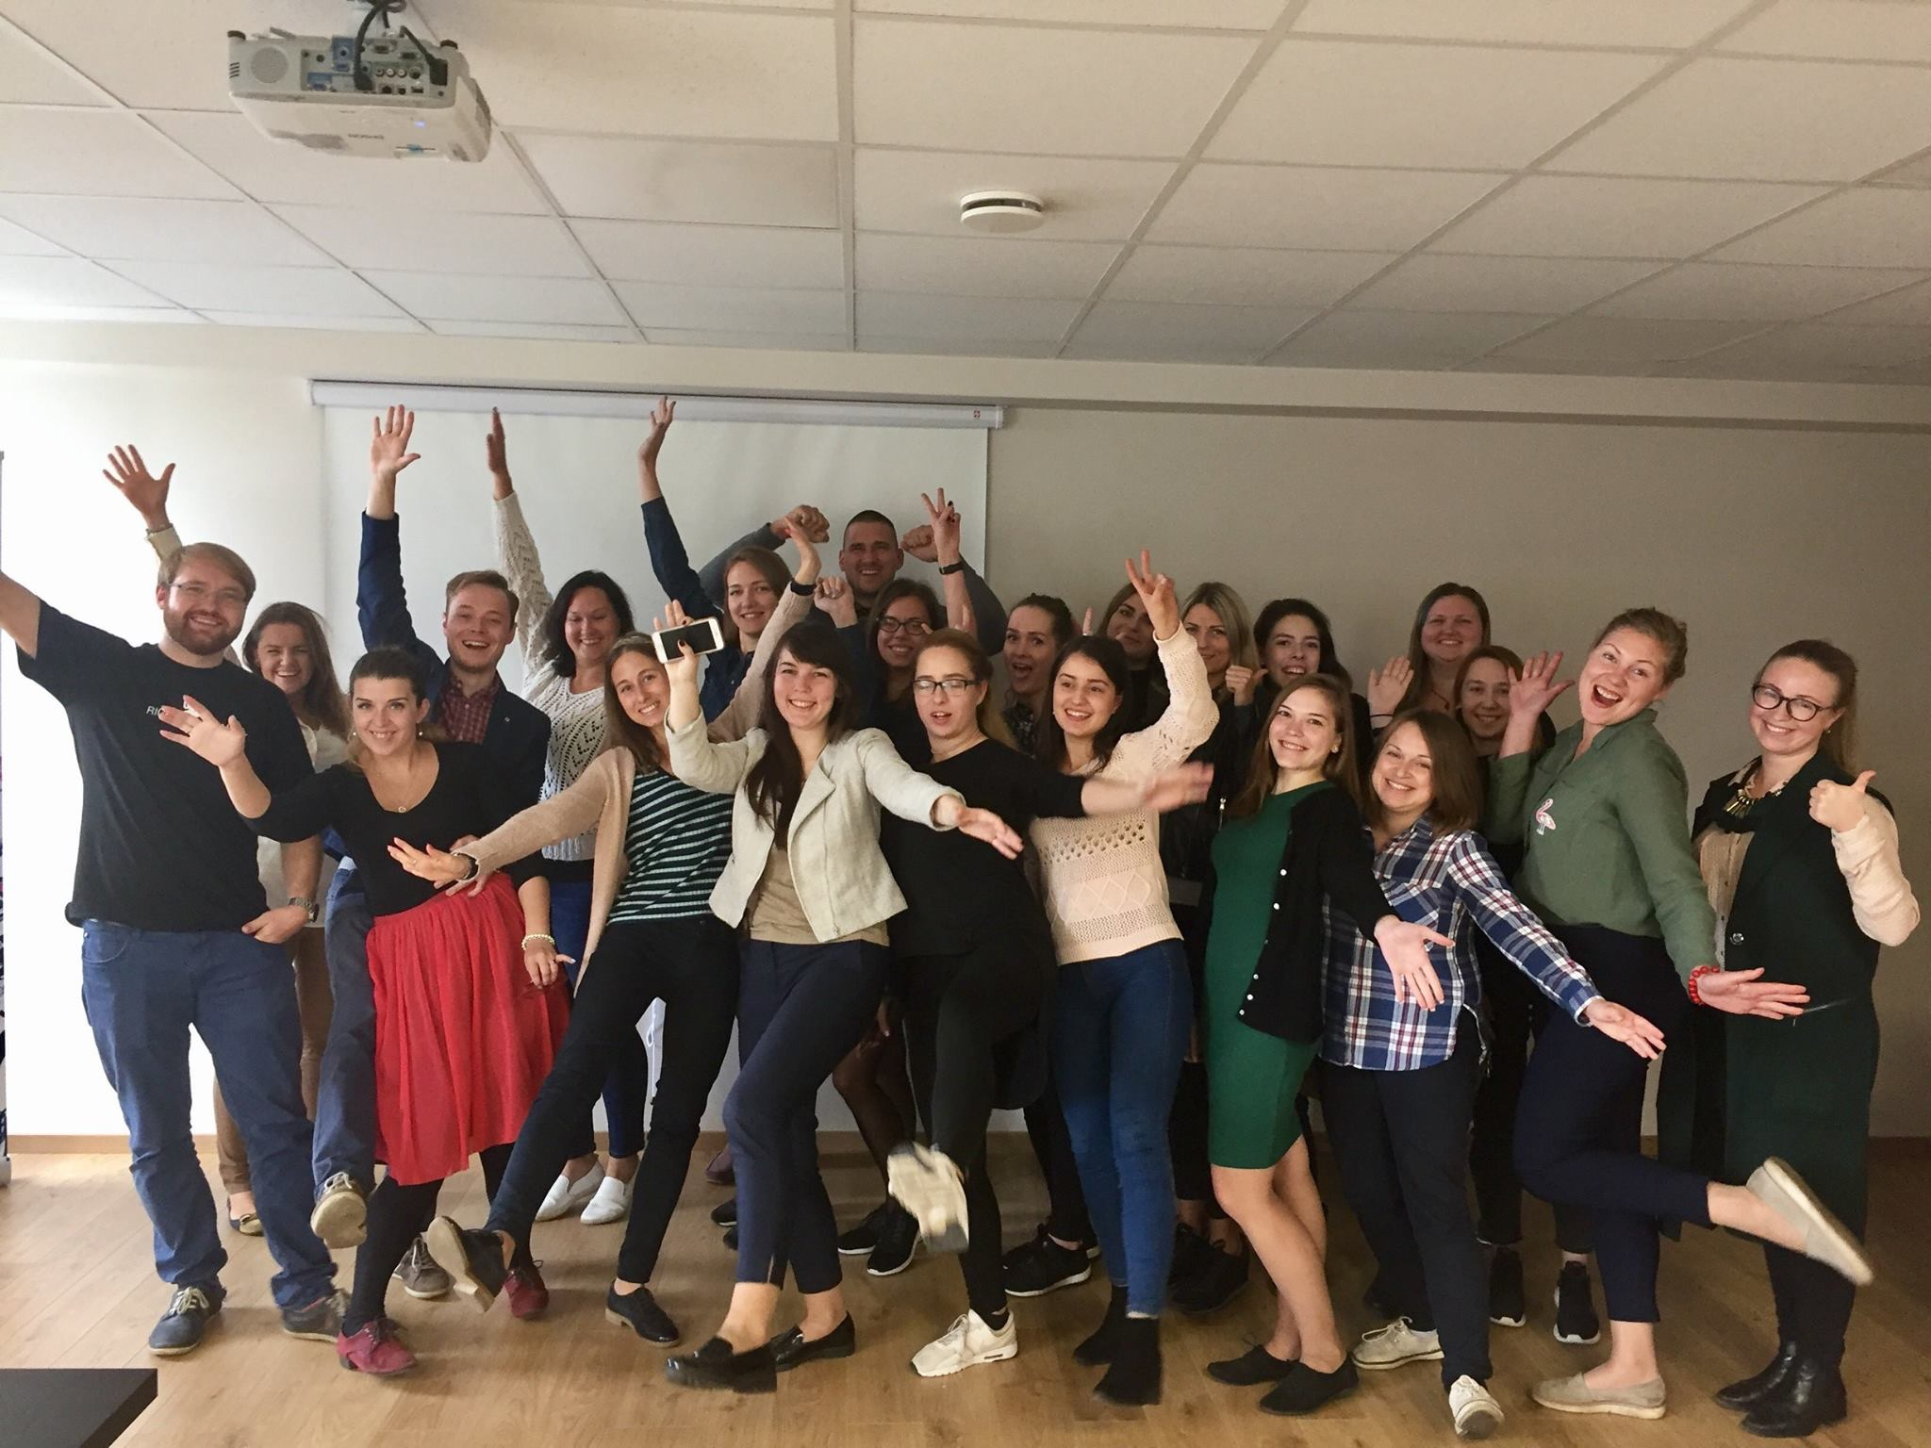
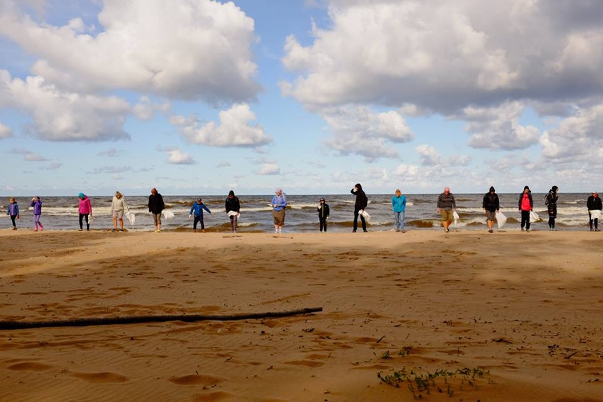
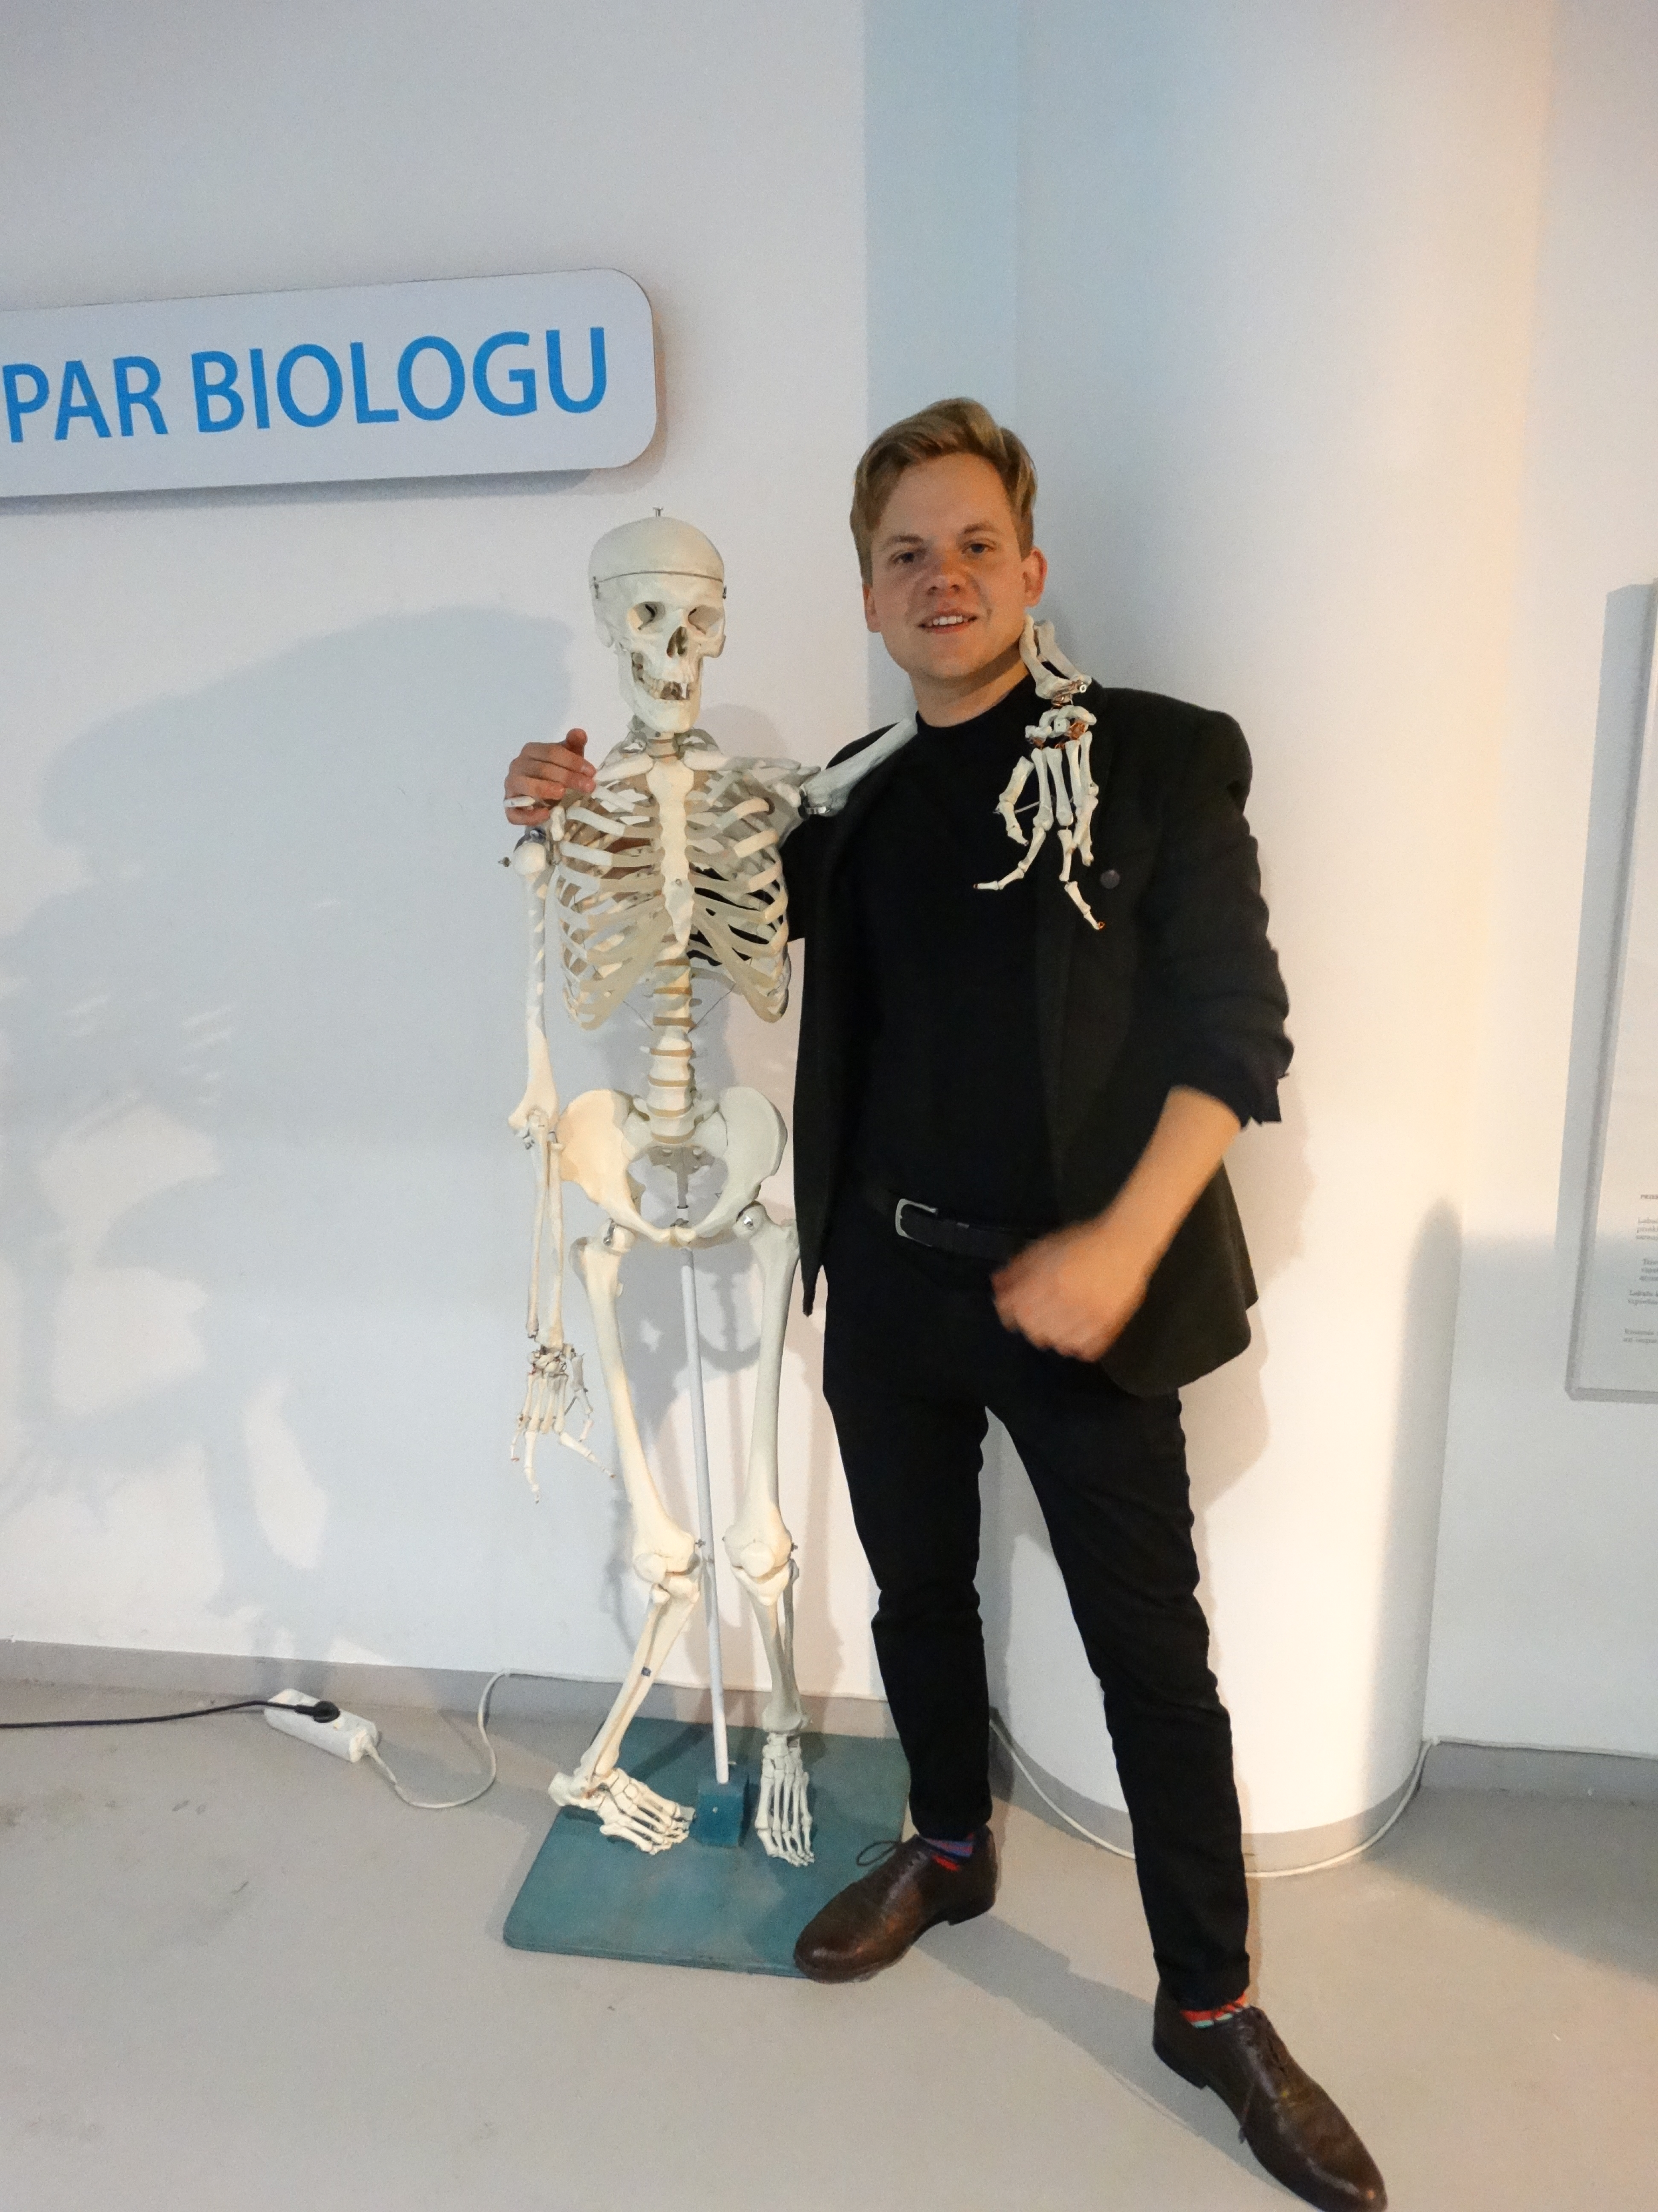
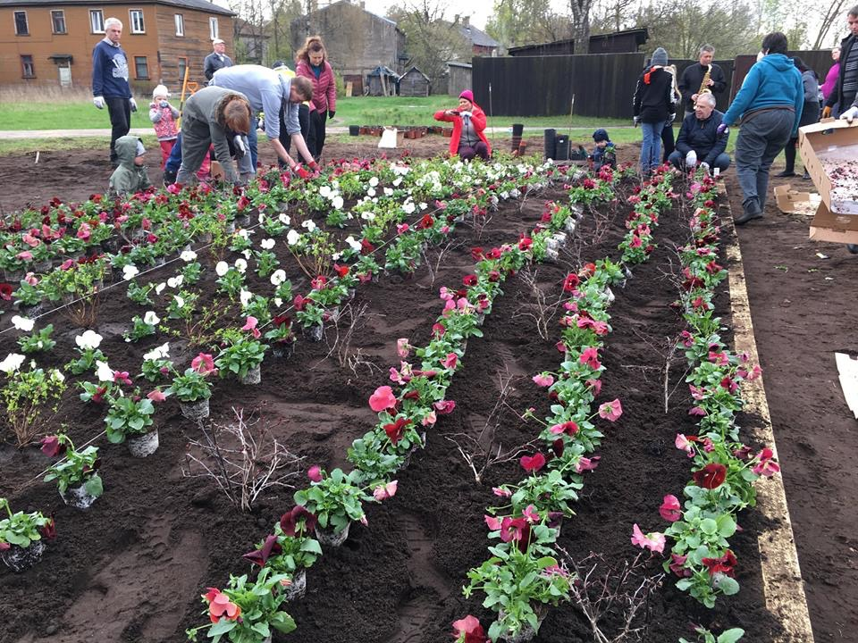
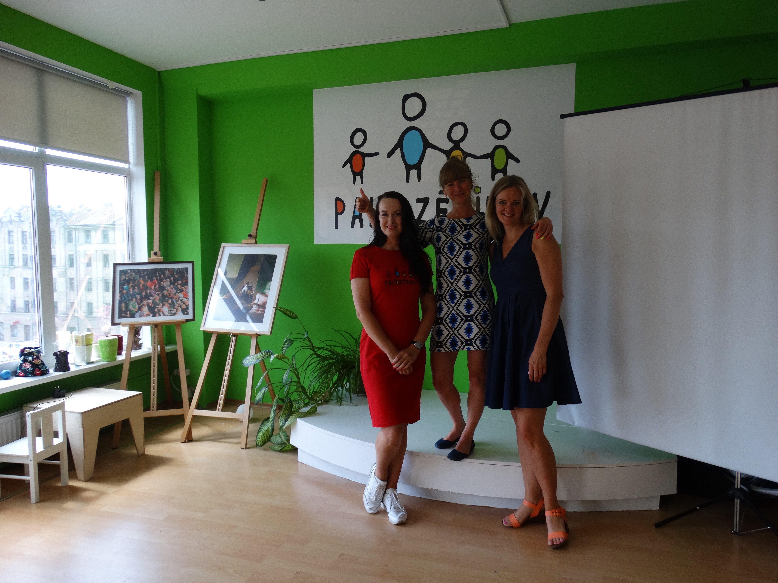
Annex - cases

Slide 10
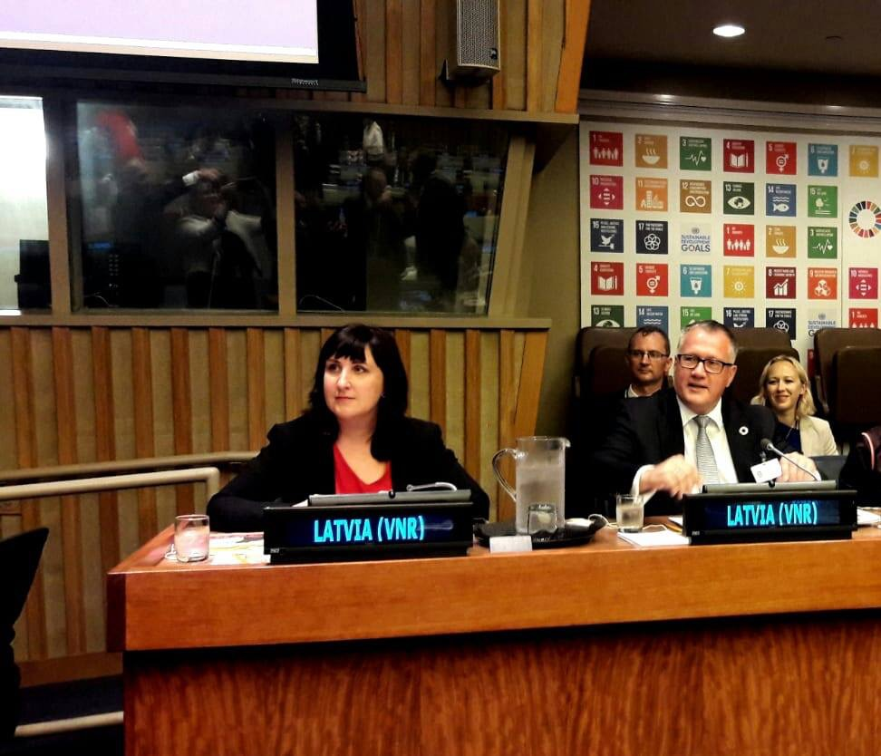
HLPF - hand in hand
Co-presentation in the panel discussion
Side-events - NGO and governmental
Very low representation of real national level NGOs
Huge learning about the process and about content

Slide 11
And now what?
Follow up event - more than 50 people applied, 14 (!) speakers
Questionnaire - in favor about the multistakeholder coalition
New National Development Plan is drafted
Many opportunities. Except resources
Solution - focusing - statistics
Awareness raising - constant mainstreaming

Slide 12
SDG1
High inequality
Poverty risk groups
Linked with all SDGs
Cases – FB page, palidzesim.lv, family support

Slide 13
SDG3
Health insurance reform
Healthy towns/municipalities
Reproductive health – political issue
Prevention, education, men’s health
Lack of family doctors in regions
Cases – Veloronis, Marta center, Linda Zvaune

