Slide 1
Unistream in Slovakia
After School Club as a Tool of Social Inclusion

Slide 2
Pontis means a bridge in Latin. We link people, companies, NGOs and countries to make a positive impact in transparency, education and social inclusion.
Lenka Surotchak
Director of the Pontis Foundation

Slide 3
Social Inclusion Team
Administration of Endowment Funds and company and individual philatrohpy in supporting the integration of children and people with health or social disadvantages.

Slide 4
Pilot in Slovakia 2019

Slide 5
Unistream model
After School Clubs for children from socially deprived enviroments
Vision of Unistream: close socio-economic gaps by forging the next generation of socially conscious leaders and entrepreneurs.
By introducing participants to the world of business development, we provide them with tangible skills, enabling them to become self-sufficient, contributing members of society.

Slide 6
Micro-start-up: collaborative problem solving, social enterpreneurship
Linking companies and experts
Program decreases social
inequalities in Izrael
since 2001
Regional partners:
local administration,
schools,
NGOs and
community centres
An after school club
(25p for 3y)

Slide 7
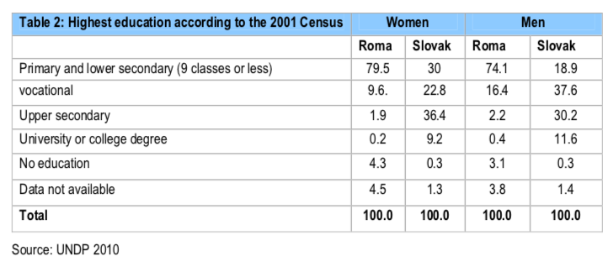
Unistream in Slovakia
Program gives a chance to those who fall through
the formal education system
Slovakia has major problems with educating children from poorer or second language background, especially Roma (OECD 2017, UNDP 2010)

Slide 8
University attendance –
(25% higher among alumni in
Unistream IZ|
Linking companies (15 – 20 donors, mentors) and 3 universities
Impact
300 Roma with
High Schools Leaving Certification annually
(CVEK)
20 Unistream alumni
by 2022

Slide 9
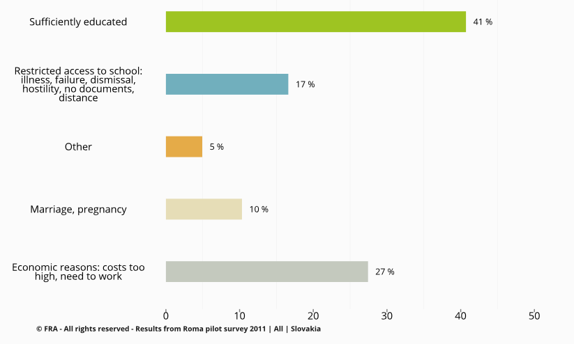
Challenges
Inclusion of Roma girls (FRA 2011: reasons for leaving school)

Slide 10
Thank you
daniela.kellerova@nadaciapontis.sk

