Slide 1




Tackling Inequality Through
Entrepreneurship

Slide 2
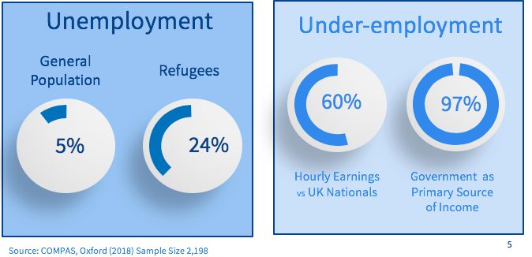
UK REFUGEE POPULATION

Slide 3
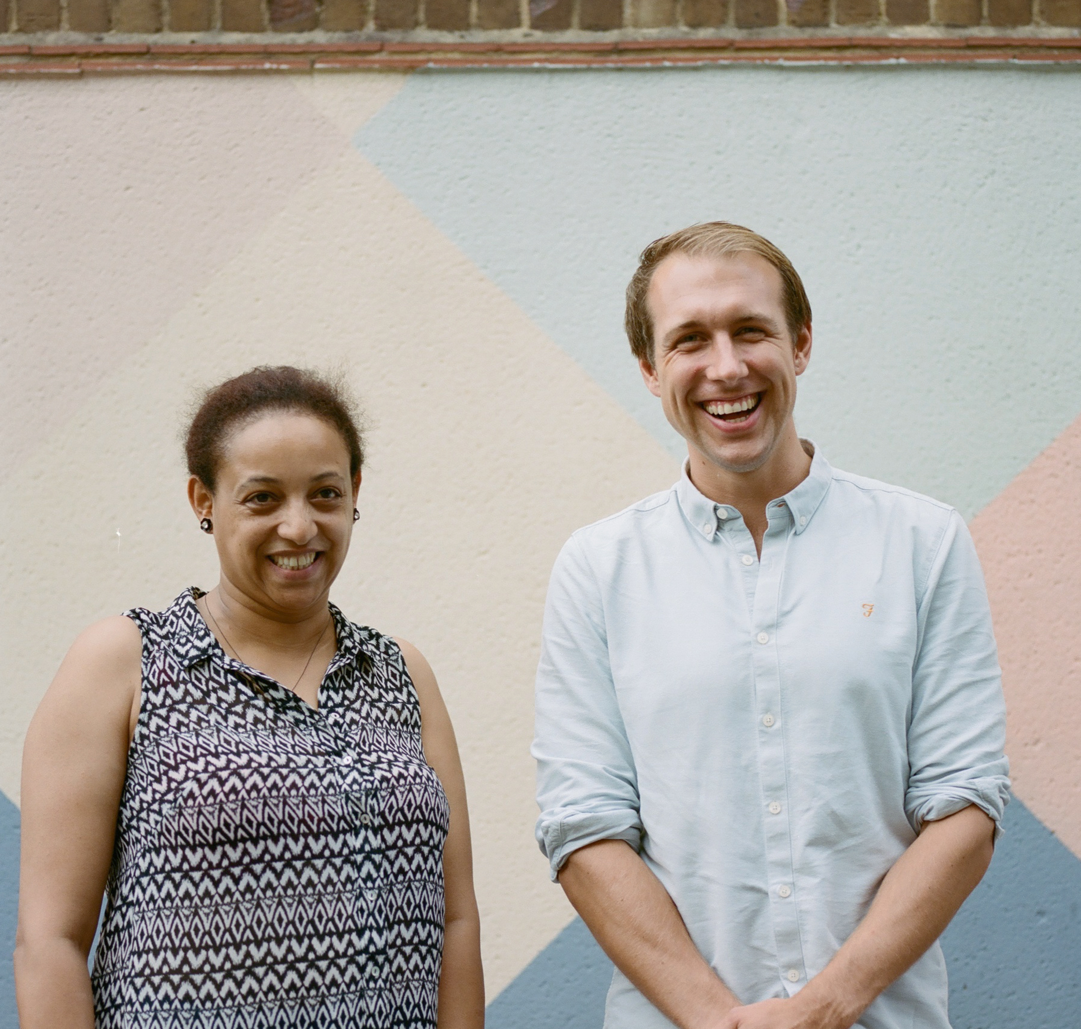
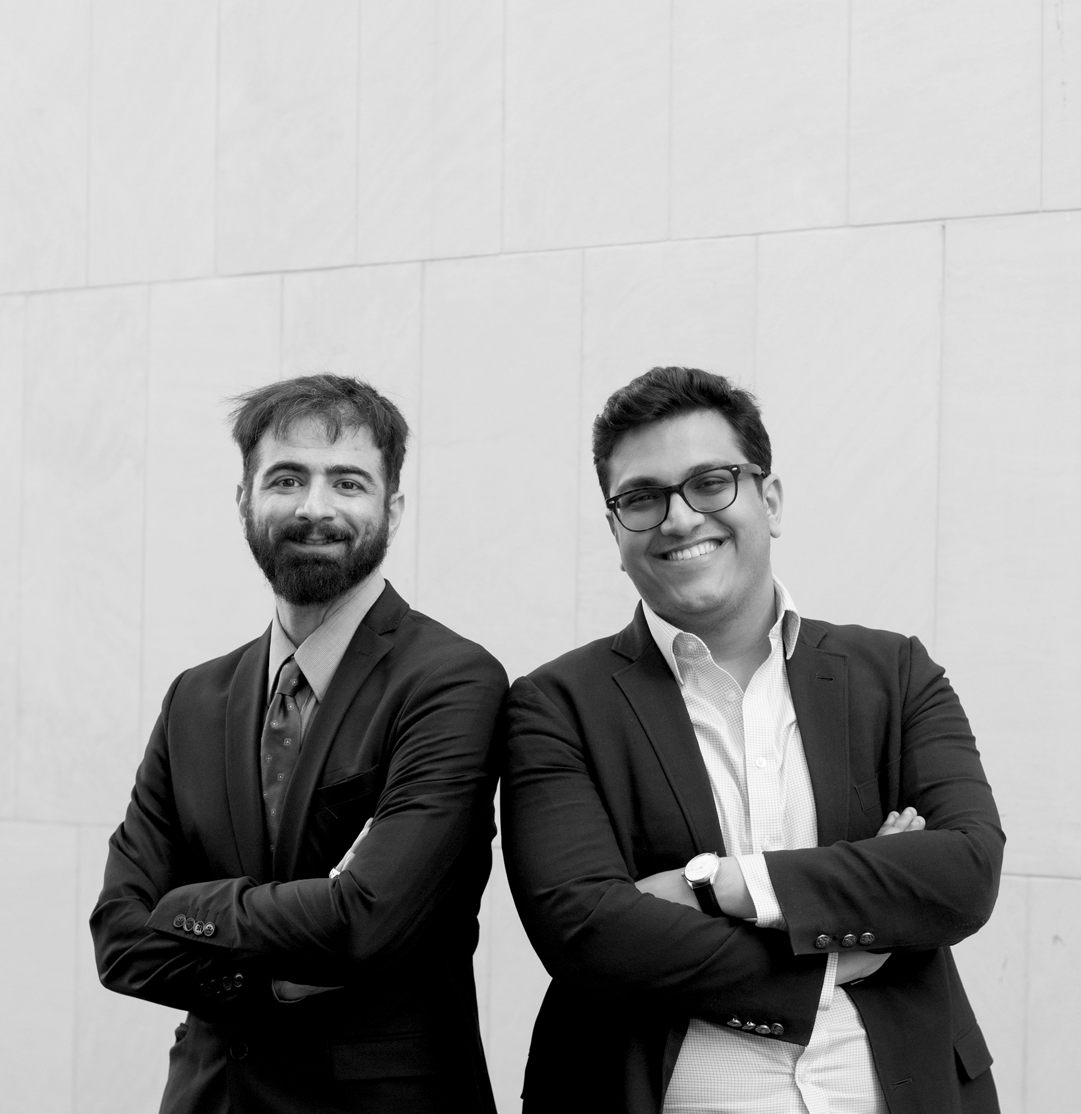


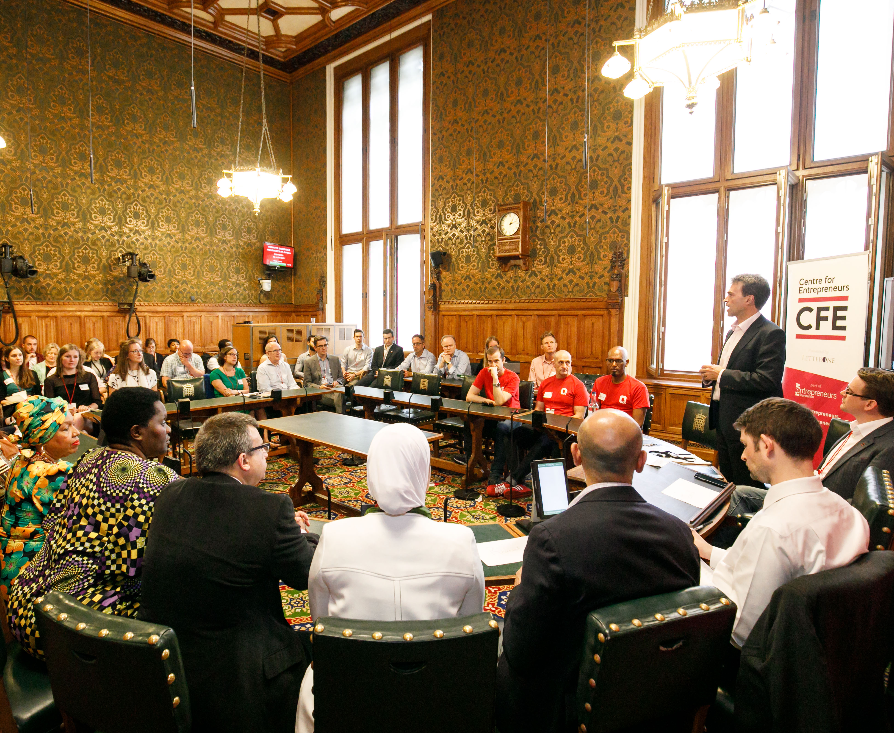

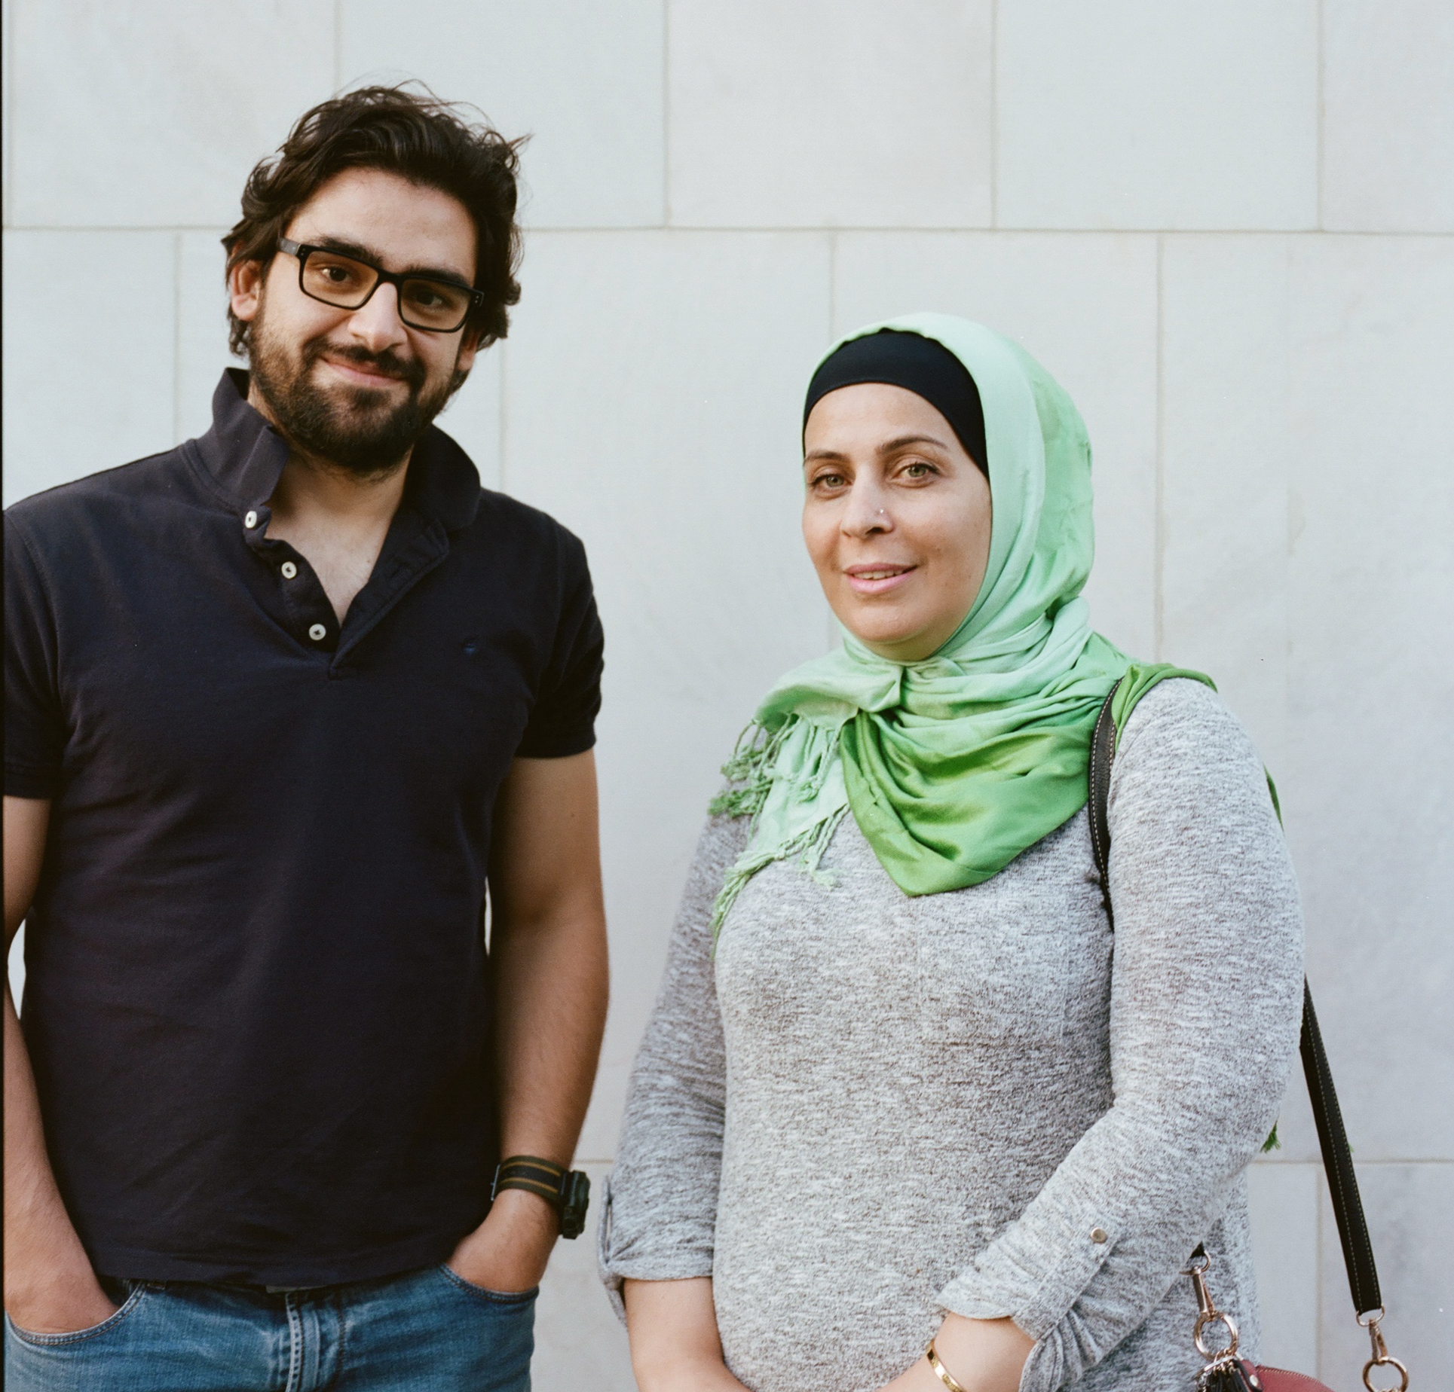
OUR COMMUNITY: 105 entrepreneurs

Slide 4
COMMUNITY OVERVIEW
2-5 years
42%
up to 19
AVERAGE LENGTH OF TIME IN THE UK
25-50 years
AVERAGE UNEMPLOYMENT RATE AT APPLICATION
3:1
NUMBER OF ORIGIN COUNTRIES REPRESENTED IN PROGRAMME
AVERAGE AGE
MALE-FEMALE RATIO

Slide 5

Our Mission
  To enable refugees to thrive through the power of their own ideas.
Our Goal
TERN will enable 1,000 refugees to launch businesses by 2025.

Slide 6



TERN’S ENTREPRENEURSHIP SUPPORT SERVICES
1
INTRODUCE
2
LAUNCH
3
IGNITE

Slide 7
IMPACT AT A GLANCE: LAUNCH PROGRAMME 2018
11
ENTREPRENEURS
320
HOURS OF SUPPORT
+26%
BUSINESS SKILLS SCORE
+8%
COMMUNITY INTEGRATION
+18% CONFIDENCE SCORE

Slide 8


BUSINESS CAPITAL

Slide 9





REVENUE
IDEA REFINEMENT
BUSINESS CAPITAL
NETWORKS
FINANCIAL
STRATEGY
CUSTOMER ENGAGEMENT

Slide 10

BUSINESS
CAPITAL

Slide 11





PERSONAL
CAPITAL
BUSINESS
CAPITAL

Slide 12






BUILDING SUSTAINABLE PARTNERSHIPS
Refugee-focused
Nonprofits

Slide 13


BUILDING SUSTAINABLE PARTNERSHIPS
Refugee-focused
Nonprofits
Social Finance
Providers
TERN’s dedicated
loan partner
Affiliate of

Slide 14


BUILDING SUSTAINABLE PARTNERSHIPS
Refugee-focused
Nonprofits
Social Finance
Providers
Private Sector
TERN’s dedicated
loan partner
Affiliate of

Slide 15


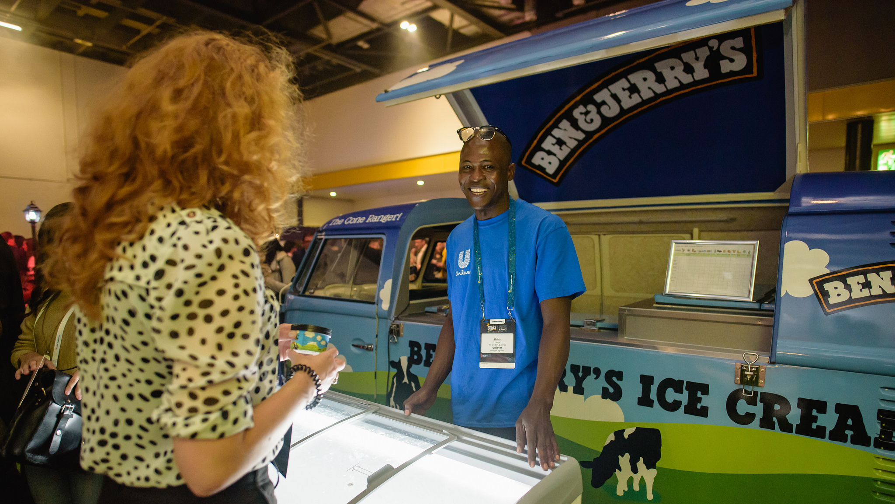

SALES TRAINING &
SUMMER JOB
ENTREPRENEURSHIP TRAINING
+

Slide 16
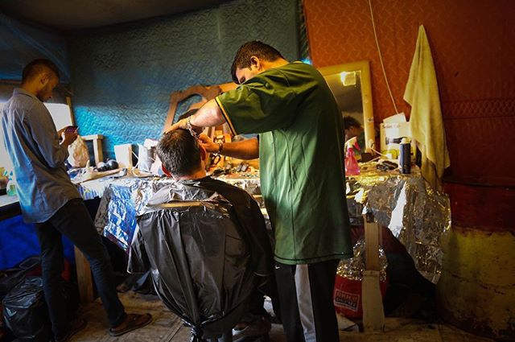
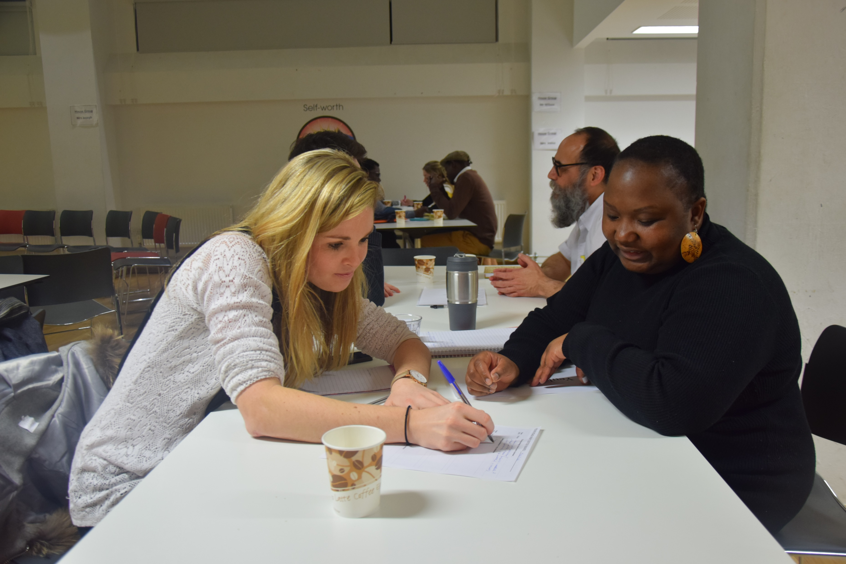


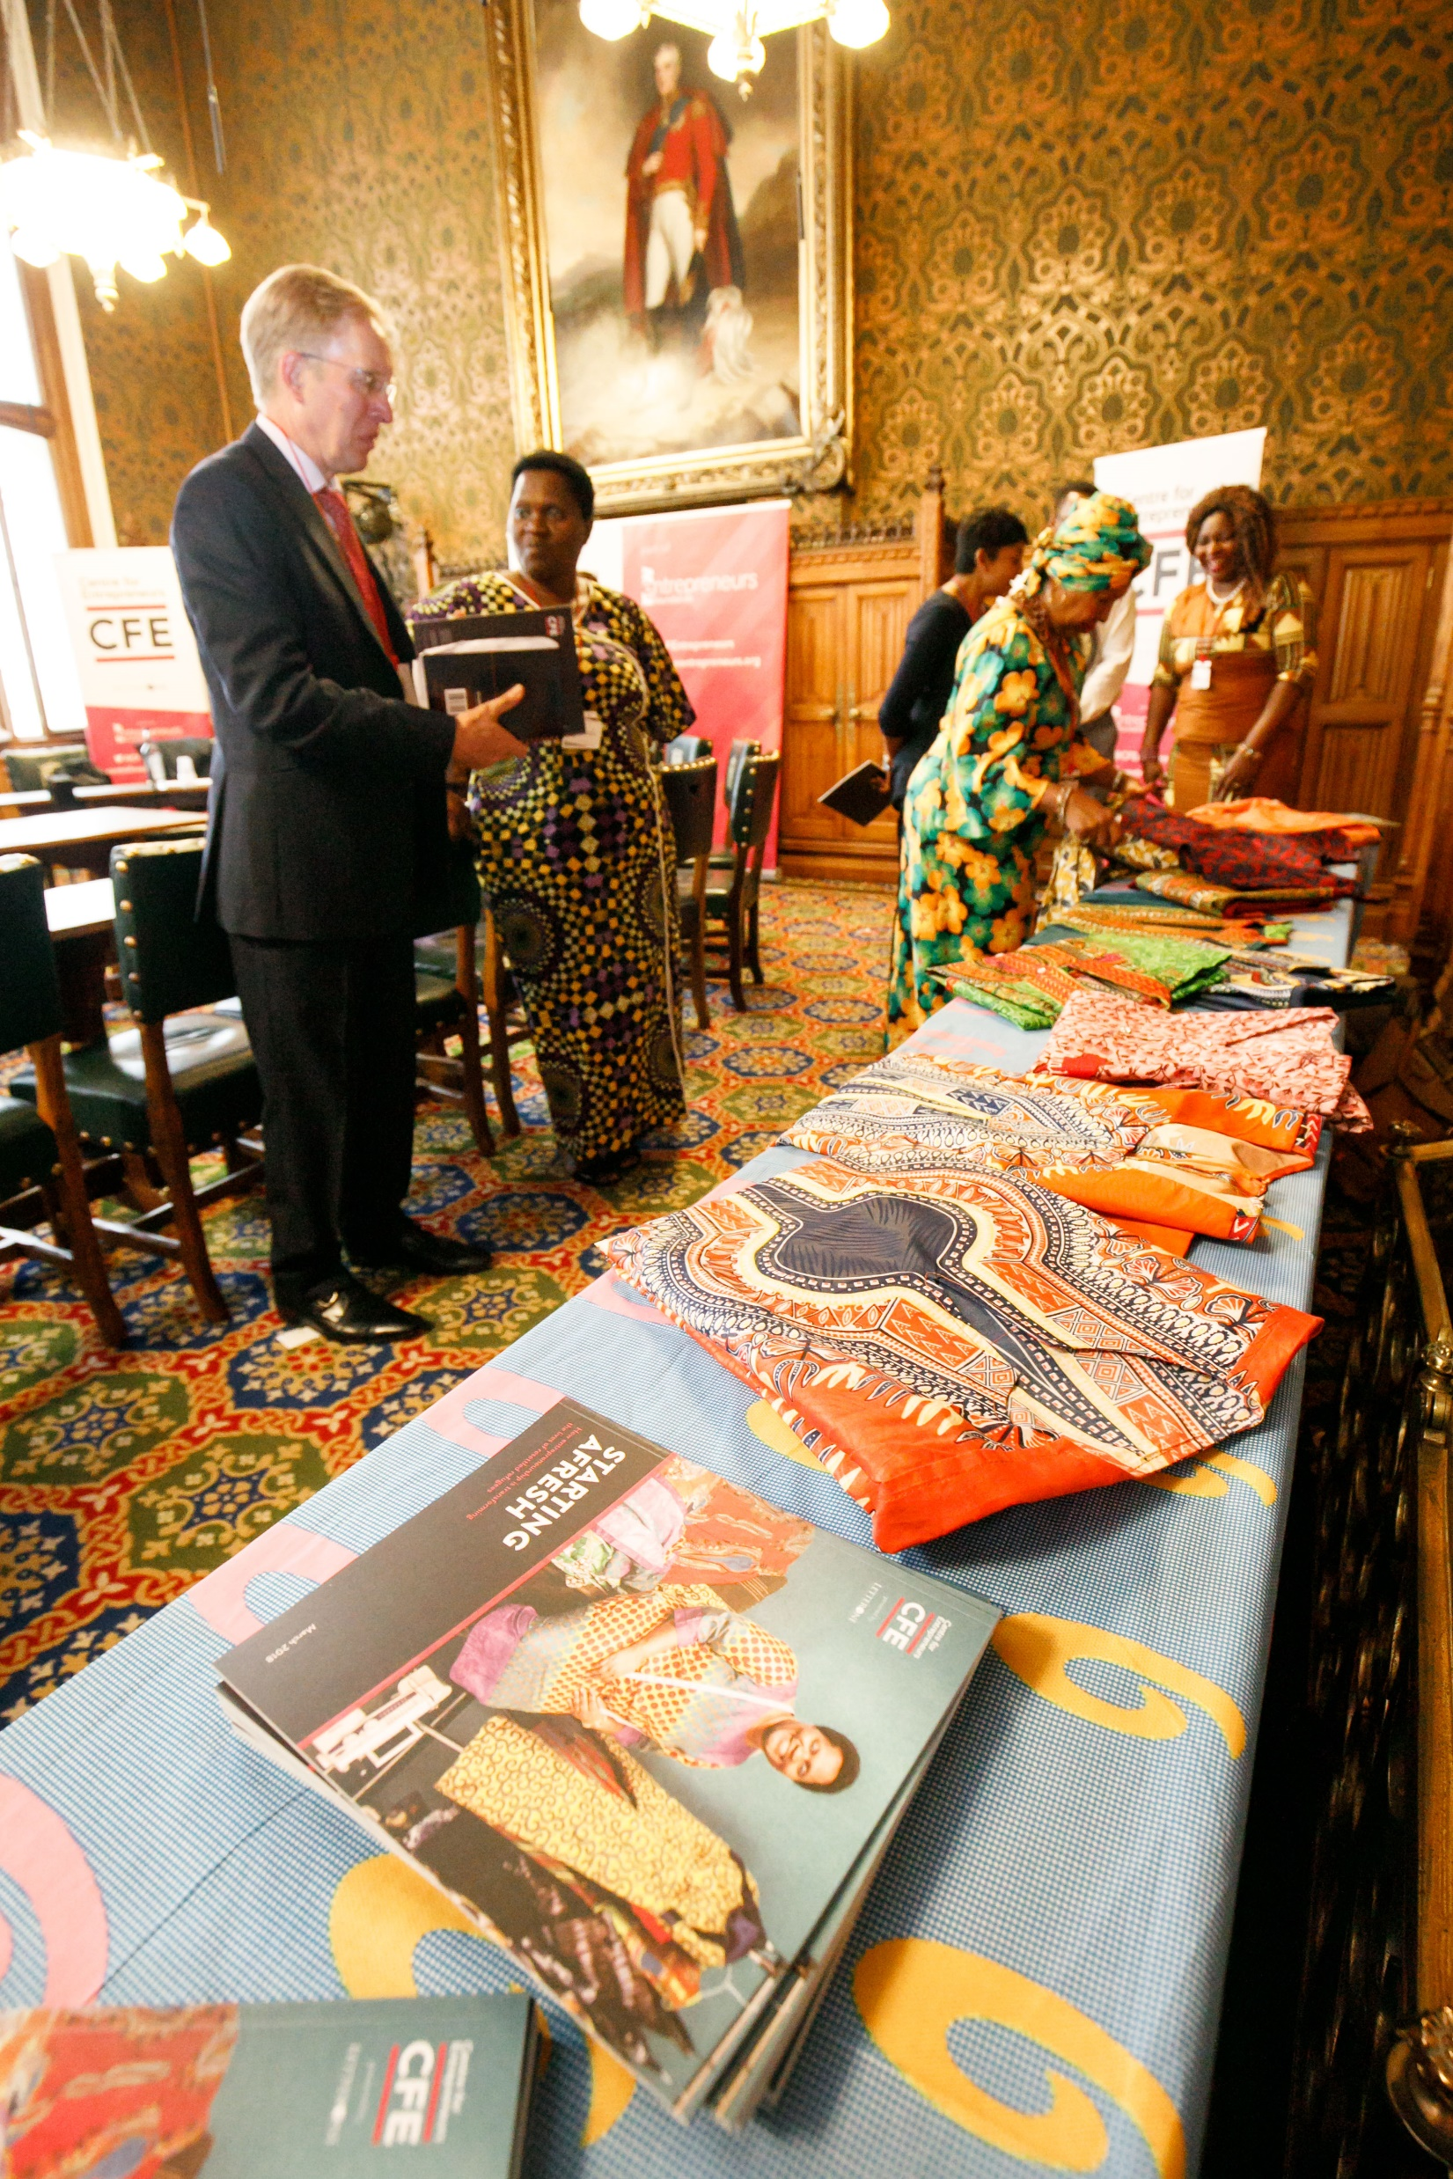
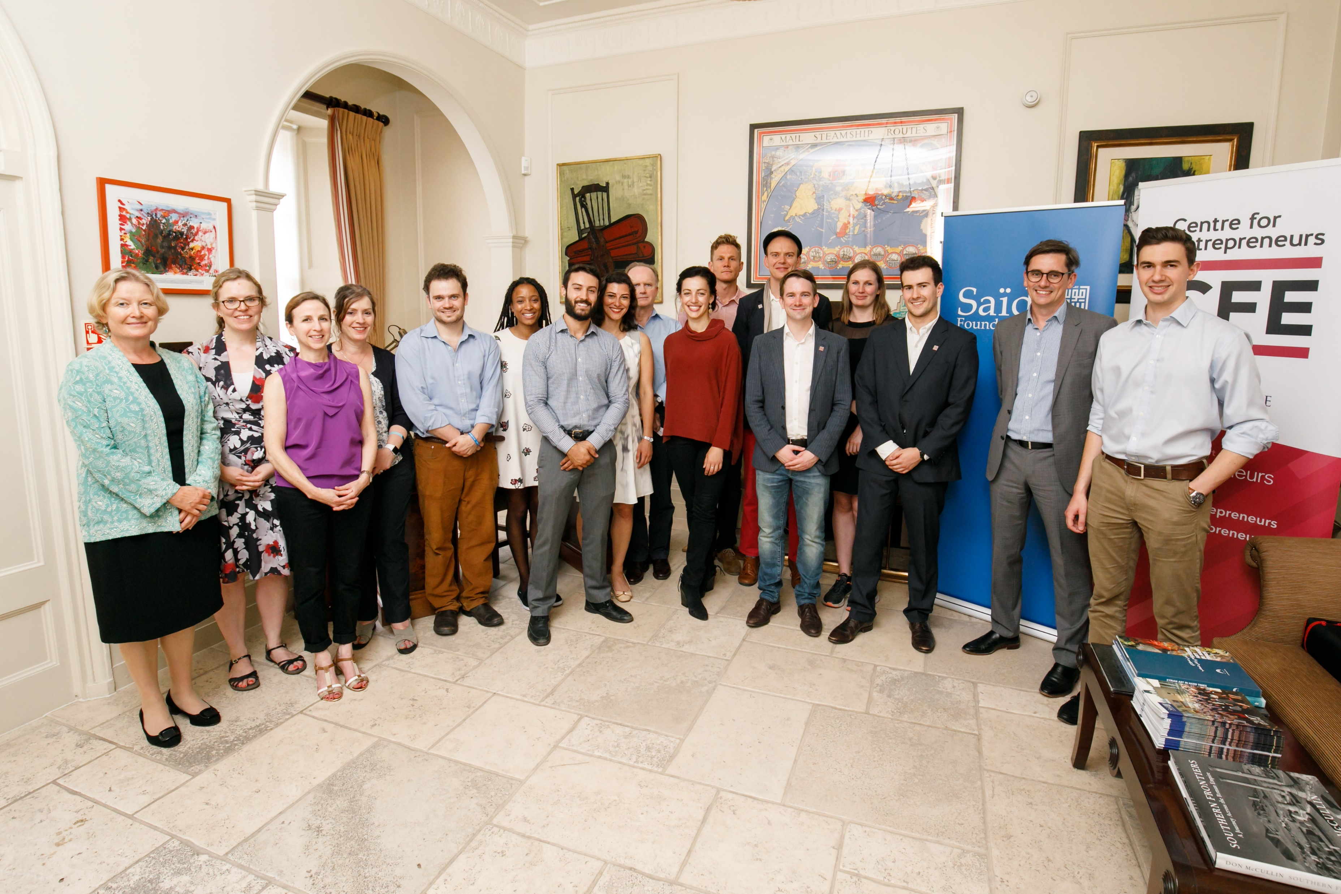
Refugee Entrepreneurship as an OUTCOME and PATHWAY

