Slide 1


Slide 2
AGENDA
16:00/16:10 - Introduction
Germana Girelli
Project Manager Assistant for Materahub Consortium of Creative and Cultural Industries
16:10/16:30 - The Capital of Women
Chiara Prascina, Catia Caponero
Founders of Collettivo Donne Matera
16:30/16:50 - Matera becomes rainbow with RiSvolta
Vanessa Vizziello
President of RiSvolta Association – Matera
16:50/17:00 - Q&A Discussion

Slide 3
Housekeeping
The webinar is being recorded and it will be published on our
You Tube channel afterwords
Please use #sociSDG for social media
Your voice will be automatically muted upon joining the webinar
To ask question or engage in discussion please use the chat window
If you have any comments, please write us at sociSDGs@gmail.com

Slide 4
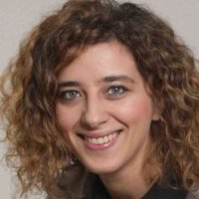

Introduction to the topic
Germana Girelli
Project Manager Assistant for Materahub Consortium of Creative and Cultural Industries

Slide 5

THE SUSTAINABLE DEVELOPMENT GOALS

Slide 6


Goal 5: Achieve Gender Equality
and empower all women and girls

Slide 7
SDG 5: GENDER EQUALITY
Gender equality is not only a fundamental human right, but a necessary foundation for a peaceful, prosperous and sustainable world.
Providing women and girls with equal access to education, health care, decent work, and representation in political and economic decision-making processes will fuel sustainable economies and benefit societies and humanity at large.
Implementing new legal frameworks regarding female equality in the workplace and the eradication of harmful practices targeted at women is crucial to ending the gender-based discrimination prevalent in many countries around the world.

Slide 8
The main objectives of SDG5 are:
End all forms of discrimination against all women and girls everywhere.
Eliminate all forms of violence against all women and girls in the public and private spheres, including tracking and sexual and other types of exploitation.
Eliminate all harmful practices, such as child, early and forced marriage and female genital mutilation.
Recognise and value unpaid care and domestic work through the provision of public services, infrastructure and social protection policies and the promotion of shared responsibility within the household and the family as nationally appropriate.
Ensure women’s full and effective participation and equal opportunities for leadership at all levels of decision-making in political, economic and public life.

Slide 9
The main objectives of SDG5 are:
Ensure universal access to sexual and reproductive health and reproductive rights as agreed in accordance with the Programme of Action of the International Conference on Population and Development and the Beijing Platform for Action and the outcome documents of their review conferences.
Undertake reforms to give women equal rights to economic resources, as well as access to ownership and control over land and other forms of property, financial services, inheritance and natural resources, in accordance with national laws.
Enhance the use of enabling technology, in particular information and communications technology, to promote the empowerment of women.
Adopt and strengthen sound policies and enforceable legislation for the promotion of gender equality and the empowerment of all women and girls at all levels.
Link - http://www.un.org/sustainabledevelopment/gender-equality/

Slide 10
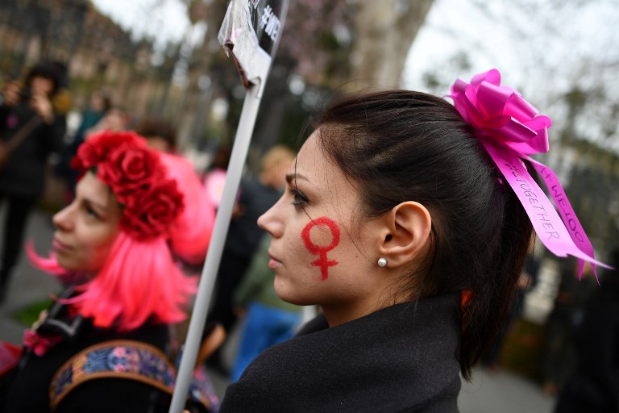
12 Statistics that show the state of Gender Equality in Italy

Slide 11
SOME DATA
ITALY is on the 14° position between the 28 Eu members
Italy's pay gap is a little over 5%
Fewer than half of working-age Italian women are in employment
Around 62% of Italian women's work each day is unpaid compared to 30 percent for Italian men
14% of women are graduated compared to 12% of men
Just 31% of Italy's last parliament was female
Women made up a measly 16% of decision-making bodies in 2017
In 2017, 121 women in Italy were murdered, according to police figures
Police handled 4,261 cases of sexual violence last year, of which 54% took place on the street or in cars
Some 3.5 million women in Italy have been victims of stalking at least once between the ages of 16 and 70
Almost half of Italy's adult women have experienced some form of sexual harassment
Women are more likely to read, go to the theatre, visit a museum or gallery, or create online content, according to Istat. For instance, in 2016, 47% of girls and women over the age of 6 said they had a read a book in the past 12 months; for boys and men, the figure was 34 percent
Women in Italy have an average life expectancy of 84.9 years while men are expected to live to 80.6

Slide 12
Resources
http://www.oecd.org/gender/data/?fbclid=IwAR2IxcZ_4zQls6t8Z7d7C9a9R9cZHMPNhAGVhaHUTKZyXyUaW4hh2EaWji0
https://www.internationalwomensday.com/Theme
https://www.un.org/sustainabledevelopment/sustainable-development-goals/

Slide 13
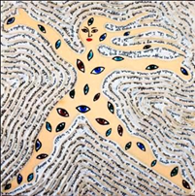
The Capital of women
Catia Caponero
Founders of Collettivo Donne Matera

Slide 14
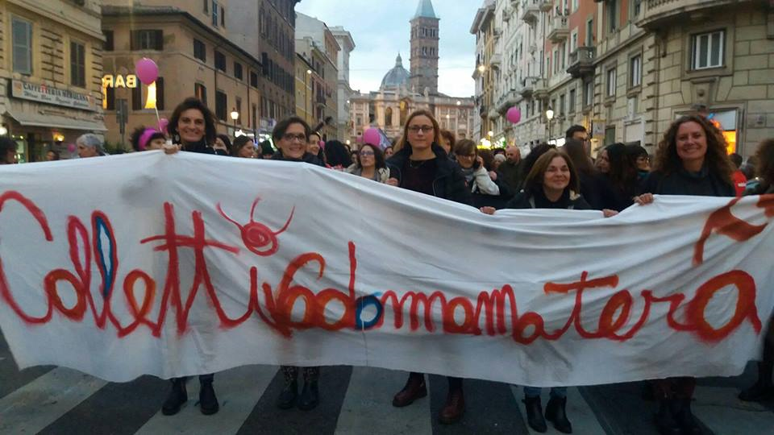
The CollettivoDonneMatera was founded in Matera in 2013

Slide 15
The aim of the association is:
promote women's self-determination and the possibility of making choices independently by increasing the capacity to protect oneself against physical and psychological violence
through:
the knowledge of the phenomenon of gender violence in our territory
the dissemination of adequate information
the promotion of a culture and practices to combat gender violence

Slide 16
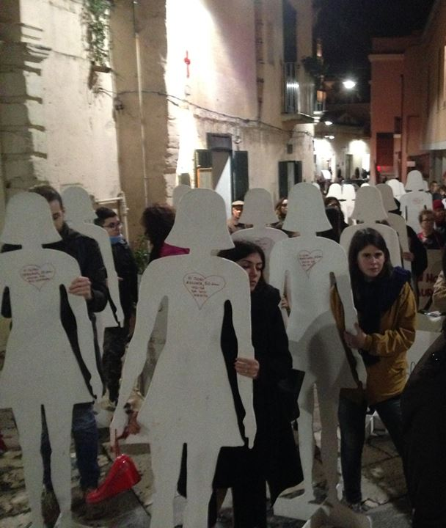
How we move
Actions to report and investigate the characteristics of the phenomenon:
From 2013 annual organization of November 25, international day against violence against women
Since 2014, interventions in schools through the promotion of assemblies and training courses with students and professional actors
Promoting a culture of respect through positive practices:
Awareness raising campaigns: from 2015 «We are here» and joining the «Non una di Meno» international campaign

Slide 17

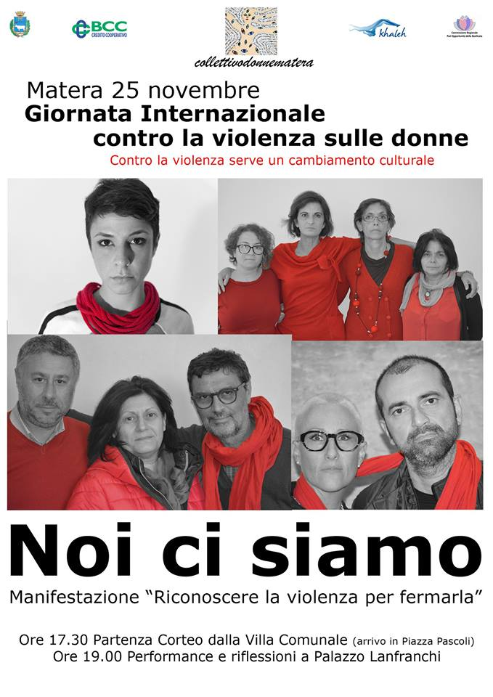

Slide 18
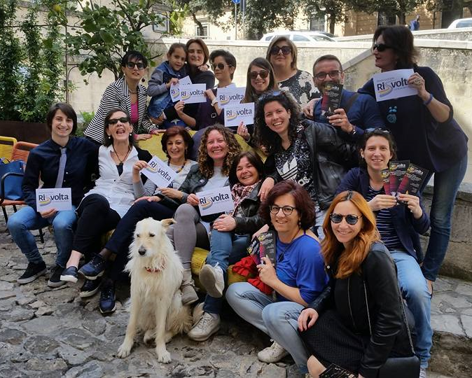
We already look at the violence in general
The Collettivodonnematera over time decided to operate more generally to combat violence in general.
1. Information and awareness campaign on the recognition of LGBT people.
In 2015/2016 film reviews
meetings with authors and book presentations
promotion to the City of Matera of the Register of Civil Unions
promotion of the RiSvolta Association

Slide 19



Slide 20
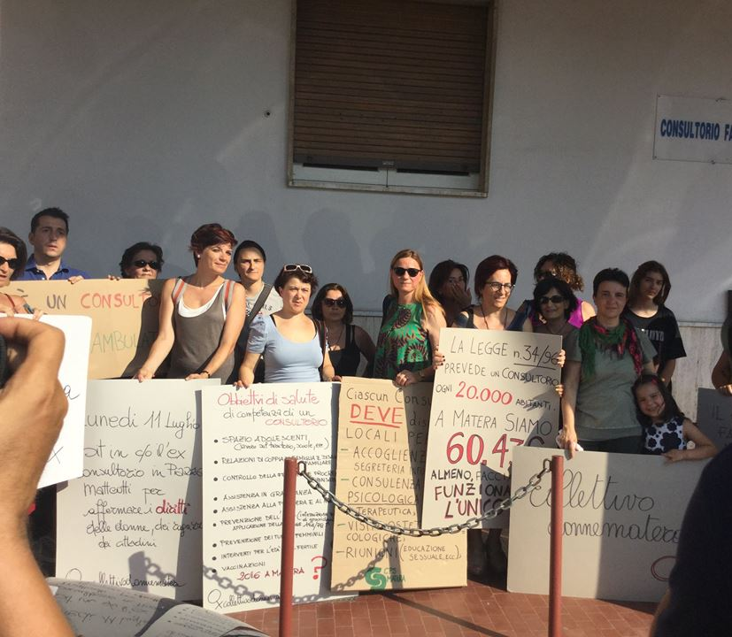
We already look at the violence in general
The Collettivodonnematera over time decided to operate more generally to combat violence in general.
2. Interventions to combat economic and social inequalities
2014/2015, participation in initiatives for a citizenship income, in collaboration with the national BIN network
2016, actions in support of public health more attentive to the needs of women (demonstration against the transfer of the advisory center within the ASL of Matera)

Slide 21
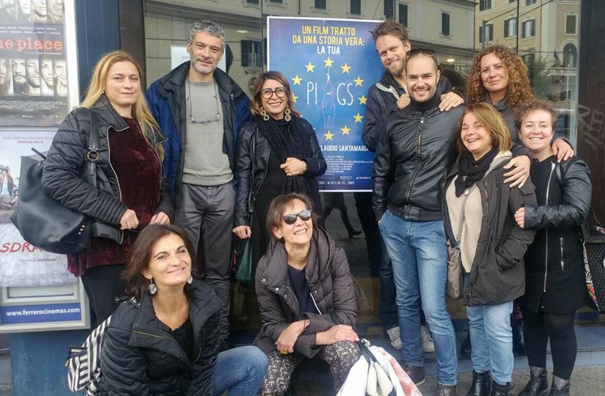
We already look at the violence in general
The Collettivodonnematera over time decided to operate more generally to combat violence in general.
2. Interventions to combat economic and social inequalities.
2017, screening of the PIIGS documentary film and promotion of debates related to a deepening of European economic policies and its monetary treaties.

Slide 22
The year that will be the future…
The Collettivodonnematera intends to keep moving on two floors:
1. Cultural: actions of denunciation on the occasion of International Days against violence against women; organization of an international conference in Matera on gender violence and in general
2. Operational: creation of a Social Consultory in Matera as a positive practice and as an intervention tool in the full realization of the objectives of the Collective

Slide 23
Thank you for your attention!!!
CollettivoDonneMatera

Slide 24
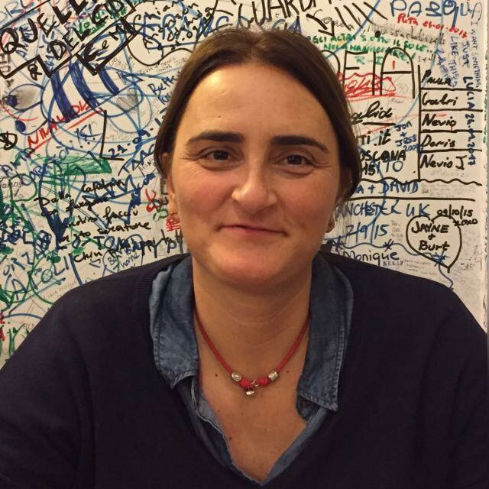

Matera becomes rainbow with RiSvolta
Vanessa Vizziello
President of RiSvolta Association - Matera

Slide 25
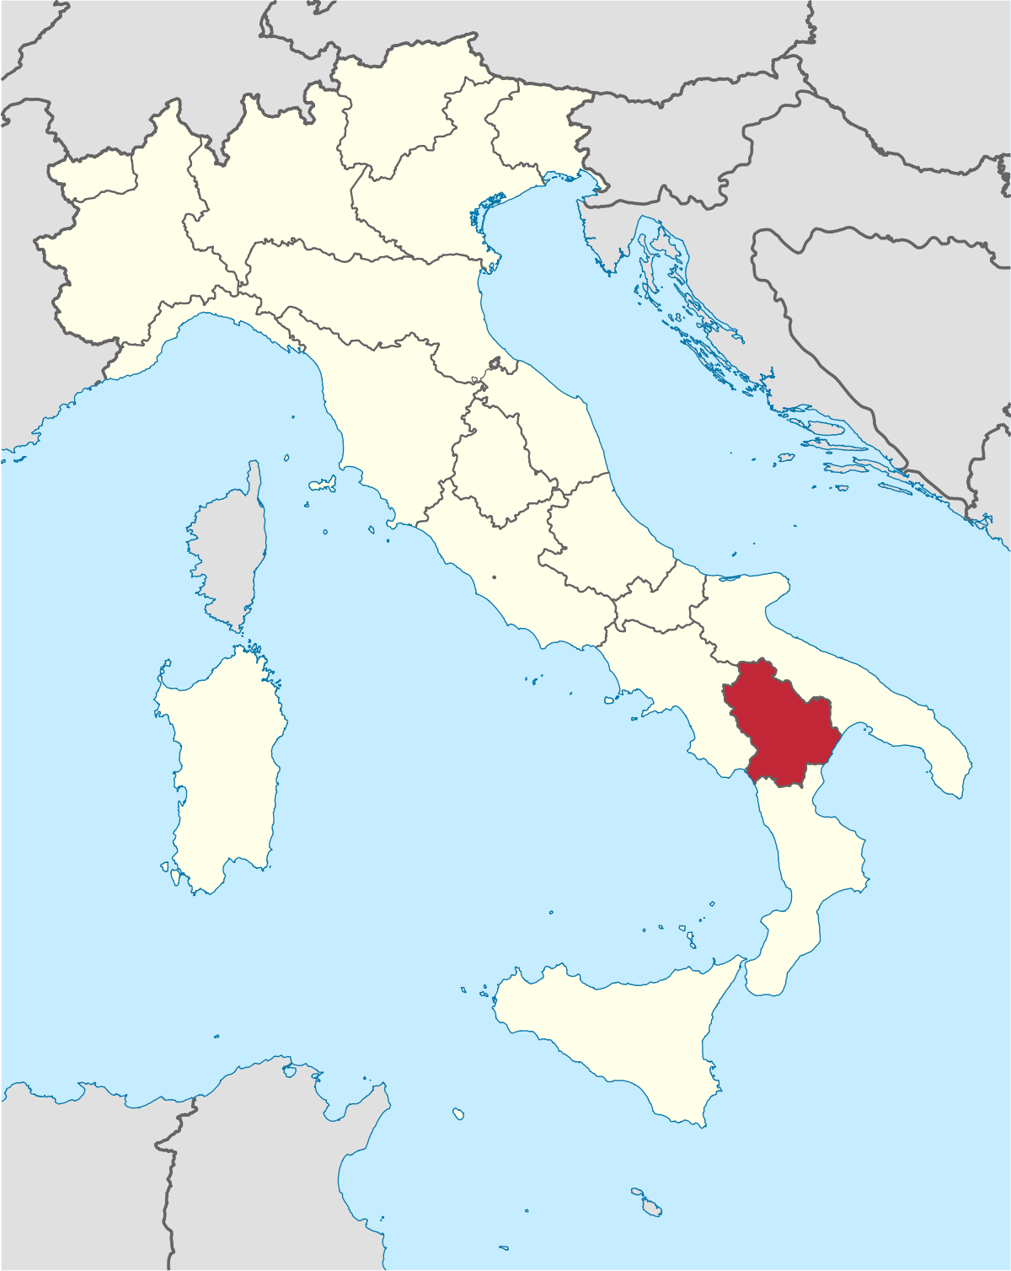

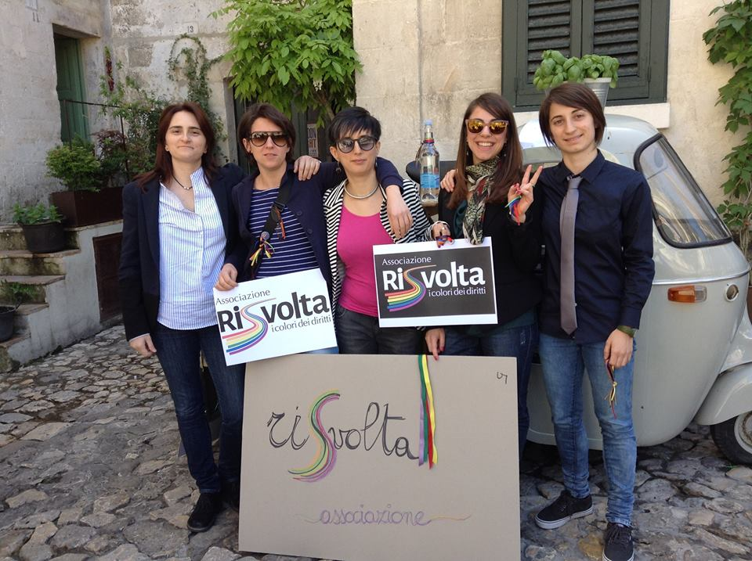

RiSvolta is a LGBT Association
born in Matera, Basilicata
(South of Italy) in 2016.

Slide 26
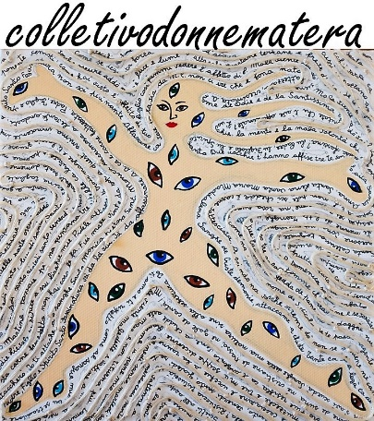
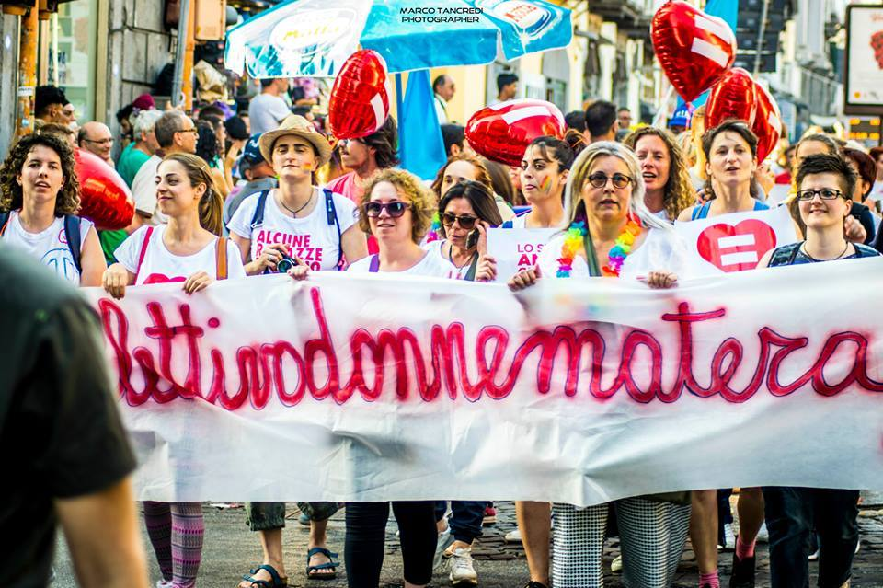
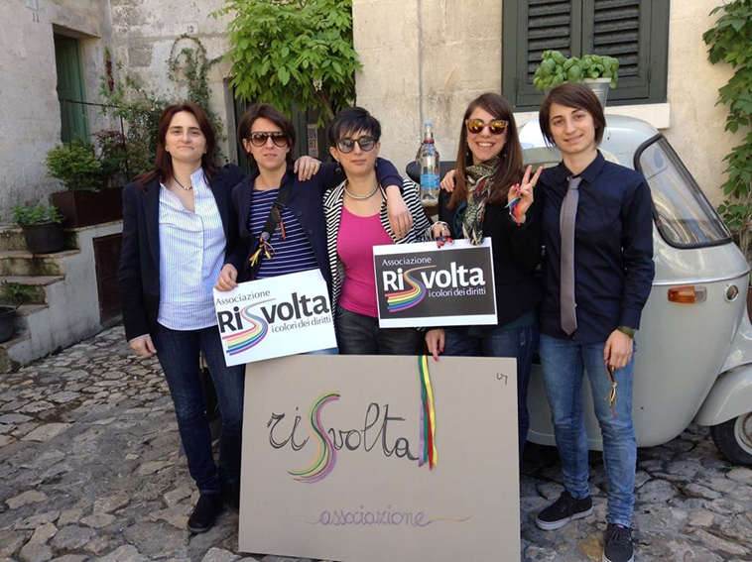
RiSvolta
was created by 5 lesbian girls
that had met in the Collettivodonnematera
We currently count about 100 members

Slide 27
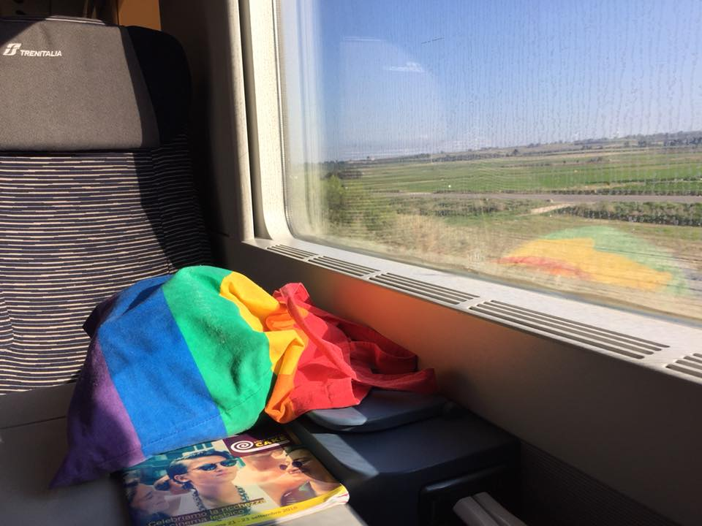
Our MISSION is to educate on this…
« well-being is for everybody,
nobody must be left out»

Slide 28
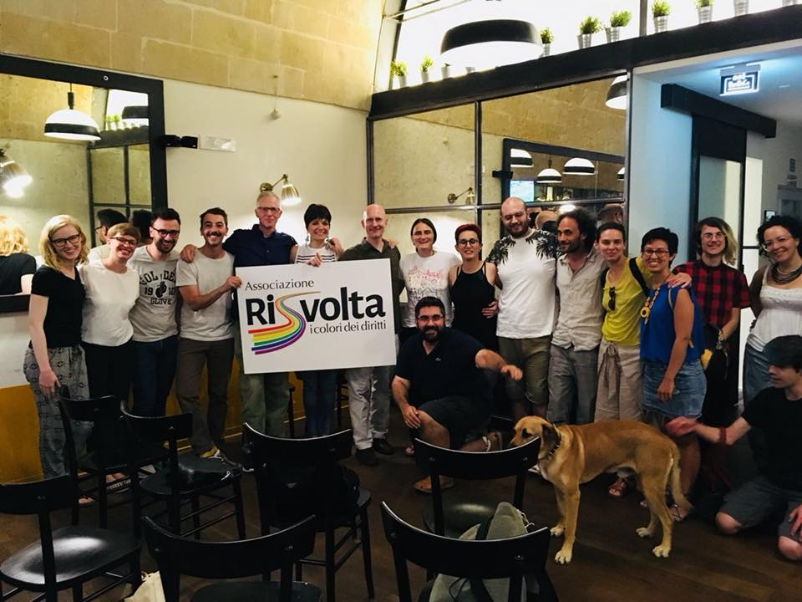
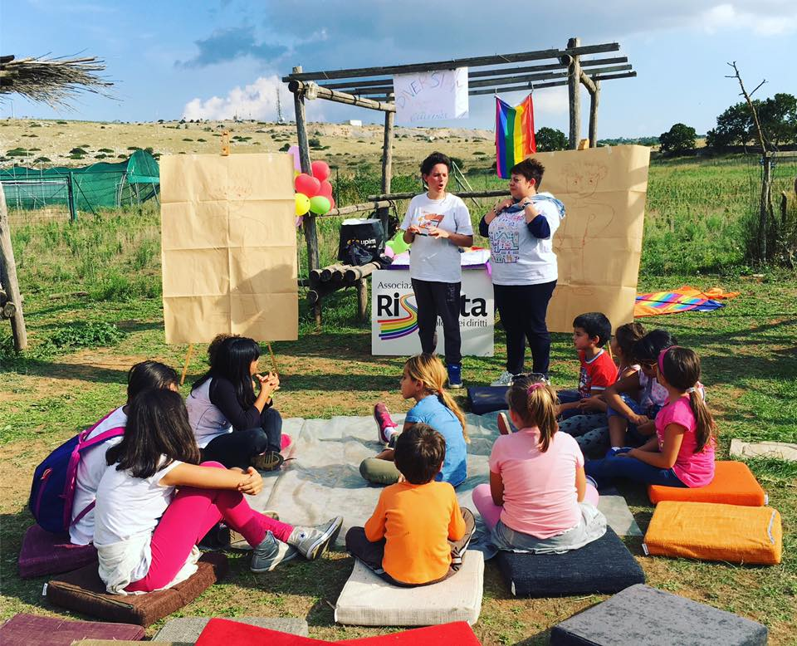

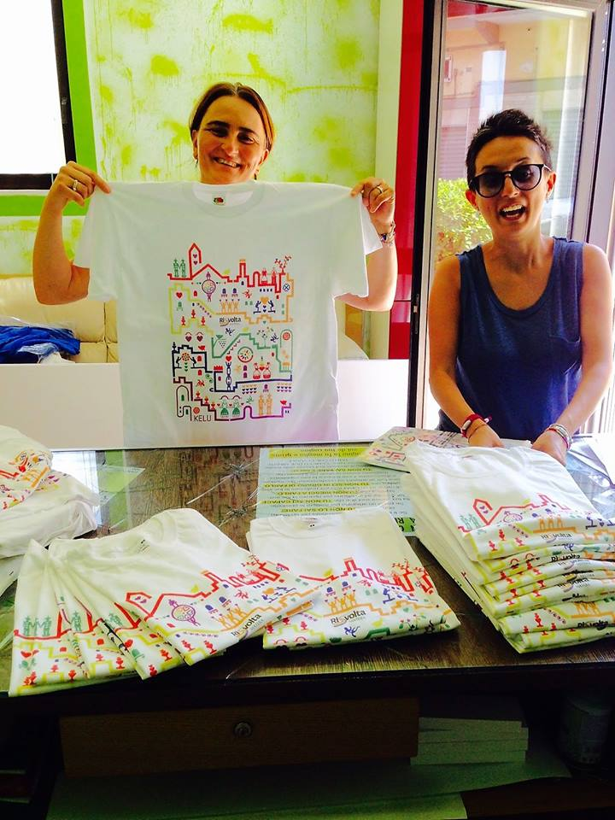
3 ACTIONS
ACTION 1
ACTION 2
ACTION 3
FOR
LOCAL LGBT PEOPLE
FOR
LOCAL CIVIL SOCIETY
FOR
TOURISTS

Slide 29
ACTION 1
LOCAL LGBT PEOPLE
TODAY
GOALS
TOOLS
Local LGBT people aren’t visible
A lot of gay and lesbian people in Matera live their personal life privatly and not publicly, hiding their relationships or their sexual-orientation
Dedicated apps and chats are the only way to find sexual partners and there aren’t any public spaces to express the sexual orientations
THERE IS NO LGBT COMMUNITY
Helping local LGBT people to be fearless, proud and visible
Meeting adults and young LGBT people to talk about their sexual orientation and to show them that they can live a happy and full life
Being a solid point of reference for them
Creating some public meeting places
Giving life to a happy LGBT community
Meetings (private or public) and activities for them in our office
Focus groups
Taking part in local activities with other partners
Materafriendly

Slide 30
ACTION 2
LOCAL CIVIL SOCIETY
TODAY
GOALS
TOOLS
Local citizens have very little information about LGBT life and have many stereotypes
Young people and teachers have very little informations about gender studies
Local citizens are also friendly and open to the dialogue
Parents are not much friendly
Giving basic informations about sexual orientations and gender identity
Improving the social acceptance of LGBT people
Fighting the stereotypes and «Gender theory»
Fighting homophobia and bullyism and cyber-violence in schools
Giving informations to the teachers and educators about LGBT young people
Giving support to the parents
Meetings (private or public) in our office
Focus groups
Taking part in activities with LGBT people
Meetings in schools (primary and secondary) with students and teachers
Meetings with LGBT people’s parents

Slide 31
ACTION 3
TOURISTS
TODAY
GOALS
TOOLS
Many LGBT tourists come to Matera every day
Gay and lesbian couples and rainbow families can spend their time in our city peacefully
Local people are friendly with tourists
Improving local hospitality and inclusiveness
Providing to tourists rainbow spaces where they can be themselves
Giving some simple tools to giude their choices when they book their holidays or when they stay in our city
Expanding the MateraFriendly circuit to other local activities
Creating and promoting Materafriendly
Make the LGBT rainbow visible in Matera
Setting up a website
Educating local businesspeople to inclusiveness and equality

Slide 32
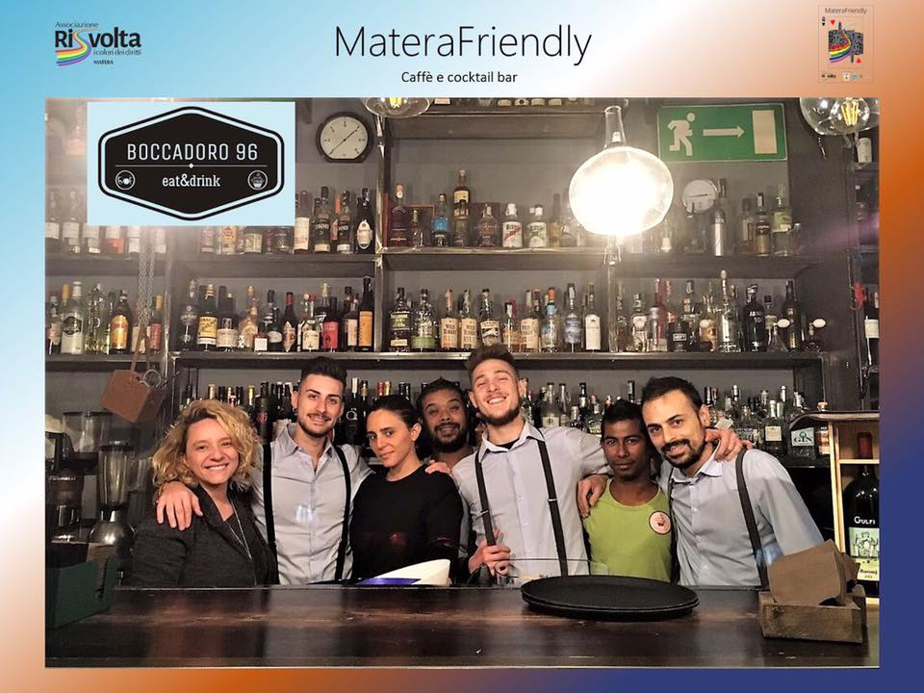


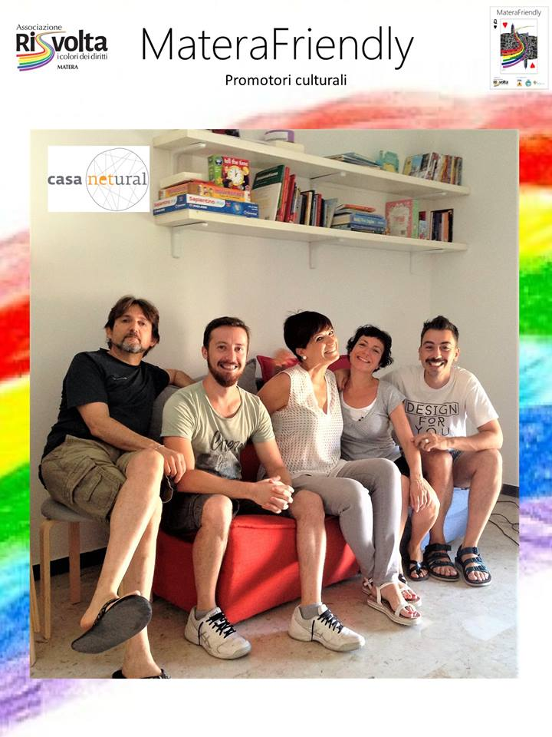
MateraFriendly is a local circuit that combines commercial and cultural activities,
tourist-accommodation facilities under the common commitment to break down
any form of sexual orientation-related discrimination

Slide 33



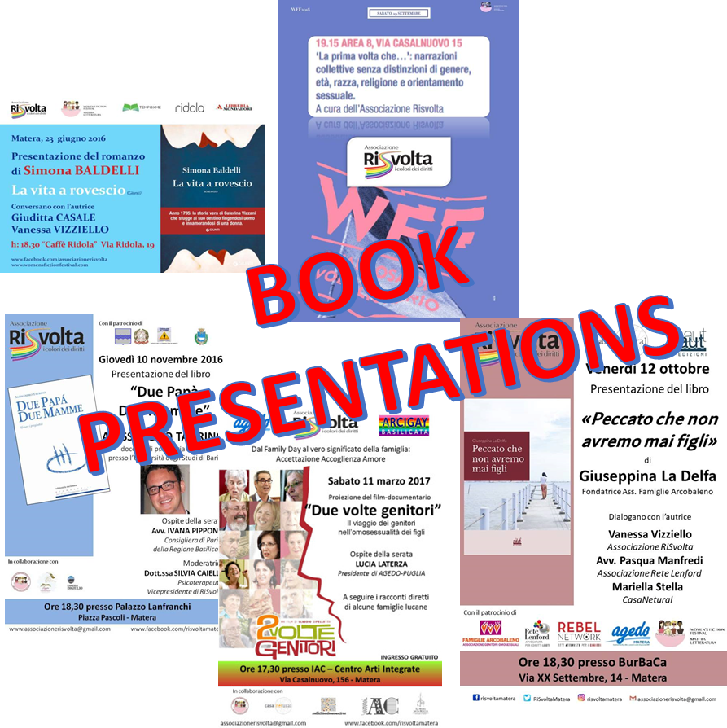

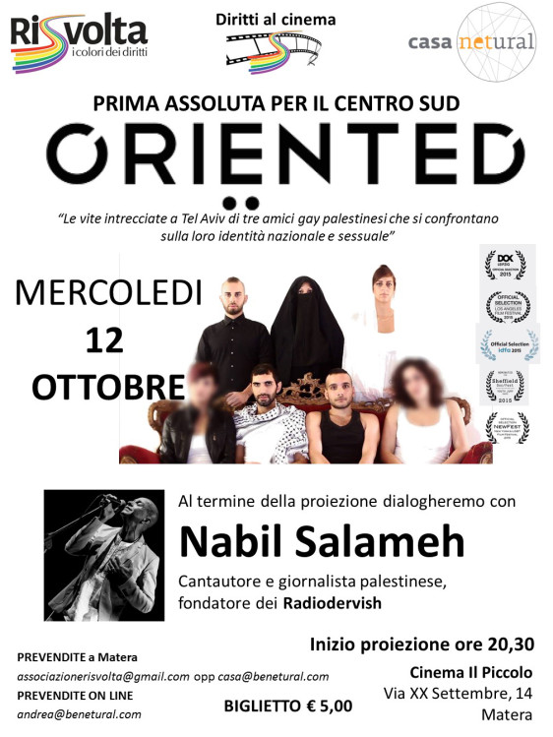


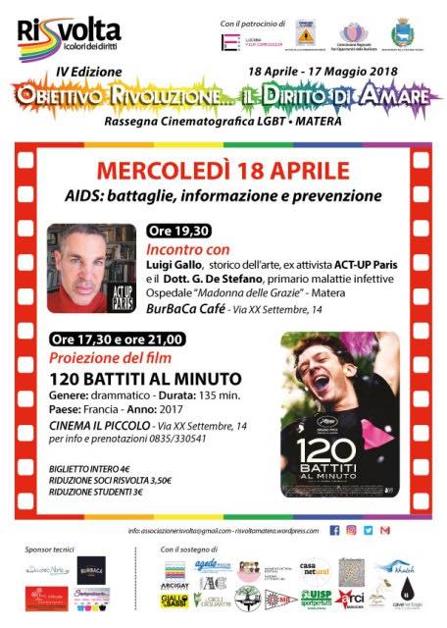
ANNUAL ACTIVITIES
FILM FESTIVALS

Slide 34

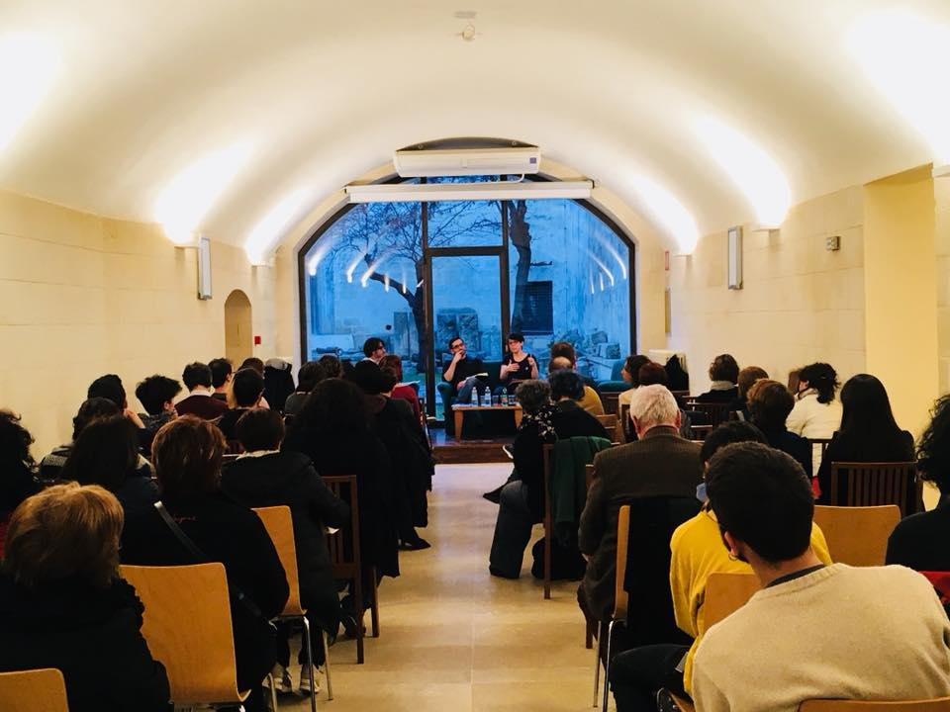
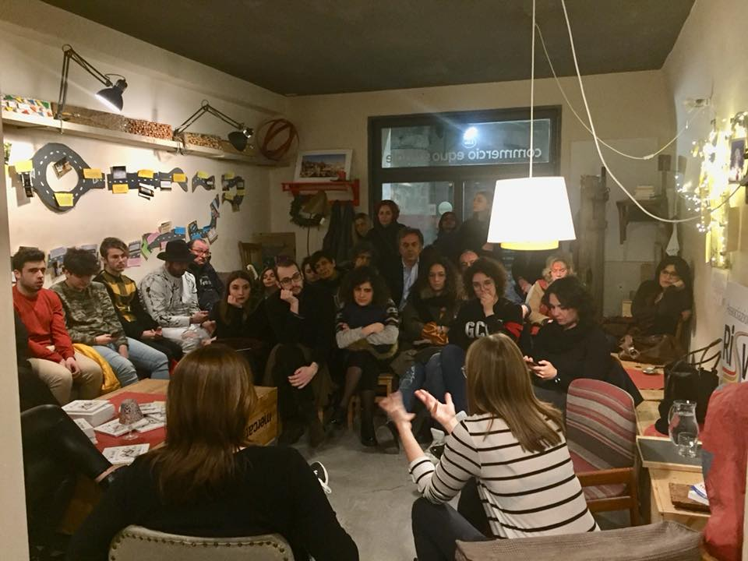

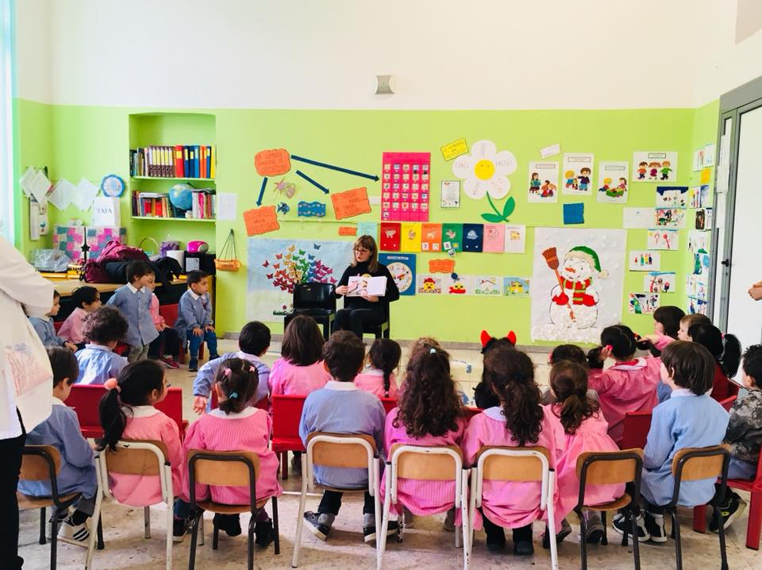
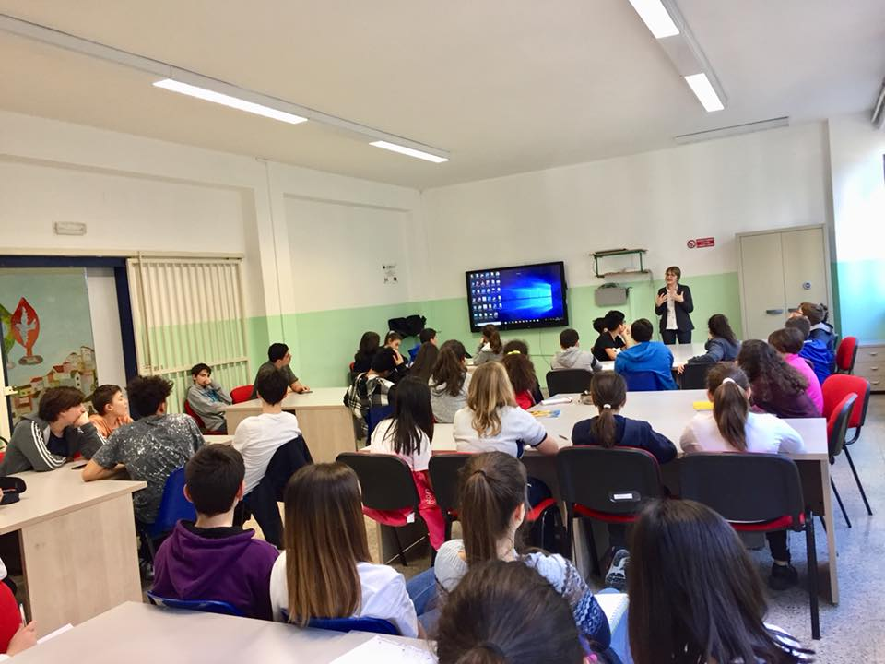
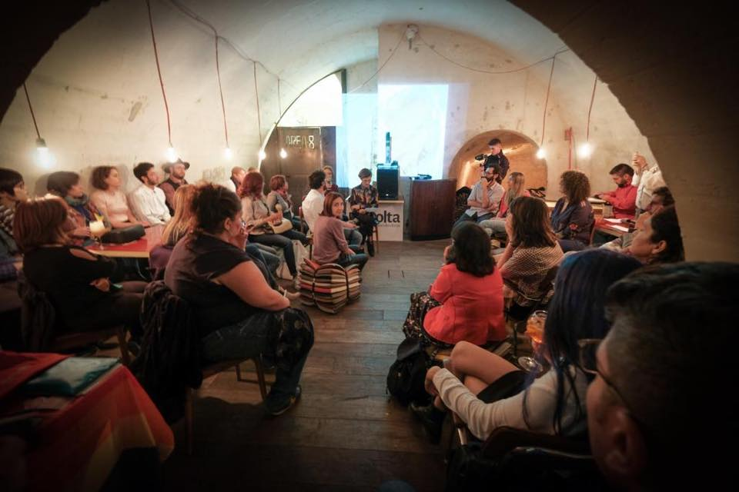
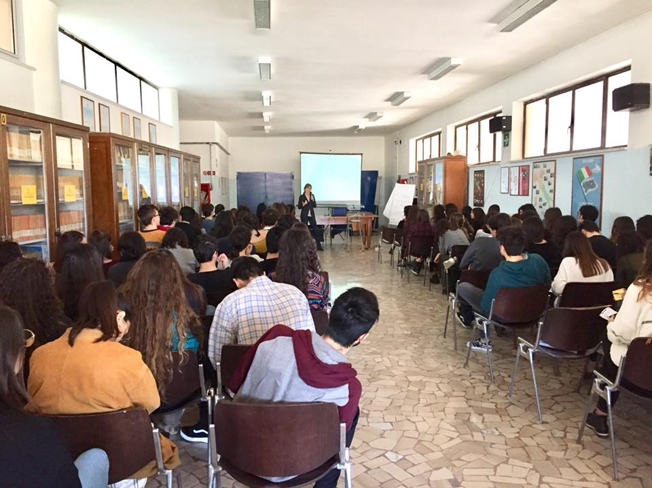
ANNUAL ACTIVITIES
MEETINGS

Slide 35
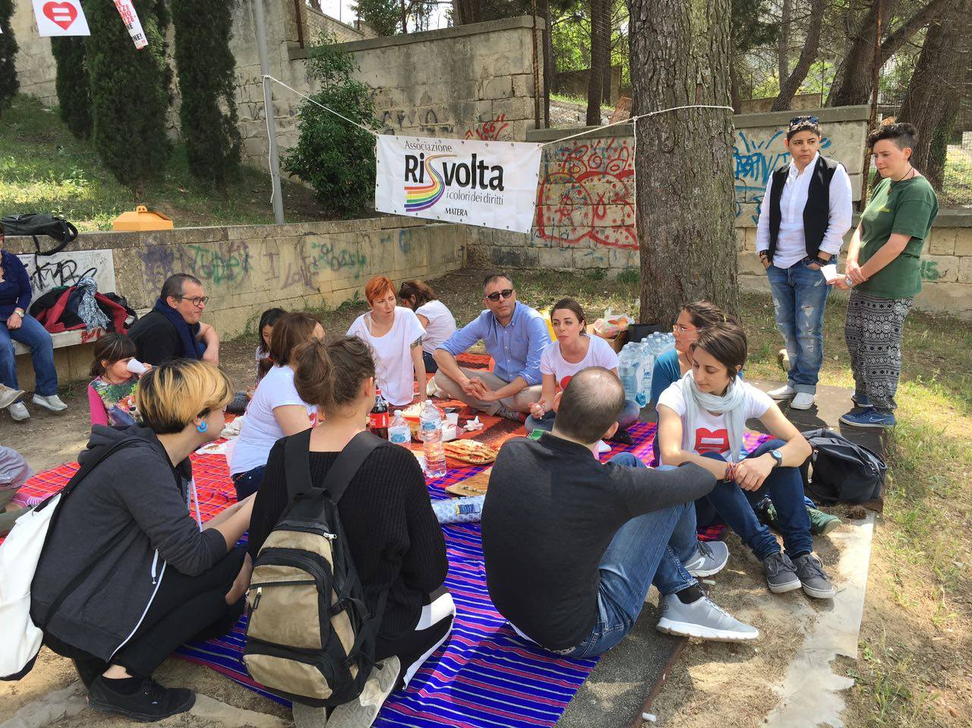
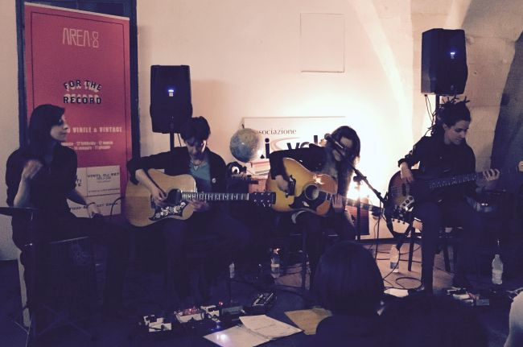

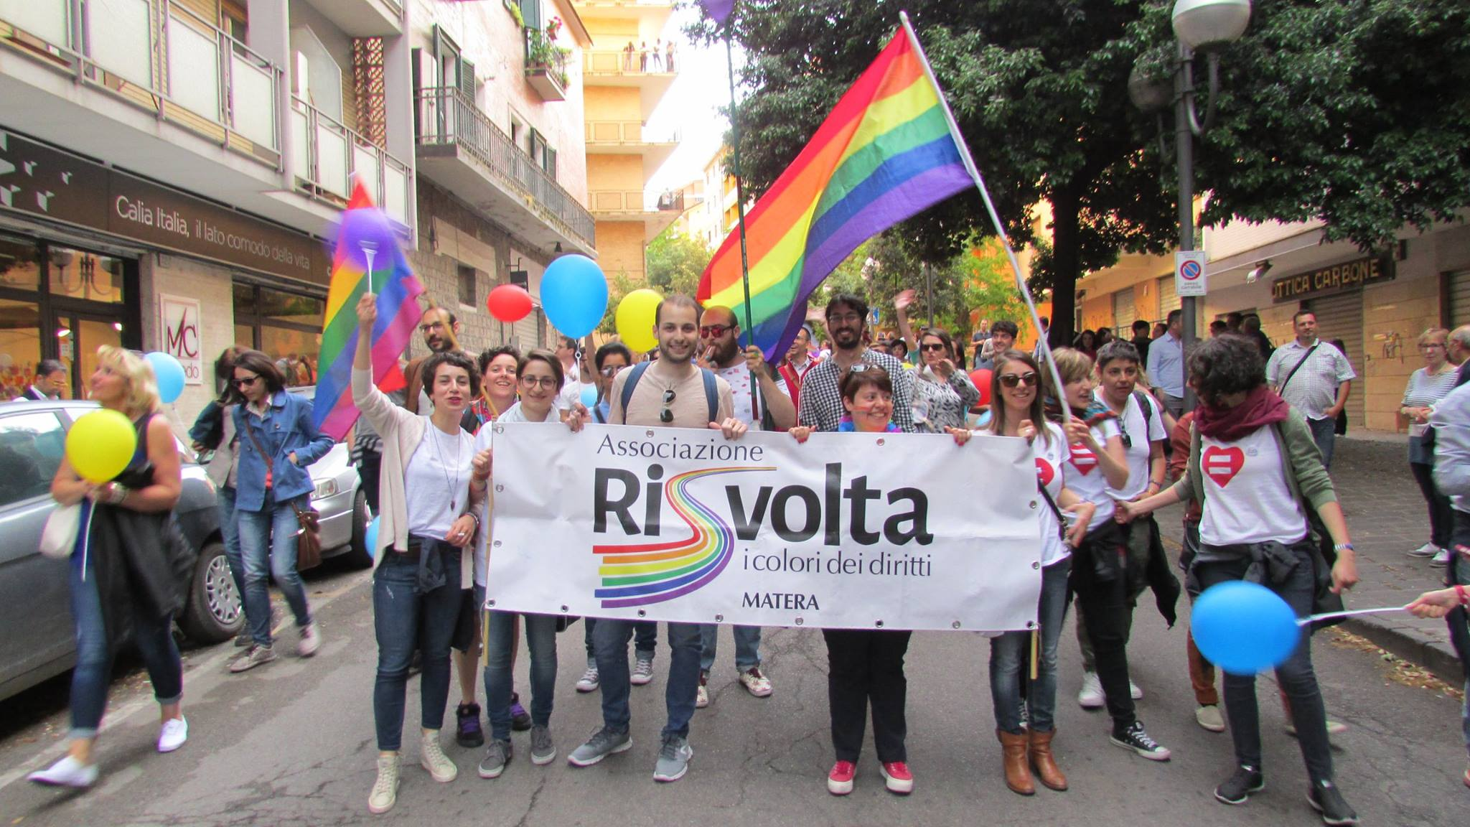
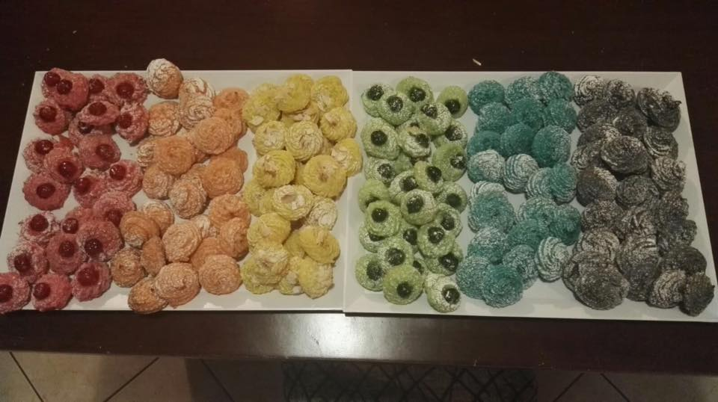

ANNUAL ACTIVITIES
LEISURE
And…HAPPINESS

Slide 36


THANK YOU
FOR YOUR ATTENTION

Slide 37

Questions & Answers

Slide 38
THANK YOU
FOR YOUR ATTENTION
AND PARTICIPATION

Slide 39
CONNECT & THANK YOU!
SOCI_SDG @sdg_SDG

