Slide 1
Gender equality in Latvia
Desktop research by Markuss Svageris

Slide 2
Gender equality is one of the main value in Latvia Constiution.
In Latvia we do not have any laws, that would protect gender equality
Only laws for gender equality are stated in employment field.
There are big gender discrimination in education for schools field.
The main problems for the gender equality in Latvia is unevenly paid salaries, harder to find job and a lot of stereotypes, which affects their everyday life.

Slide 4
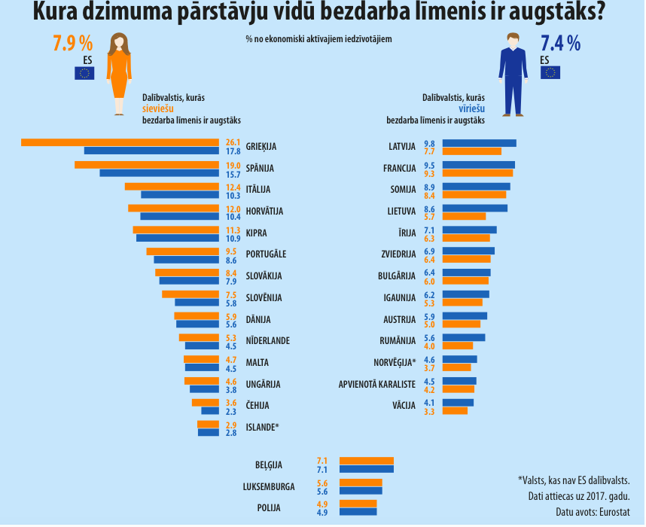

Slide 6
https://www.csb.gov.lv/sites/default/files/tile/LV_LV_womenmen_2018/vis/quiz/index.html?lang=lv
https://www.csb.gov.lv/sites/default/files/tile/LV_LV_womenmen_2018/index.html?lang=lv

